Slide 1
Good News for everyone

Slide 2
Working Hard, or Hardly Working
Luke 6:1-11
Jesus and the Sabbath

Slide 3
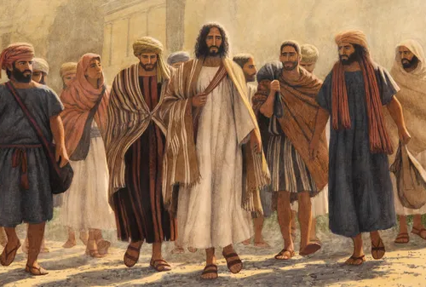
The Gospel of Luke
an introduction

Slide 4
Understanding why a focus on the Sabbath, following the rules, and good works can actually stunt our spiritual growth.

Slide 6
Jesus and the Sabbath
(Luke 6:1-11)

Slide 7
1 Jesus was going through the grain fields on a Sabbath,

Slide 8
and His disciples picked some heads of wheat, rubbed them in their hands, and ate them.

Slide 9
2 But some of the Pharisees said, “Why are you doing what is against the law on the Sabbath?”

Slide 11
3 Jesus answered them,

Slide 12
“Haven’t you read what David did when he and his companions were hungry—

Slide 13
4 how he entered the house of God, took and ate the sacred bread,

Slide 14
which is not lawful for any to eat but the priests alone, and gave it to his companions?”

Slide 15
5 Then He said to them, “The Son of Man is Lord of the Sabbath.”

Slide 17
6 On another Sabbath, Jesus entered the synagogue and was teaching.

Slide 18
Now a man was there whose right hand was withered.

Slide 19
7 The experts in the law and the Pharisees watched Jesus closely to see if He would heal on the Sabbath,

Slide 20
so that they could find a reason to accuse Him.

Slide 21
8 But He knew their thoughts, and said to the man who had the withered hand,

Slide 22
“Get up and stand here.” So he rose and stood there.

Slide 24
9 Then Jesus said to them,

Slide 25
“I ask you, is it lawful to do good on the Sabbath or to do evil, to save a life or to destroy it?”

Slide 26
10 After looking around at them all, He said to the man,

Slide 27
“Stretch out your hand.” The man did so, and his hand was restored.

Slide 28
11 But they were filled with mindless rage

Slide 29
and began debating with one another what they would do to Jesus.

Slide 31
Is your focus on what you’re doing or what God has already done?

Slide 32
The Gospel of Luke
an introduction

Slide 33
Good News for everyone

