Slide 1
Good News for everyone

Slide 2
Why Forgiveness Matters
Luke 5:12-26
The Leper and the Paralytic

Slide 3
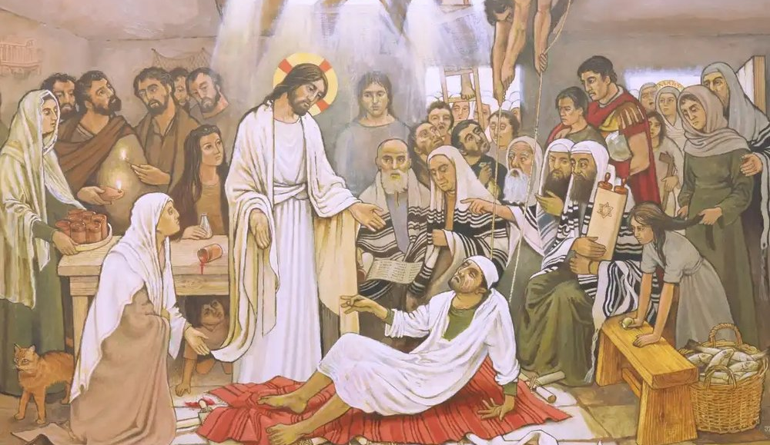
The Gospel of Luke
an introduction

Slide 4
Why sin is humanity’s deepest problem, and how forgiveness breaks its power

Slide 6
The Leper and the Paralytic
(Luke 5:12-26)

Slide 7
12 While Jesus was in one of the towns, a man came to Him who was covered with leprosy.

Slide 8
When he saw Jesus, he bowed down with his face to the ground and begged Him,

Slide 9
“Lord, if you are willing, you can make me clean.”

Slide 10
13 So He stretched out His hand and touched him, saying,

Slide 11
“I am willing. Be clean!” And immediately the leprosy left him.

Slide 13
14 Then He ordered the man to tell no one, but commanded him,

Slide 14
“Go and show yourself to a priest, and bring the offering for your cleansing

Slide 15
as Moses commanded, as a testimony to them.”

Slide 17
15 But the news about Him spread even more, and large crowds were gathering together

Slide 18
to hear Him and to be healed of their illnesses.

Slide 19
16 Yet Jesus himself frequently withdrew to the wilderness and prayed.

Slide 21
17 Now on one of those days, while He was teaching,

Slide 22
there were Pharisees and teachers of the law sitting nearby

Slide 23
[they] had come from every village of Galilee, and Judea, and from Jerusalem,

Slide 24
and the power of the Lord was with Him to heal.

Slide 25
18 Just then some men showed up, carrying a paralyzed man on a stretcher.

Slide 26
They were trying to bring him in and place him before Jesus.

Slide 27
19 But since they found no way to carry him in because of the crowd,

Slide 28
they went up on the roof and let him down on the stretcher through the roof tiles, right in front of Jesus.

Slide 29
20 When Jesus saw their faith, He said, “Friend, your sins are forgiven.”

Slide 31
21 Then the experts in the law and the Pharisees began to think to themselves,

Slide 32
“Who is this man who is uttering blasphemies?

Slide 33
Who can forgive sins but God alone?”

Slide 34
22 When Jesus perceived their hostile thoughts, He said to them,

Slide 35
“Why are you raising objections within yourselves?

Slide 36
23 Which is easier, to say, ‘Your sins are forgiven,’ or to say, ‘Stand up and walk’?

Slide 37
24 But so that you may know that the Son of Man has authority on earth to forgive sins”

Slide 38
—He said to the paralyzed man—

Slide 39
“I tell you, stand up, take your stretcher and go home.”

Slide 41
25 Immediately he stood up before them, picked up the stretcher he had been lying on,

Slide 42
and went home, glorifying God.

Slide 43
26 Then astonishment seized them all, and they glorified God.

Slide 44
They were filled with awe, saying, “We have seen incredible things today.”

Slide 46
Are you walking in the power of forgiveness?

Slide 47
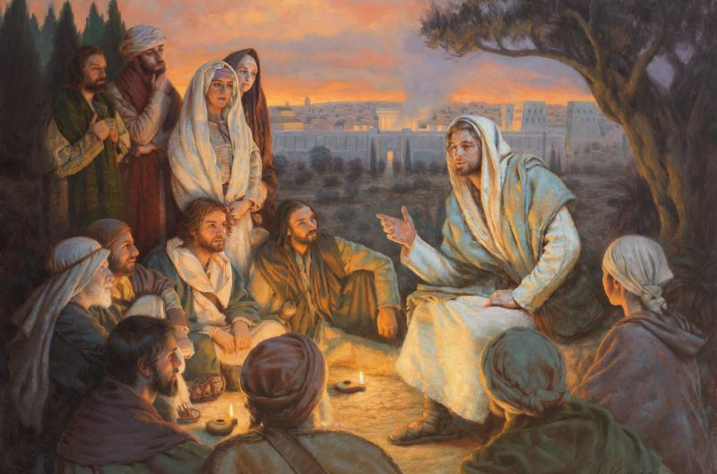
The Gospel of Luke
an introduction

Slide 48
Good News for everyone

