Slide 1

Good News for everyone

Slide 2

The Purpose of Prayer
Luke 6:12-16
Jesus appoints His Apostles

Slide 3
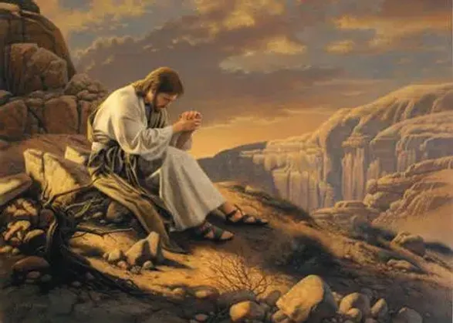
The Gospel of Luke
an introduction

Slide 4
How the practice of prayer really works, and why we need it far more than we realize.

Slide 6
Jesus appoints His Apostles
(Luke 6:12-16)

Slide 7
12 Now it was during this time that Jesus went out to the mountain to pray,

Slide 8
and He spent all night in prayer to God.

Slide 9
13 When morning came, He called His disciples and chose 12 of them,

Slide 10
whom He also named apostles:

Slide 11
14 Simon (whom He named Peter), and his brother Andrew;

Slide 12
and James, John, Philip, Bartholomew,

Slide 13
15 Matthew, Thomas, James the son of Alphaeus, Simon who was called the Zealot,

Slide 14
16 Judas the son of James, and Judas Iscariot, who became a traitor.

Slide 16
Has your life been shaped and guided by the practice of prayer?

Slide 17
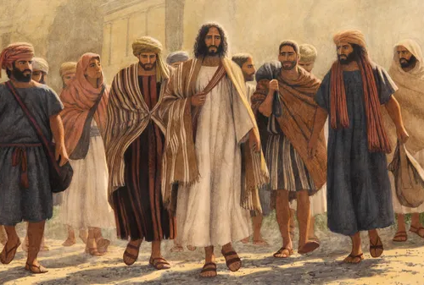
The Gospel of Luke
an introduction

Slide 18
Good News for everyone

