Slide 1
Good News for everyone

Slide 2
A Blessing for the Broken (part 2)
Luke 4:31-44
Jesus heals and delivers

Slide 3
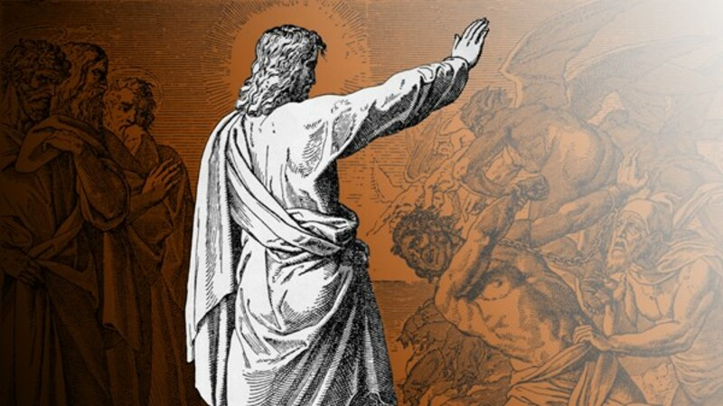
The Gospel of Luke
an introduction

Slide 4
Why Jesus healed and delivered people, and what it means for us as His followers today.

Slide 6
Jesus Heals and Delivers
(Luke 4:31-44)

Slide 7
31 So He went down to Capernaum, a town in Galilee,

Slide 8
and on the Sabbath He began to teach the people.

Slide 9
32 They were amazed at his teaching because He spoke with authority.

Slide 11
33 Now in the synagogue there was a man who had the spirit of an unclean demon,

Slide 12
and he cried out with a loud voice,

Slide 13
34 “Ha! Leave us alone, Jesus the Nazarene! Have you come to destroy us?

Slide 14
I know who you are—the Holy One of God.”

Slide 15
35 But Jesus rebuked him: “Silence! Come out of him!”

Slide 16
Then, after the demon threw the man down in their midst, he came out of him without hurting him.

Slide 17
36 They were all amazed and began to say to one another, “What’s happening here?

Slide 18
For with authority and power He commands the unclean spirits, and they come out!”

Slide 19
37 So the news about Him spread into all areas of the region.

Slide 21
38 After Jesus left the synagogue, He entered Simon’s house.

Slide 22
Now Simon’s mother-in-law was suffering from a high fever, and they asked Jesus to help her.

Slide 23
39 So He stood over her, commanded the fever, and it left her.

Slide 24
Immediately she got up and began to serve them.

Slide 26
40 As the sun was setting,

Slide 27
all those who had any relatives sick with various diseases brought them to Jesus.

Slide 28
He placed his hands on every one of them and healed them.

Slide 29
41 Demons also came out of many, crying out, “You are the Son of God!”

Slide 30
But He rebuked them and would not allow them to speak because they knew that He was the Christ.

Slide 32
42 The next morning Jesus departed and went to a deserted place.

Slide 33
Yet the crowds were seeking Him,

Slide 34
and they came to Him and tried to keep him from leaving them.

Slide 35
43 But Jesus said to them, “I must proclaim the good news of the kingdom of God to the other towns too,

Slide 36
for that is what I was sent to do.”

Slide 37
44 So he continued to preach in the synagogues of Judea.

Slide 39
Are you broken enough to be filled with JESUS?

Slide 40
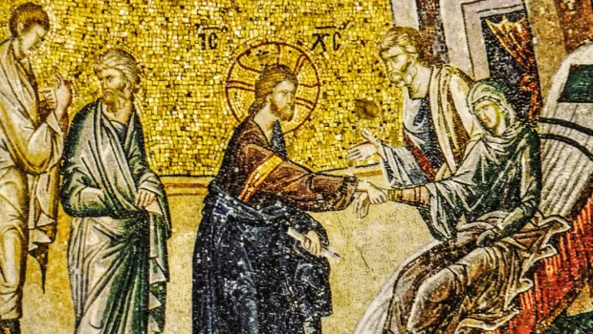
The Gospel of Luke
an introduction

Slide 41
Good News for everyone

