Slide 1
Good News for everyone

Slide 2
Sinners Welcome
Luke 5:27-39
Jesus Calls Matthew

Slide 3
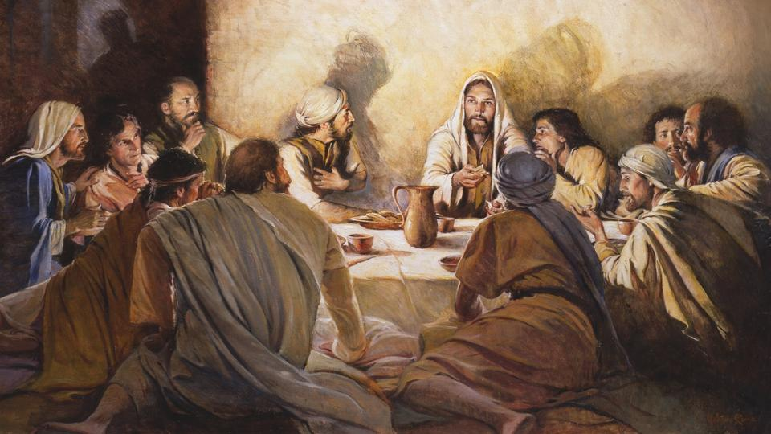
The Gospel of Luke
an introduction

Slide 4
How Jesus’ Teaching shows why good people aren’t good, bad people aren’t so bad, and a new way of life is possible for us all.

Slide 6
Jesus Calls Matthew
(Luke 5:27-39)

Slide 7
27 After this, Jesus went out and saw a tax collector named Levi sitting at the tax booth.

Slide 8
“Follow me,” He said to him.

Slide 9
28 And he got up and followed Him, leaving everything behind.

Slide 11
29 Then Levi gave a great banquet in his house for Jesus,

Slide 12
and there was a large crowd of tax collectors and others sitting at the table with them.

Slide 13
30 But the Pharisees and their experts in the law complained to His disciples,

Slide 14
Saying “Why do you eat and drink with tax collectors and sinners?”

Slide 16
31 Jesus answered them,

Slide 17
“Those who are well don’t need a physician, but those who are sick do.

Slide 18
32 I have not come to call the righteous, but sinners to repentance.”

Slide 20
33 Then they said to Him, “John’s disciples frequently fast and pray, and so do the disciples of the Pharisees,

Slide 21
but yours continue to eat and drink.”

Slide 22
34 So Jesus said to them,

Slide 23
“You cannot make the wedding guests fast while the bridegroom is with them, can you?

Slide 24
35 But those days are coming, and when the bridegroom is taken from them,

Slide 25
at that time they will fast.”

Slide 27
36 He also told them a parable:

Slide 28
“No one tears a patch from a new garment and sews it on an old garment.

Slide 29
If he does, he will have torn the new, and the piece from the new will not match the old.

Slide 30
37 And no one pours new wine into old wineskins.

Slide 31
If he does, the new wine will burst the skins and will be spilled, and the skins will be destroyed.

Slide 32
38 Instead new wine must be poured into new wineskins.

Slide 33
39 No one after drinking old wine wants the new,

Slide 34
for he says, ‘The old is good enough.’”

Slide 36
What is your attitude towards sin?

Slide 37
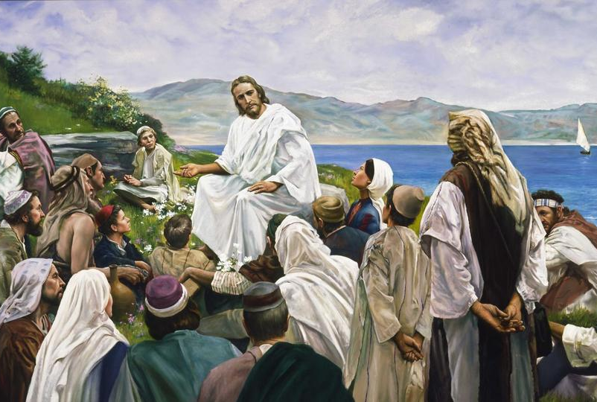
The Gospel of Luke
an introduction

Slide 38
Good News for everyone

