Slide 1

Good News for everyone

Slide 2

The Surprising Mission of Christ
Luke 4:14-30
Jesus visits Nazareth

Slide 3
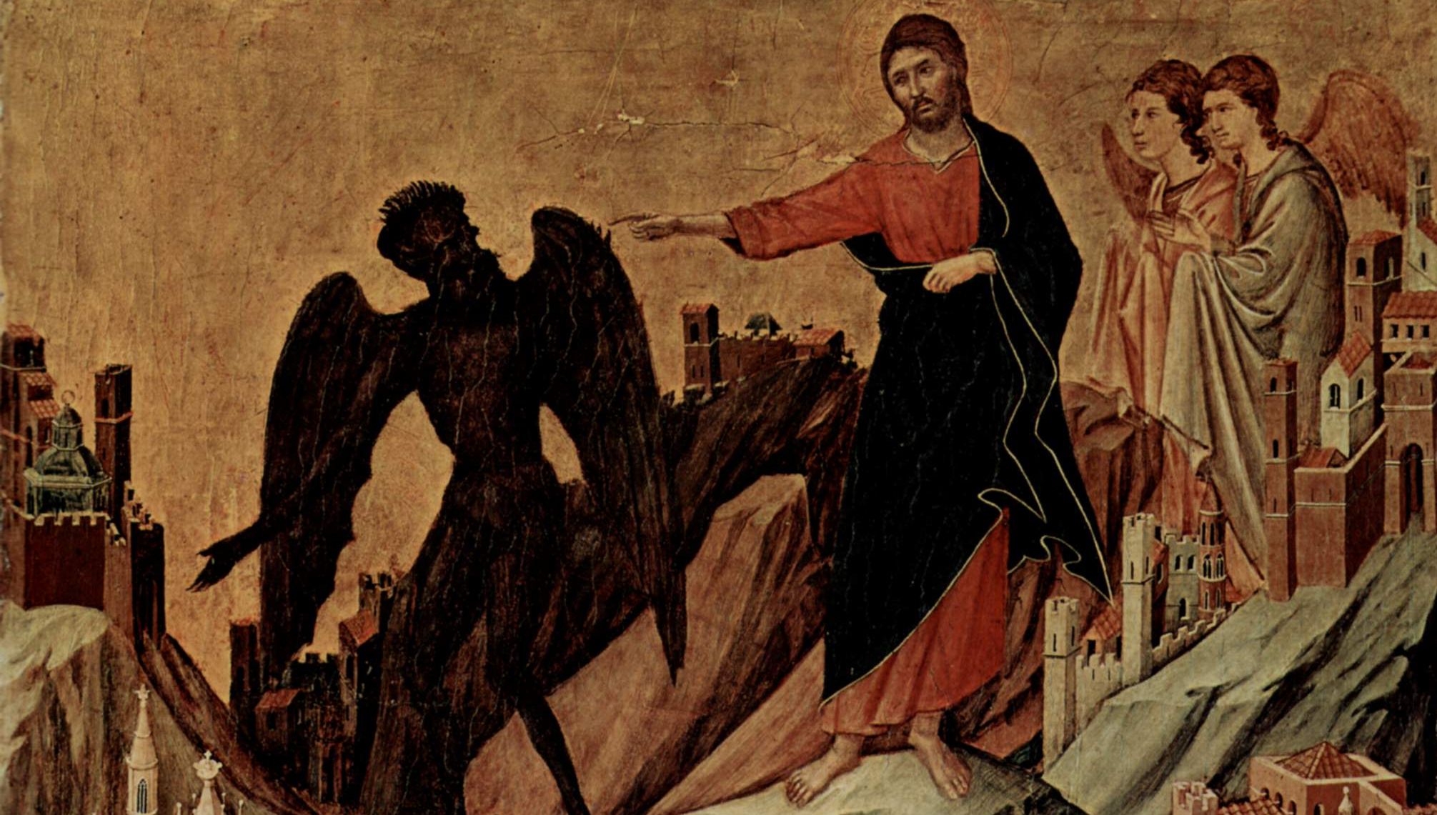
The Gospel of Luke
an introduction

Slide 4
How Jesus’ mission defies our expectations, and why that’s the key to having a new life with Him.

Slide 6
Jesus visits Nazareth
(Luke 4:14-30)

Slide 7
14 Then Jesus, in the power of the Spirit, returned to Galilee,

Slide 8
and news about Him spread throughout the surrounding countryside.

Slide 9
15 He began to teach in their synagogues and was praised by all.

Slide 11
16 Now Jesus came to Nazareth, where he had been brought up,

Slide 12
and went into the synagogue on the Sabbath day, as was His custom.

Slide 13
He stood up to read, 17 and the scroll of the prophet Isaiah was given to Him.

Slide 14
He unrolled the scroll and found the place where it was written,

Slide 16
18 “The Spirit of the Lord is upon me,

Slide 17
because He has anointed me to proclaim good news to the poor.

Slide 18
He has sent me to proclaim release to the captives

Slide 19
and the regaining of sight to the blind,

Slide 20
to set free those who are oppressed,

Slide 21
19 to proclaim the year of the Lord’s favor.”

Slide 23
20 Then He rolled up the scroll, gave it back to the attendant, and sat down.

Slide 24
The eyes of everyone in the synagogue were fixed on Him.

Slide 25
21 Then He began to tell them,

Slide 26
“Today this scripture has been fulfilled even as you heard it being read.”

Slide 27
22 All were speaking well of Him, and were amazed at the gracious words coming out of His mouth.

Slide 28
They said, “Isn’t this Joseph’s son?”

Slide 29
23 Jesus said to them, “No doubt you will quote to me the proverb, ‘Physician, heal yourself!’ and say,

Slide 30
‘What we have heard that you did in Capernaum, do here in your hometown too.’”

Slide 31
24 And he added, “I tell you the truth, no prophet is acceptable in his hometown.

Slide 32
25 But in truth I tell you, there were many widows in Israel in Elijah’s days,

Slide 33
when the sky was shut up three and a half years and there was a great famine over all the land.

Slide 34
26 Yet Elijah was sent to none of them, but only to a woman who was a widow at Zarephath in Sidon.

Slide 35
27 And there were many lepers in Israel in the time of the prophet Elisha,

Slide 36
yet none of them was cleansed except Naaman the Syrian.”

Slide 38
28 When they heard this, all the people in the synagogue were filled with rage.

Slide 39
29 They got up, forced Him out of the town,

Slide 40
and brought Him to the brow of the hill on which their town was built,

Slide 41
so that they could throw him down the cliff.

Slide 42
30 But he passed through the crowd and went on his way.

Slide 44
Has Jesus lead you to your own cross?

Slide 45
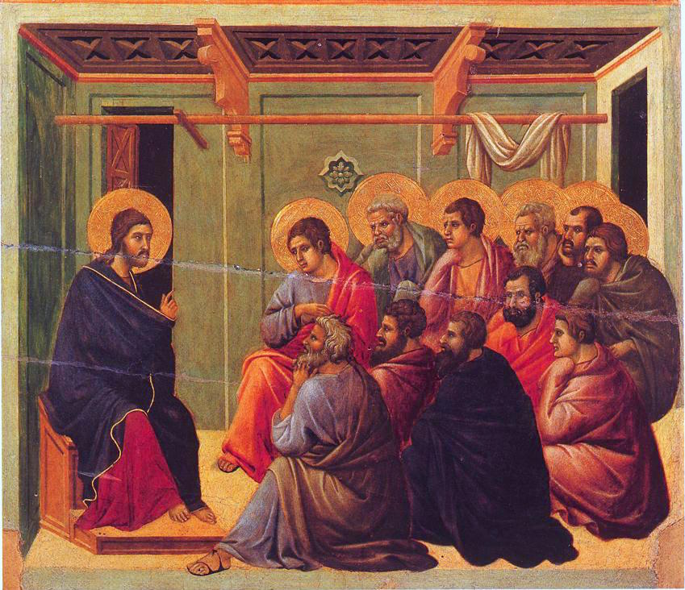
The Gospel of Luke
an introduction

Slide 46
Good News for everyone

