Slide 1
Good News for everyone

Slide 2
A Mile in our Shoes
Luke 4:1-13
The Temptation of Christ

Slide 3
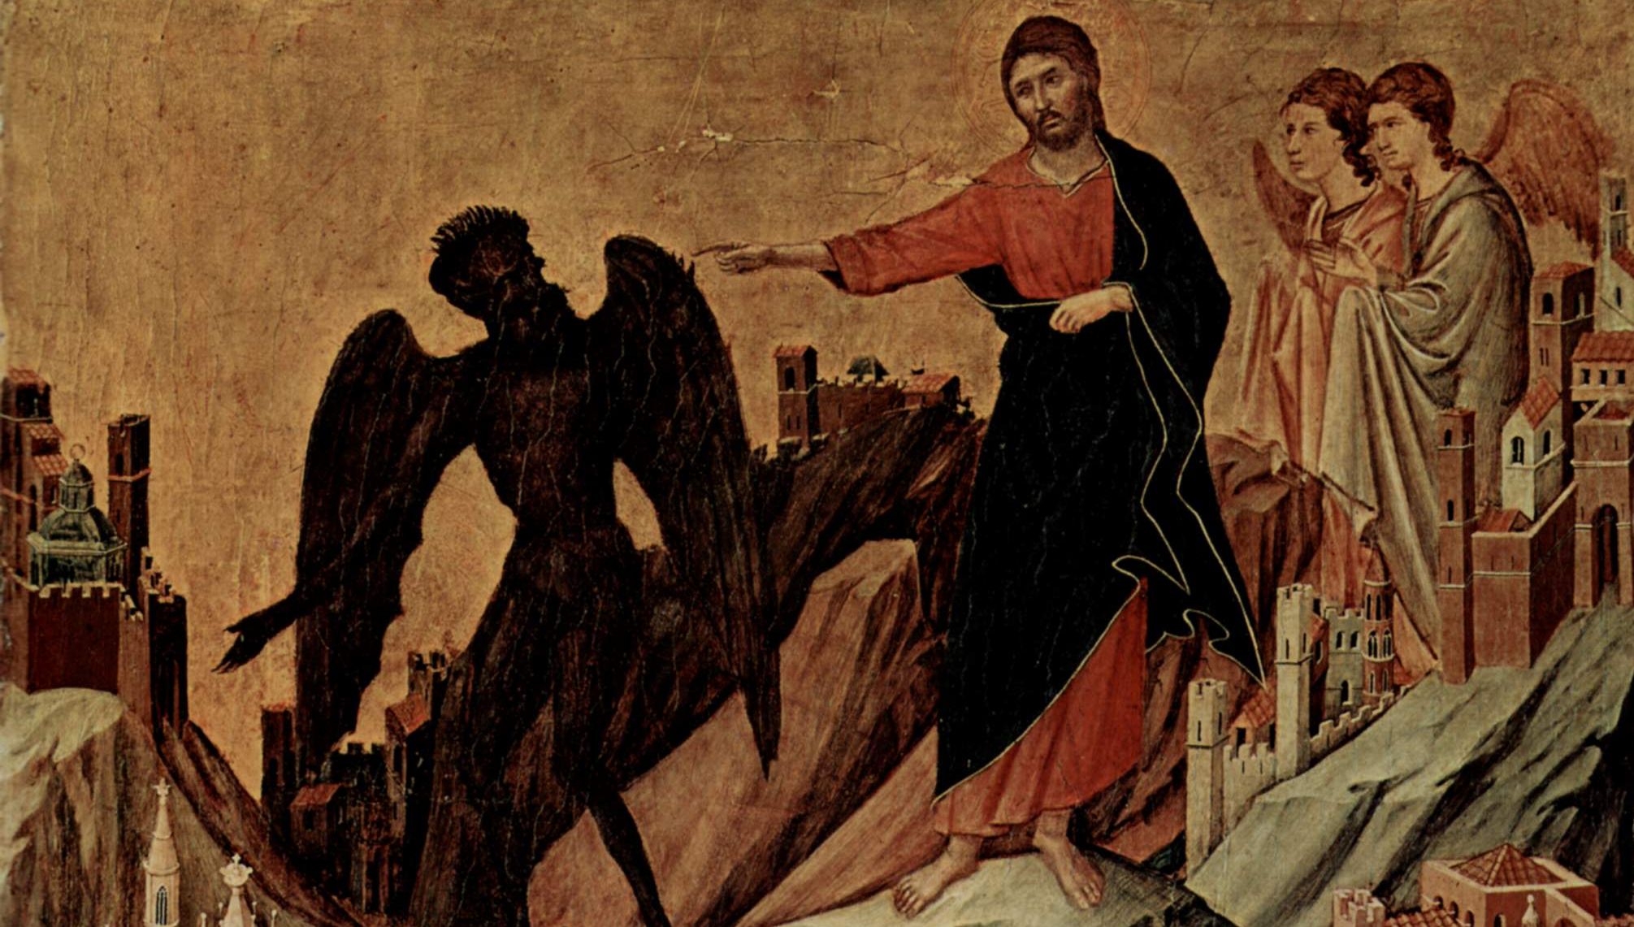
The Gospel of Luke
an introduction

Slide 4
Why Jesus was lead into temptation and how He can lead us out of it today.

Slide 6
The Temptation of Christ
(Luke 4:1-13)

Slide 7
1 Then Jesus, full of the Holy Spirit, returned from the Jordan River

Slide 8
and was led by the Spirit in the wilderness,

Slide 9
2 where for forty days he endured temptations from the devil.

Slide 10
He ate nothing during those days, and when they were completed, he was famished.

Slide 11
3 The devil said to him,

Slide 12
“If you are the Son of God, command this stone to become bread.”

Slide 13
4 Jesus answered him, “It is written, ‘Man does not live by bread alone.’”

Slide 15
5 Then the devil led Him up to a high place and showed Him in a flash all the kingdoms of the world.

Slide 16
6 And he said to Him, “To you I will grant this whole realm—and the glory that goes along with it,

Slide 17
for it has been relinquished to me, and I can give it to anyone I wish.

Slide 18
7 So then, if you will worship me, all this will be yours.”

Slide 19
8 Jesus answered him,

Slide 20
“It is written, ‘You are to worship the Lord your God and serve only Him.’”

Slide 22
9 Then the devil brought Him to Jerusalem, had Him stand on the highest point of the temple,

Slide 23
and said to him, “If you are the Son of God, throw yourself down from here,

Slide 24
10 for it is written, ‘He will command his angels concerning you, to protect you,’

Slide 25
11 and ‘with their hands they will lift you up, so that you will not strike your foot against a stone.’”

Slide 26
12 Jesus answered him,

Slide 27
“It is said, ‘You are not to put the Lord your God to the test.’”

Slide 28
13 So when the devil had completed every temptation,

Slide 29
he departed from Him until a more opportune time.

Slide 31
How do you deal with temptations?

Slide 32
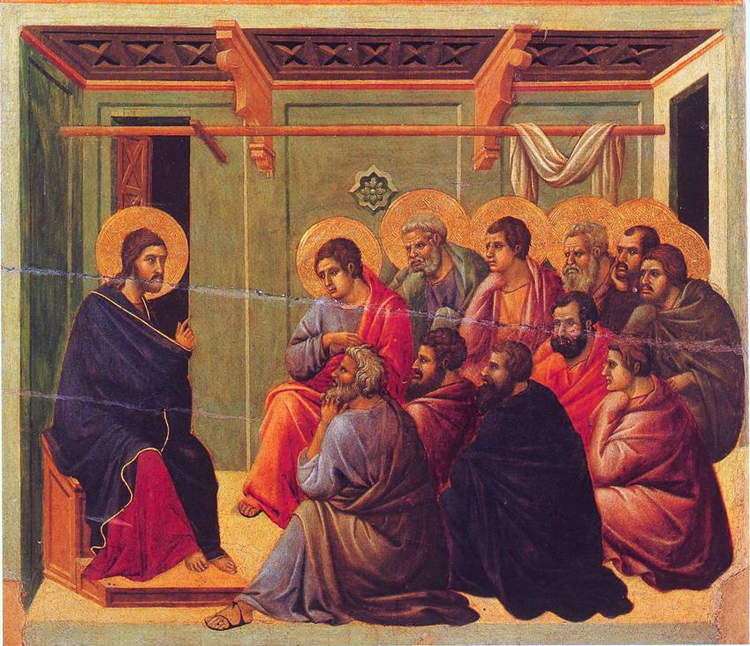
The Gospel of Luke
an introduction

Slide 33
Good News for everyone

