Slide 1
Good News for everyone

Slide 2
A Man in the Desert
Luke 3:1-20
The ministry of John the Baptist

Slide 3
The Gospel of Luke
an introduction

Slide 4
Understanding the prophetic message of repentance, and why that really is Good News for everyone.

Slide 6
The Ministry of John the Baptist
(Luke 2:41-52)

Slide 7
In the fifteenth year of the reign of Tiberius Caesar, when Pontius Pilate was governor of Judea,

Slide 8
and Herod was tetrarch of Galilee, and his brother Philip was tetrarch

Slide 9
of the region of Iturea and Trachonitis, and Lysanias was tetrarch of Abilene,

Slide 10
2 during the high priesthood of Annas and Caiaphas,

Slide 11
the word of God came to John the son of Zechariah in the wilderness.

Slide 12
3 He went into all the region around the Jordan River,

Slide 13
preaching a baptism of repentance for the forgiveness of sins.

Slide 15
4 As it is written in the book of the words of the prophet Isaiah,

Slide 16
“The voice of one shouting in the wilderness: ‘Prepare the way for the Lord, make His paths straight.

Slide 17
5 Every valley will be filled, and every mountain and hill will be brought low,

Slide 18
and the crooked will be made straight, and the rough ways will be made smooth,

Slide 19
6 and all humanity will see the salvation of God.’”

Slide 21
7 So John said to the crowds that came out to be baptized by him,

Slide 22
“ You offspring of vipers! Who warned you to flee from the coming wrath?

Slide 23
8 Therefore produce fruit that proves your repentance,

Slide 24
and don’t begin to say to yourselves, ‘We have Abraham as our father.’

Slide 25
For I tell you that God can raise up children for Abraham from these stones!

Slide 26
9 Even now the axe is laid at the root of the trees,

Slide 27
and every tree that does not produce good fruit will be cut down and thrown into the fire.”

Slide 29
10 So the crowds were asking him, “What then should we do?”

Slide 30
11 John answered them, “The person who has two tunics must share with the person who has none,

Slide 31
and the person who has food must do likewise.”

Slide 32
12 Tax collectors also came to be baptized, and they said to him, “Teacher, what should we do?”

Slide 33
13 He told them, “Collect no more than you are required to.”

Slide 34
14 Then some soldiers also asked him, “And as for us—what should we do?”

Slide 35
He told them, “Take money from no one by violence or by false accusation, and be content with your pay.”

Slide 37
15 While the people were filled with anticipation and they all wondered whether perhaps John could be the Christ,

Slide 38
16 John answered them all, “I baptize you with water, but one more powerful than I am is coming—

Slide 39
I am not worthy to untie the strap of his sandals. He will baptize you with the Holy Spirit and fire.

Slide 40
17 His winnowing fork is in His hand to clean out His threshing floor and to gather the wheat into His storehouse,

Slide 41
but the chaff he will burn up with inextinguishable fire.”

Slide 43
18 And in this way, with many other exhortations, John proclaimed good news to the people.

Slide 44
19 But when John rebuked Herod the tetrarch because of Herodias, his brother’s wife,

Slide 45
and because of all the evil deeds that he had done, 20 Herod added this to them all:

Slide 46
He locked up John in prison.

Slide 48
In what ways has the Gospel contradicted with your thinking?

Slide 49
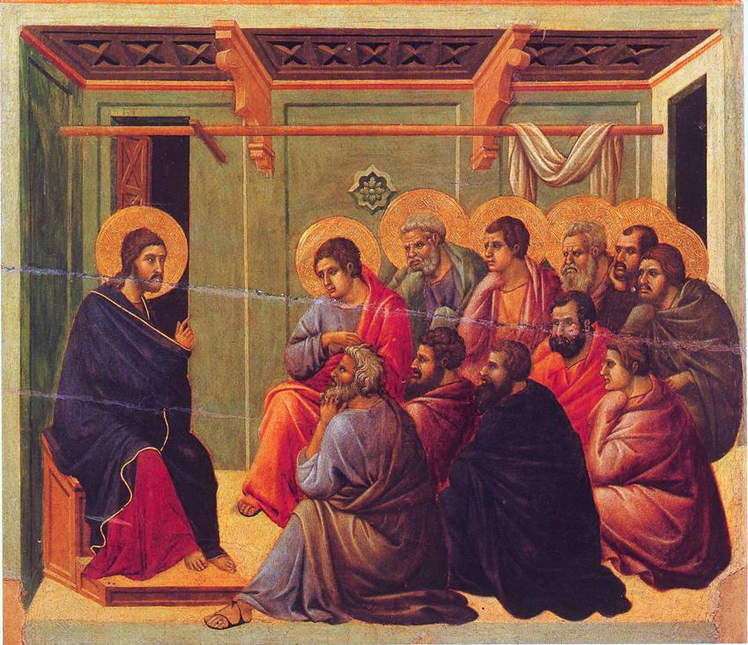
The Gospel of Luke
an introduction

Slide 50
Good News for everyone

