Slide 1
Good News for everyone

Slide 2
A Long-Awaited Savior
Luke 2:21-40
Jesus’ Temple Dedication

Slide 3
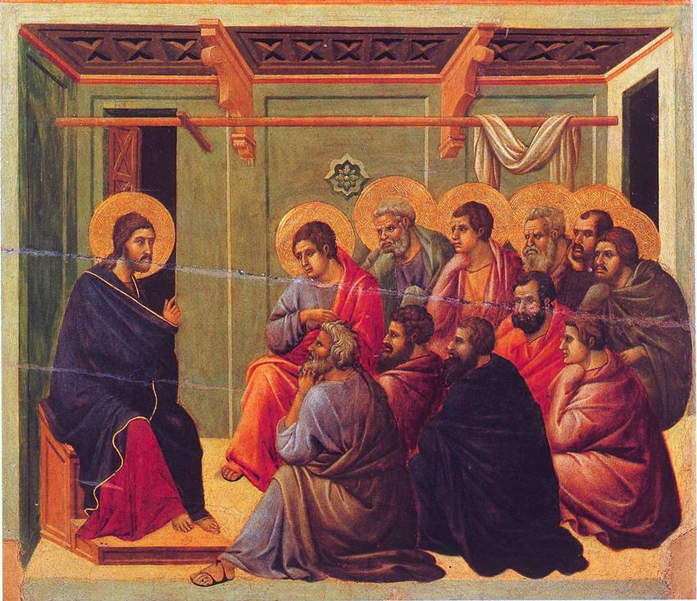
The Gospel of Luke
an introduction

Slide 4
Understanding the divisive nature of Jesus’ identity as the Messiah, and how it still splits the World today.

Slide 6
Jesus’ Temple Dedication
(Luke 2:21-40)

Slide 7
21 At the end of eight days [the baby] was circumcised and He was named Jesus,

Slide 8
the name given by the angel before He was conceived in the womb.

Slide 9
22 Now when the time came for their purification according to the law of Moses,

Slide 10
Joseph and Mary brought Jesus up to Jerusalem to present Him to the Lord

Slide 11
23 ( just as it is written in the law of the Lord, “Every firstborn male will be set apart to the Lord” ),

Slide 12
24 and to offer a sacrifice according to what is specified in the law of the Lord, a pair of doves or two young pigeons.

Slide 14
25 Now there was a man in Jerusalem named Simeon who was righteous and devout,

Slide 15
[and he was] looking for the restoration of Israel, and the Holy Spirit was upon him.

Slide 16
26 It had been revealed to him by the Holy Spirit that he would not die before he had seen the Lord’s Christ.

Slide 17
27 So Simeon, directed by the Spirit, came into the temple courts,

Slide 18
and when the parents brought in the child Jesus

Slide 19
to do for Him what was customary according to the law,

Slide 20
28 Simeon took Him in his arms and blessed God, saying,

Slide 22
29 “Now, Sovereign Lord, You are letting Your bond-servant depart in peace, According to Your word;

Slide 23
30 For my eyes have seen Your salvation,

Slide 24
31 Which You have prepared in the presence of all peoples:

Slide 25
32 A light for revelation for the Gentiles, And the glory of Your people Israel.”

Slide 27
33 So the child’s father and mother were amazed at what was said about Him.

Slide 28
34 Then Simeon blessed them and said to His mother Mary, “Listen carefully:

Slide 29
This child is destined to be the cause of the falling and rising of many in Israel

Slide 30
and to be a sign that will be rejected.

Slide 31
35 Indeed, as a result of Him the thoughts of many hearts will be revealed—

Slide 32
and a sword will pierce your own soul as well!”

Slide 34
36 There was also a prophetess, Anna the daughter of Phanuel, of the tribe of Asher.

Slide 35
She was very old, having been married to her husband for seven years until his death.

Slide 36
37 She had lived as a widow since then for eighty-four years.

Slide 37
She never left the temple, worshiping with fasting and prayer night and day.

Slide 38
38 At that very moment, she came up to them, and began to give thanks to God

Slide 39
and to speak about [Jesus] to all who were looking forward to the redemption of Jerusalem.

Slide 40
39 So when Joseph and Mary had performed everything according to the law of the Lord,

Slide 41
they returned to Galilee, to their own town of Nazareth.

Slide 42
40 And the child grew and became strong, filled with wisdom, and the favor of God was upon Him.

Slide 44
Is Jesus your stumbling block, or your cornerstone?

Slide 45
The Gospel of Luke
an introduction

Slide 46
Good News for everyone

