Slide 1
Good News for everyone

Slide 2
Salvation is Born
Luke 2:1-20
The birth of Jesus

Slide 3
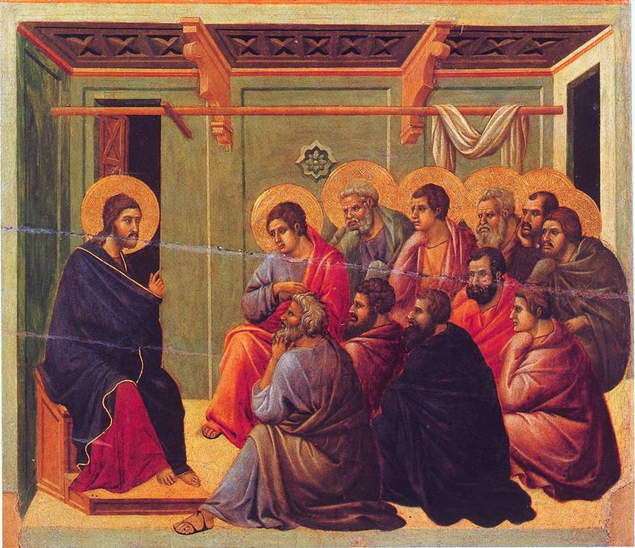
The Gospel of Luke
an introduction

Slide 4
Understanding ‘the why’ behind Jesus’ birth, and what it means for you and me today.

Slide 6
The Birth of Jesus
(Luke 2:1-20)

Slide 7
1 Now in those days a decree went out from Caesar Augustus to register all the empire for taxes.

Slide 8
2 This was the first registration, taken when Quirinius was governor of Syria.

Slide 9
3 Everyone went to his own town to be registered.

Slide 10
4 So Joseph also went up from the town of Nazareth in Galilee to Judea,

Slide 11
to the city of David called Bethlehem, because he was of the house and family line of David.

Slide 12
5 He went to be registered with Mary, who was promised in marriage to him, and who was expecting a child.

Slide 13
6 While they were there, the time came for her to deliver her child.

Slide 14
7 And she gave birth to her firstborn son and wrapped him in strips of cloth and laid him in a manger,

Slide 15
because there was no place for them in the inn.

Slide 17
8 Now there were shepherds nearby living out in the field, keeping guard over their flock at night.

Slide 18
9 An angel of the Lord appeared to them, and the glory of the Lord shone around them, and they were absolutely terrified.

Slide 19
10 But the angel said to them,

Slide 20
“Do not be afraid!

Slide 21
Listen carefully, for I proclaim to you good news that brings great joy to all the people:

Slide 22
11 Today your Savior is born in the city of David.

Slide 23
He is Christ the Lord.

Slide 24
12 This will be a sign for you: You will find a baby wrapped in strips of cloth and lying in a manger.”

Slide 25
13 Suddenly a vast, heavenly army appeared with the angel, praising God and saying,

Slide 27
14 “Glory to God in the highest, and on earth peace among people with whom He is pleased!”

Slide 29
15 When the angels left them and went back to heaven, the shepherds said to one another,

Slide 30
“Let us go over to Bethlehem and see this thing that has taken place, that the Lord has made known to us.”

Slide 31
16 So they hurried off and located Mary and Joseph, and found the baby lying in a manger.

Slide 32
17 When they saw Him, they related what they had been told about this child,

Slide 33
18 and all who heard it were astonished at what the shepherds said.

Slide 34
19 But Mary treasured up all these words, pondering in her heart what they might mean.

Slide 35
20 So the shepherds returned, glorifying and praising God for all they had heard and seen;

Slide 36
everything was just as they had been told.

Slide 38
Is your faith based on an encounter with Jesus?

Slide 39
The Gospel of Luke
an introduction

Slide 40
Good News for everyone

