Slide 1
Good News for everyone

Slide 2
Learning to Worship God
Luke 1:39-56
Mary visits Elizabeth

Slide 3
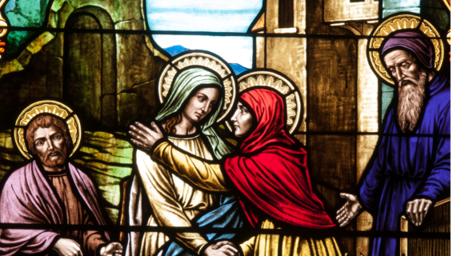
The Gospel of Luke
an introduction

Slide 4
How our experience with God teaches us to worship Him, and why we are all called to be worshippers.

Slide 6
Mary visits Elizabeth
(Luke 1:39-56)

Slide 7
39 In those days Mary got up and went hurriedly into the hill country, to a town of Judah,

Slide 8
40 and she entered Zechariah’s house and greeted Elizabeth.

Slide 9
41 When Elizabeth heard Mary’s greeting, the baby leaped in her womb, and Elizabeth was filled with the Holy Spirit.

Slide 10
42 She exclaimed with a loud voice,

Slide 11
“Blessed are you among women, and blessed is the child in your womb!

Slide 12
43 And who am I that the mother of my Lord should come and visit me?

Slide 13
44 For the instant the sound of your greeting reached my ears, the baby in my womb leaped for joy.

Slide 14
45 And blessed is she who believed that what was spoken to her by the Lord would be fulfilled.”

Slide 16
46 And Mary said,

Slide 17
“My soul exalts the Lord,

Slide 18
47 and my spirit has begun to rejoice in God my Savior,

Slide 19
48 because He has looked upon the humble state of His servant.

Slide 20
For from now on all generations will call me blessed,

Slide 21
49 because He who is mighty has done great things for me, and holy is His name;

Slide 22
50 from generation to generation He is merciful to those who fear him.

Slide 24
51 He has demonstrated power with His arm;

Slide 25
He has scattered those whose pride wells up from the sheer arrogance of their hearts.

Slide 26
52 He has brought down the mighty from their thrones,

Slide 27
and has lifted up those of lowly position;

Slide 28
53 He has filled the hungry with good things, and has sent the rich away empty.

Slide 29
54 He has helped His servant Israel, remembering his mercy,

Slide 30
55 as He promised to our ancestors, to Abraham and to His descendants forever.”

Slide 32
56 So Mary stayed with Elizabeth about three months and then returned to her home.

Slide 34
What has experience taught you about who God is?

Slide 35
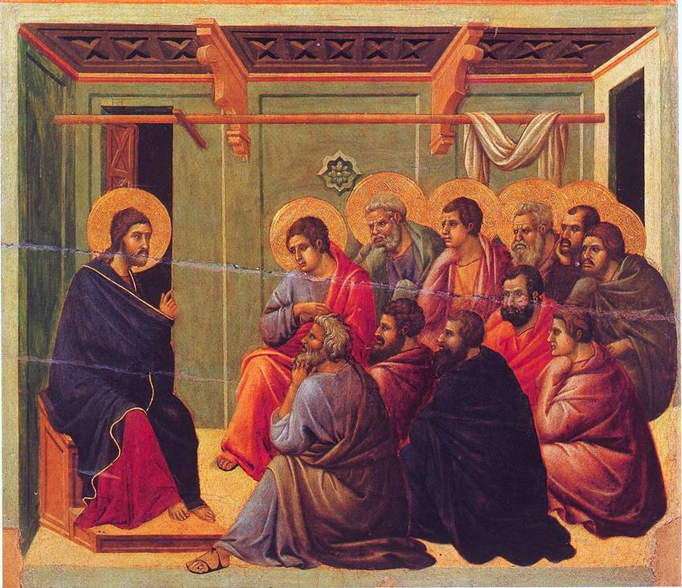
The Gospel of Luke
an introduction

Slide 36
Good News for everyone

