Slide 1
Good News for everyone

Slide 2
Trusting in God’s Timing
Luke 1:5-25
Zechariah's Angelic Visit

Slide 3
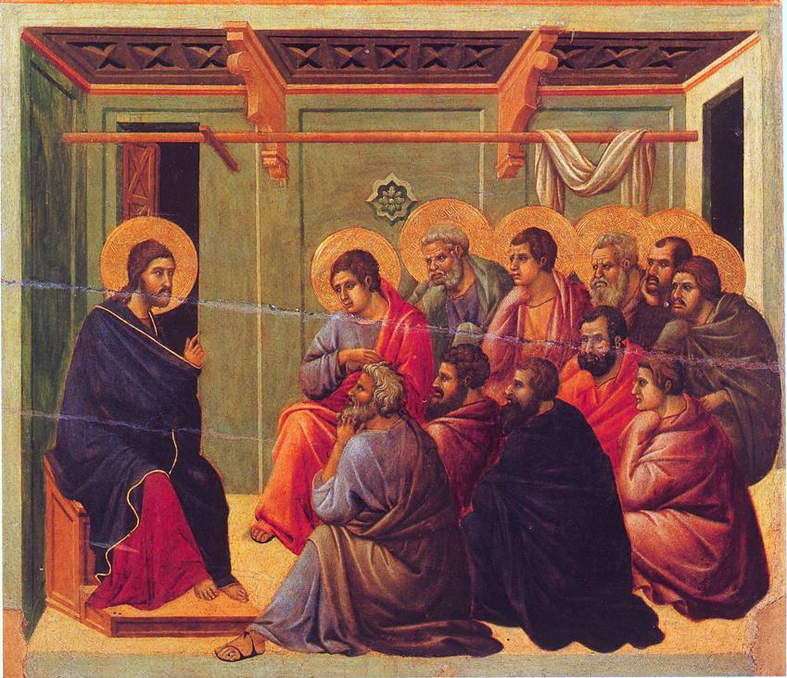
The Gospel of Luke
an introduction

Slide 4
The hard truth about learning to wait on God, what it may cost you, and why you’ll never be the same again afterwards.

Slide 6
Trusting in God’s Timing
(Luke 1:5-25)

Slide 7
5 During the reign of Herod king of Judea, there lived a priest named Zechariah who belonged to the priestly division of Abijah,

Slide 8
and he had a wife named Elizabeth, who was a descendant of Aaron. 6 They were both righteous in the sight of God,

Slide 9
following all the commandments and ordinances of the Lord blamelessly.

Slide 10
7 But they did not have a child because Elizabeth was barren, and they were both very old.

Slide 12
8 Now while Zechariah was serving as priest before God when his division was on duty, 9 he was chosen by lot according to the custom of the priesthood,

Slide 13
to enter the Holy Place of the Lord and burn incense. 10 Now the whole crowd of people were praying outside at the hour of the incense offering.

Slide 14
11 An angel of the Lord, standing on the right side of the altar of incense, appeared to him.

Slide 15
12 And Zechariah, visibly shaken when he saw the angel, was seized with fear.

Slide 16
13 But the angel said to him, “Do not be afraid, Zechariah, for your prayer has been heard,

Slide 17
and your wife Elizabeth will bear you a son; you will name him John. 14 Joy and gladness will come to you, and many will rejoice at his birth,

Slide 18
15 for he will be great in the sight of the Lord. He must never drink wine or strong drink,

Slide 19
and he will be filled with the Holy Spirit, even before his birth.

Slide 20
16 He will turn many of the people of Israel to the Lord their God.

Slide 21
17 And he will go as forerunner before the Lord in the spirit and power of Elijah, to turn the hearts of the fathers back to their children

Slide 22
and the disobedient to the wisdom of the just, to make ready for the Lord a people prepared for him.”

Slide 24
18 Zechariah said to the angel, “How can I be sure of this? For I am an old man, and my wife is old as well.”

Slide 25
19 The angel answered him, “I am Gabriel, who stands in the presence of God, and I was sent to speak to you and to bring you this good news.

Slide 26
20 And now because you did not believe my words, which will be fulfilled in their time,

Slide 27
you will be silent, unable to speak, until the day these things take place.”

Slide 29
21 Now the people were waiting for Zechariah, and they began to wonder why he was delayed in the Holy Place.

Slide 30
22 When he came out, he was not able to speak to them.

Slide 31
They realized that he had seen a vision in the Holy Place because he was making signs to them and remained unable to speak.

Slide 32
23 When his time of service was over, he went to his home.

Slide 34
24 After some time his wife Elizabeth became pregnant, and for five months she kept herself in seclusion.

Slide 35
She said, 25 “This is what the Lord has done for me at the time when he has been gracious to me,

Slide 36
to take away my disgrace among people.”

Slide 38
Have you learned to wait on God?

Slide 39
The Gospel of Luke
an introduction

Slide 40
Good News for everyone

