Slide 1
Good News for everyone

Slide 2
The Gospel of Luke
an introduction

Slide 3
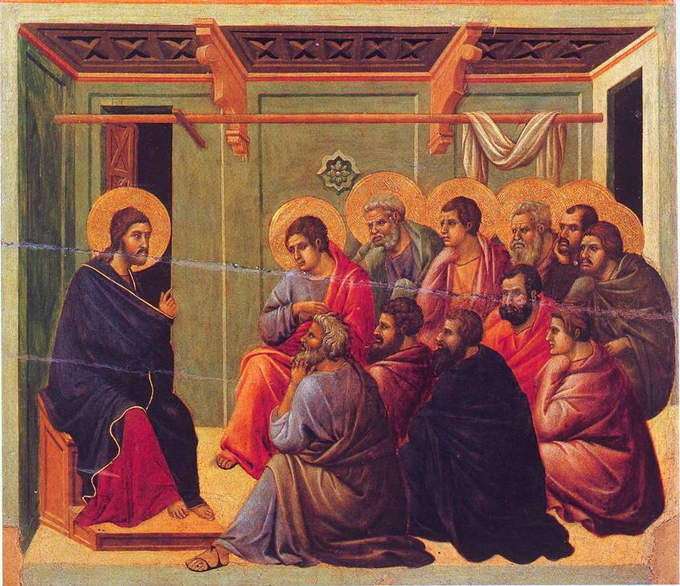
The Gospel of Luke
an introduction

Slide 4
How Luke’s pursuit of Christ informed the Gospel he wrote, and how we can follow in his footsteps today.

Slide 5
Quick Gospel Facts about Luke:
Longest gospel (also, book in NT)
Unique in its focus and breadth
Portrayal of Christ as Savior
All about becoming a student of Jesus Christ

Slide 7
Luke’s Pursuit of Christ
(Luke 1:1-4)

Slide 8
1 Now many have undertaken to compile an account of the things that have been fulfilled among us,

Slide 9
2 like the accounts passed on to us by those who were eyewitnesses and servants of the word from the beginning.

Slide 10
3 So it seemed good to me as well, because I have followed all things carefully from the beginning,

Slide 11
to write an orderly account for you, most excellent Theophilus, 4 so that you may know for certain the things you were taught.

Slide 13
Is following Christ our life’s pursuit?

Slide 14
The Gospel of Luke
an introduction

Slide 15
Good News for everyone

