Slide 1
Good News for everyone

Slide 2
Our Savior has a Name
Luke 1:26-38
Mary's Angelic Visit

Slide 3
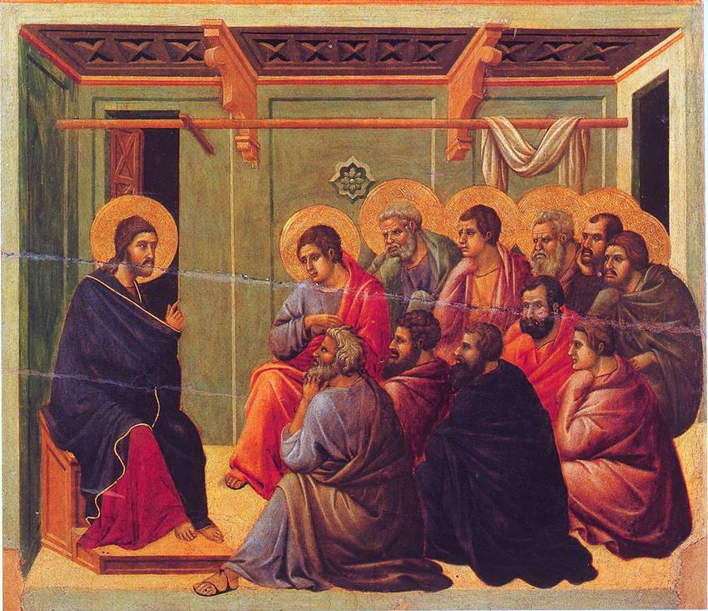
The Gospel of Luke
an introduction

Slide 4
Why Jesus is our Savior, how He meets all of our needs, and why His coming kingdom requires an answer from all of us.

Slide 6
Our Savior has a Name
(Luke 1:26-38)

Slide 7
26 In the sixth month of Elizabeth’s pregnancy, the angel Gabriel was sent by God to a town of Galilee called Nazareth,

Slide 8
27 to a virgin engaged to a man whose name was Joseph, a descendant of David, and the virgin’s name was Mary.

Slide 9
28 The angel came to her and said, “Greetings, favored one, the Lord is with you!”

Slide 10
29 But she was greatly troubled by his words and began to wonder about the meaning of this greeting.

Slide 11
30 So the angel said to her, “Do not be afraid, Mary, for you have found favor with God!

Slide 13
31 Listen: You will become pregnant and give birth to a son, and you will name him Jesus.

Slide 14
32 He will be great, and will be called the Son of the Most High, and the Lord God will give him the throne of his father David.

Slide 15
33 He will reign over the house of Jacob forever, and his kingdom will never end.”

Slide 16
34 Mary said to the angel, “How will this be, since I have not been intimate with a man?”

Slide 17
35 The angel replied, “The Holy Spirit will come upon you, and the power of the Most High will overshadow you.

Slide 18
Therefore the child to be born will be holy; he will be called the Son of God.

Slide 20
36 “And look, your relative Elizabeth has also become pregnant with a son in her old age—

Slide 21
— although she was called barren, she is now in her sixth month! 37 For nothing will be impossible with God.”

Slide 22
38 So Mary said, “Yes, I am a servant of the Lord; let this happen to me according to your word.” Then the angel departed from her.

Slide 24
Is your life prepared for Jesus to come?

Slide 25
The Gospel of Luke
an introduction

Slide 26
Good News for everyone

