Slide 2
The Reliable words of the LORD
(Revelation 22:6-21)

Slide 3
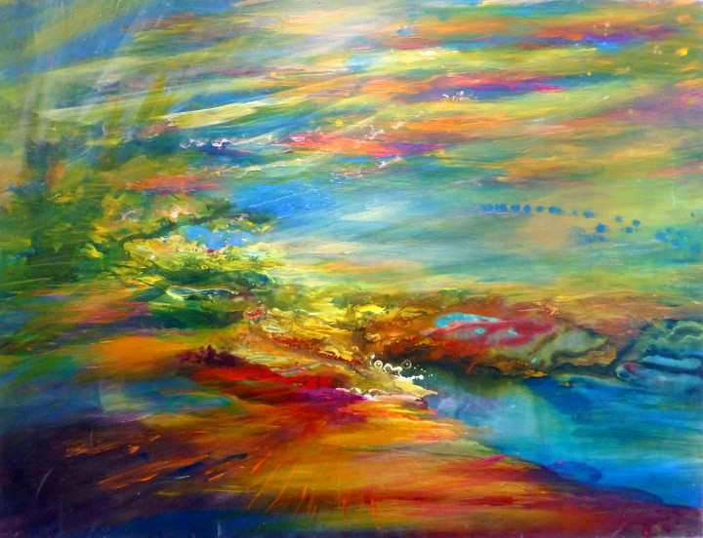

Slide 4
Revelation Recap

Slide 6
The Reliable Words of the LORD
(Revelation 22:6-21

Slide 7
6 Then the angel said to me,

Slide 8
“These words are reliable and true. The Lord, the God of the spirits of the prophets,

Slide 9
has sent his angel to show his servants what must happen soon.”

Slide 11
7 (Look ! I am coming soon!

Slide 12
Blessed is the one who keeps the words of the prophecy expressed in this book.)

Slide 14
8 I, John, am the one who heard and saw these things, and when I heard and saw them,

Slide 15
I threw myself down to worship at the feet of the angel who was showing them to me.

Slide 16
9 But he said to me,

Slide 17
“Do not do this! I am a fellow servant with you and with your brothers the prophets, and with those who obey the words of this book. Worship God!”

Slide 18
10 Then he said to me, “Do not seal up the words of the prophecy contained in this book, because the time is near.

Slide 19
11 The evildoer must continue to do evil, and the one who is morally filthy must continue to be filthy.

Slide 20
The one who is righteous must continue to act righteously, and the one who is holy must continue to be holy.”

Slide 22
12 (Look ! I am coming soon,

Slide 23
and my reward is with me to pay each one according to what he has done!

Slide 24
13 I am the Alpha and the Omega,
the first and the last,
the beginning and the end!)

Slide 26
14 Blessed are those who wash their robes so they can have access to the tree of life and can enter into the city by the gates.

Slide 27
15 Outside are the dogs and the sorcerers and the sexually immoral, and the murderers, and the idolaters and everyone who loves and practices falsehood!

Slide 29
16 “I, Jesus, have sent my angel to testify to you about these things for the churches. I am the root and the descendant of David, the bright morning star!”

Slide 30
17 And the Spirit and the bride say, “Come!” And let the one who hears say: “Come!”

Slide 31
And let the one who is thirsty come; let the one who wants it take the water of life free of charge.

Slide 33
18 I testify to everyone who hears the words of the prophecy contained in this book:

Slide 34
If anyone adds to them, God will add to him the plagues described in this book.

Slide 35
19 And if anyone takes away from the words of this book of prophecy,

Slide 36
God will take away his share in the tree of life and in the holy city that are described in this book.

Slide 37
20 The one who testifies to these things says, “Yes, I am coming soon!” Amen! Come, Lord Jesus!

Slide 38
21 The grace of the Lord Jesus be with all.

Slide 40
Are you a guardian of the
words of Jesus?

