Slide 1
The Gift of Christ
(Isaiah 53:1-12)

Slide 2
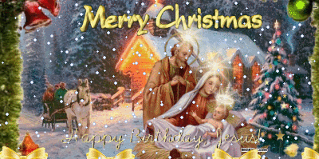

Slide 3
What Christ’s birth means for our lives and culture, and how to celebrate it today.

Slide 5
The Gift we didn’t know we needed
(Isaiah 53:1-12)

Slide 6
1 Who would have believed what we have heard?
And to who has the power of the Lord been revealed to?

Slide 7
2 He grew up before God like a young plant
and like a root out of parched ground.

Slide 8
He didn’t have an impressive form
or majesty that we should look at Him,

Slide 9
no special appearance that we should desire to follow Him.

Slide 10
3 He was despised and rejected by men,
a man of suffering who knew what sickness was.

Slide 11
He was like someone people hide their faces from;

Slide 12
He was despised, and we considered Him insignificant.

Slide 14
4 Yet He Himself bore our sicknesses,
and He carried our pains;

Slide 15
but we thought He was suffering punishment,
struck down by God, and afflicted for something He he had done.

Slide 16
5 But He was pierced because of our transgressions,
crushed because of our iniquities;

Slide 17
and the punishment for our peace was put on Him,
and by His wounds we have been healed.

Slide 18
6 We have all gone astray like sheep;
we have all turned down our own paths;

Slide 19
but the Lord has punished Him for our transgressions.

Slide 21
7 He was oppressed and afflicted,
yet He did not open His mouth.

Slide 22
Like a lamb led to the slaughter,
and like a sheep,
silent before her shearers,
He did not open His mouth.

Slide 23
8 He was taken away after an unjust trial;
But who from His generation even cared?

Slide 24
For He was cut off from the land of the living;
He was struck down because of my people’s rebellion.

Slide 25
9 They assigned His grave with the wicked,
but they buried Him in a rich man’s tomb,

Slide 26
even though He had done no violence,
nor ever spoken with deceit.

Slide 28
10 Yet it pleased the Lord to crush Him and subject Him to grief.

Slide 29
And to make Him an offering for sin,
after this He will see His lineage,

Slide 30
And His days will be prolonged,
and by Yahweh’s pleasure it will be accomplished.

Slide 31
11 After He has suffered, He will see the light of life,
and be satisfied with the fruits of His suffering

Slide 32
“My righteous Servant will justify many people, and He will carry their sins.

Slide 33
12 Therefore I will give Him the multitudes as His portion, and He will receive the mighty as His prize,

Slide 34
because He submitted Himself to death,
and was counted among the rebels;

Slide 35
yet He bore the sin of the multitudes
and interceded on behalf of the rebels.”

Slide 37
How has the gift of Christ
changed your life?

Slide 39
God has given us salvation through His Son, changing our lives forever, so that we can celebrate Christmas with grateful hearts.

