Slide 2
The Final Battle
(Revelation 19b-20)

Slide 3
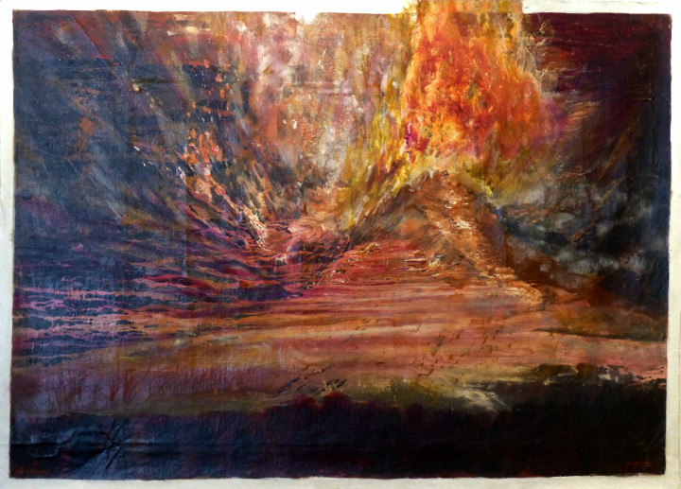

Slide 4
Revelation Recap

Slide 6
Part 2: The Kingdom, the Throne, and the Fire
(Revelation 20:1-15)

Slide 7
1 Then I saw an angel descending from heaven, holding in his hand the key to the abyss and a huge chain.

Slide 8
2 He seized the dragon—the ancient serpent, who is the devil and Satan—and tied him up for a thousand years.

Slide 9
3 The angel then threw him into the abyss and locked and sealed it so that he could not deceive the nations until the one thousand years were finished.

Slide 11
4 Then I saw thrones and seated on them were those who had been given authority to judge.

Slide 12
I also saw the souls of those who had been beheaded because of the testimony about Jesus and because of the word of God.

Slide 13
These had not worshiped the beast or his image and had refused to receive his mark on their forehead or hand.

Slide 14
They came to life and reigned with Christ for a thousand years.

Slide 15
5 (The rest of the dead did not come to life until the thousand years were finished.) This is the first resurrection.

Slide 16
6 Blessed and holy is the one who takes part in the first resurrection. The second death has no power over them,

Slide 17
but they will be priests of God and of Christ, and they will reign with him for a thousand years.

Slide 19
7 Now when the thousand years are finished, Satan will be released from his prison

Slide 20
8 and will go out to deceive the nations at the four corners of the earth, Gog and Magog, to bring them together for the battle.

Slide 21
They are as numerous as the grains of sand in the sea.

Slide 22
9 They went up on the broad plain of the earth and encircled the camp of the saints and the beloved city,

Slide 23
but fire came down from heaven and devoured them completely.

Slide 24
10 And the devil who deceived them was thrown into the lake of fire and sulfur,

Slide 25
where the beast and the false prophet are too, and they will be tormented there day and night forever and ever.

Slide 27
11 Then I saw a large white throne and the one who was seated on it; the earth and the heaven fled from his presence, and no place was found for them.

Slide 28
12 And I saw the dead, the great and the small, standing before the throne. Then books were opened, and another book was opened—the book of life.

Slide 29
So the dead were judged by what was written in the books, according to their deeds.

Slide 30
13 The sea gave up the dead that were in it, and Death and Hades gave up the dead that were in them, and each one was judged according to his deeds.

Slide 31
14 Then Death and Hades were thrown into the lake of fire. This is the second death—the lake of fire.

Slide 32
15 If anyone’s name was not found written in the book of life, that person was thrown into the lake of fire.

Slide 34
Are you living to save yourself
or fully leaning on Christ?

Slide 35
