Slide 1
Friendship with God
(Genesis 3:1-20)

Slide 2
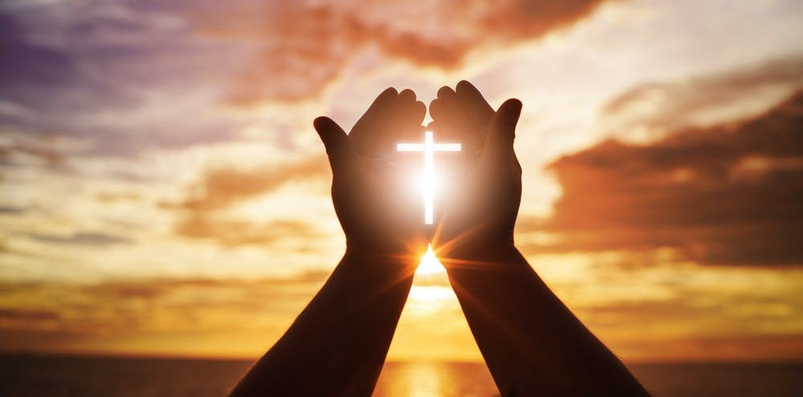

Slide 3
A picture of friendship with God, and how we can return to a full relationship with Him.

Slide 6
Friendship with God:
The Story of Eden
(Genesis 32:1-31)

Slide 7
1 Now the serpent was shrewder than any of the wild animals that the Lord God had made.

Slide 8
He said to the woman,
“Is it really true that God said, ‘You must not eat from any tree of the orchard’?”

Slide 9
2 The woman said to the serpent,
“We may eat of the fruit from the trees of the orchard;

Slide 10
3 but concerning the fruit of the tree that is in the middle of the orchard God said,

Slide 11
‘You must not eat from it, and you must not touch it, or else you will die.’”

Slide 12
4 The serpent said to the woman,
“Surely you will not die,

Slide 13
5 for God knows that when you eat from it your eyes will open and you will be like God, knowing good and evil.”

Slide 15
6 When the woman saw that the tree produced fruit that was good for food, was attractive to the eye, and was desirable for making one wise,

Slide 16
she took some of its fruit and ate it. She also gave some of it to her husband who was with her, and he ate it.

Slide 17
7 Then the eyes of both of them opened, and they knew they were naked;

Slide 18
so they sewed fig leaves together and made coverings for themselves.

Slide 20
8 Then the man and his wife heard the sound of the Lord God moving about in the orchard at the breezy time of the day,

Slide 21
and they hid from the Lord God among the trees of the orchard.

Slide 22
9 But the Lord God called to the man and said to him,
“Where are you?”

Slide 23
10 The man replied,
“I heard you moving about in the orchard, and I was afraid because I was naked, so I hid.”

Slide 24
11 And the Lord God said,
“Who told you that you were naked? Did you eat from the tree that I commanded you not to eat from?”

Slide 25
12 The man said,
“The woman whom you gave me, she gave me some fruit from the tree and I ate it.”

Slide 26
13 So the Lord God said to the woman,
“What is this you have done?”

Slide 27
And the woman replied, “The serpent tricked me, and I ate.”

Slide 29
14 The Lord God said to the serpent,

Slide 30
“Because you have done this, cursed are you
above all the cattle and
all the living creatures
of the field!

Slide 31
On your belly you will crawl
and dust you will eat
all the days of your life.

Slide 32
15 And I will put hostility between you and the woman
and between your offspring and her offspring;

Slide 33
he will strike your head,
and you will strike his heel.”

Slide 35
16 To the woman he said,

Slide 36
“I will greatly increase your labor pains;
with pain you will give birth to children.

Slide 37
You will want to control your husband,
but he will dominate you.”

Slide 39
17 But to Adam he said,

Slide 40
“Because you obeyed
your wife
and ate from the tree
about which
I commanded you,
‘You must not eat from it,’

Slide 41
the ground is cursed because of you;

Slide 42
in painful toil
you will eat of it
all the days of your life.

Slide 43
18 It will produce
thorns and thistles for you,
but you will eat
the grain of the field.

Slide 44
19 By the sweat of your brow you will eat food
until you return to the ground,

Slide 45
for out of it you were taken;
for you are dust,
and to dust you will return.”

Slide 47
20 The man named his wife Eve, because she was the mother of all the living.

Slide 48
21 The Lord God made garments from skin for Adam and his wife, and clothed them.

Slide 49
22 And the Lord God said, “Now that the man has become like one of us, knowing good and evil,

Slide 50
he must not be allowed to stretch out his hand and take also from the tree of life and eat, and live forever.”

Slide 51
23 So the Lord God expelled him from the orchard in Eden to cultivate the ground from which he had been taken.

Slide 52
24 When he drove the man out, he placed on the eastern side of the orchard in Eden angelic sentries

Slide 53
who used the flame of a whirling sword to guard the way to the tree of life.

Slide 55
Has your life been shaped by resistance to
God, or friendship with him?

Slide 57
A picture of friendship with God, and how we can return to a full relationship with Him.

Slide 58
