Slide 1
Blessed by God
(Genesis 32:1-32)

Slide 2
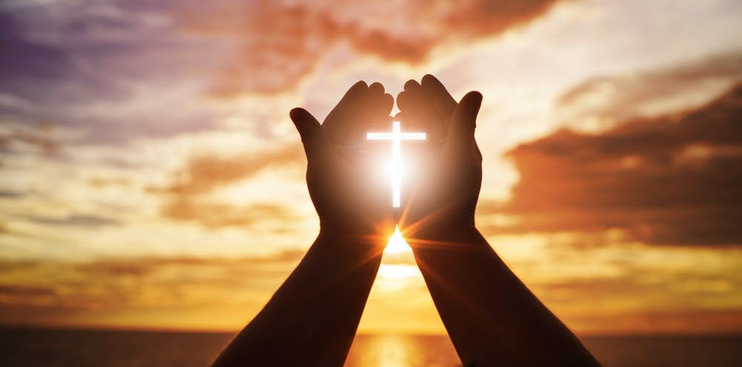

Slide 3
What it really means to be ‘#blessed’, ‘visited by God’, and ‘touched by an angel’

Slide 5
Blessed by God: Jacob at Peniel
(Genesis 32:1-32)

Slide 6
22:1 So Jacob went on his way and the angels of God met him. 2 When Jacob saw them, he exclaimed,

Slide 7
“This is the camp of God!”
So he named that place Mahanaim.

Slide 9
3 Jacob sent messengers on ahead to his brother Esau in the land of Seir, the region of Edom. 4 He commanded them,

Slide 10
“This is what you must say to my lord Esau: ‘This is what your servant Jacob says: I have been staying with Laban until now.

Slide 11
5 I have oxen, donkeys, sheep, and male and female servants. I have sent this message to inform my lord, so that I may find favor in your sight.’”

Slide 13
6 The messengers returned to Jacob and said, “We went to your brother Esau. He is coming to meet you and has 400 men with him.”

Slide 14
7 Jacob was very afraid and upset. So he divided the people who were with him into two camps, as well as the flocks, herds, and camels.

Slide 15
8 “If Esau attacks one camp,” he thought, “then the other camp will be able to escape.”

Slide 17
9 Then Jacob prayed,
“O God of my father Abraham, God of my father Isaac, O Lord, you said to me,

Slide 18
‘Return to your land and to your relatives and I will make you prosper.’

Slide 19
10 I am not worthy of all the faithful love you have shown your servant. With only my walking stick I crossed the Jordan, but now I have become two camps.

Slide 20
11 Rescue me, I pray, from the hand of my brother Esau, for I am afraid he will come and attack me, as well as the mothers with their children.

Slide 21
12 But you said,
‘I will certainly make you prosper and will make your descendants like the sand on the seashore, too numerous to count.’”

Slide 23
13 Jacob stayed there that night. Then he sent as a gift to his brother Esau 14,200 female goats and 20 male goats,

Slide 24
200 ewes and 20 rams, 1,530 female camels with their young, 40 cows and 10 bulls, and 20 female donkeys and 10 male donkeys.

Slide 25
16 He entrusted them to his servants, who divided them into herds. He told his servants,

Slide 26
“Pass over before me, and keep some distance between one herd and the next.”

Slide 27
17 He instructed the servant leading the first herd, “When my brother Esau meets you and asks,

Slide 28
‘To whom do you belong? Where are you going? Whose herds are you driving?’

Slide 29
18 then you must say, ‘They belong to your servant Jacob.

Slide 30
They have been sent as a gift to my lord Esau. In fact Jacob himself is behind us.’”

Slide 32
19 He also gave these instructions to the second and third servants, as well as all those who were following the herds, saying,

Slide 33
“You must say the same thing to Esau when you meet him. 20 You must also say, ‘In fact your servant Jacob is behind us.’”

Slide 34
Jacob thought, “I will first appease him by sending a gift ahead of me. After that I will meet him. Perhaps he will accept me.”

Slide 35
21 So the gifts were sent on ahead of him while he spent that night in the camp.

Slide 37
22 During the night Jacob quickly took his two wives, his two female servants, and his eleven sons and crossed the ford of the Jabbok.

Slide 38
23 He took them and sent them across the stream along with all his possessions.

Slide 39
24 So Jacob was left alone. Then a man wrestled with him until daybreak.

Slide 40
25 When the man saw that he could not defeat Jacob, he struck the socket of his hip

Slide 41
so the socket of Jacob’s hip was dislocated while he wrestled with him.

Slide 43
26 Then the man said, “Let me go, for the dawn is breaking.”

Slide 44
“I will not let you go,” Jacob replied, “unless you bless me.”

Slide 45
27 The man asked him, “What is your name?” He answered, “Jacob.”

Slide 46
28 “No longer will your name be Jacob,” the man told him, “but Israel,

Slide 47
because you have fought with God and with men and have prevailed.”

Slide 48
29 Then Jacob asked, “Please tell me your name.”

Slide 49
“Why do you ask my name?” the man replied.
Then he blessed Jacob there.

Slide 50
30 So Jacob named the place Peniel, explaining,

Slide 51
“Certainly I have seen God face to face and have survived.”

Slide 53
31 The sun rose over him as he crossed over Penuel, but he was limping because of his hip.

Slide 54
32 That is why to this day the Israelites do not eat the sinew which is attached to the socket of the hip,

Slide 55
because he struck the socket of Jacob’s hip near the attached sinew.

Slide 57
Jacob:
The Man Blessed by God

Slide 58
What’s the Context?
Jacob’s family & history
Jacob’s ‘Esau Crisis’
God’s plan in Genesis

Slide 60
How have you been marked
by God showing up in your life?

Slide 62
What does it really mean to be ‘#blessed’, ‘visited by God’, and ‘touched by an angel’?

