Slide 2
Armageddon: The Last Battle
(Revelation 19:6-20)

Slide 3
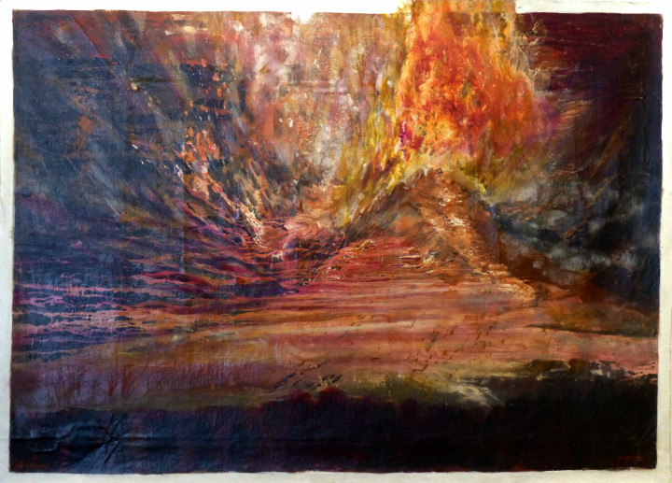

Slide 4
Revelation Recap

Slide 6
Part 1: The Lamb Goes to WAR
(Revelation 19:6-21)

Slide 7
6 Then I heard what sounded like the voice of a vast throng, like the roar of many waters and like loud crashes of thunder.

Slide 8
They were shouting:

Slide 9
“Hallelujah! For the Lord our God, the All-Powerful, reigns!

Slide 10
7 Let us rejoice and exult
and give him glory,
because the wedding celebration of the Lamb has come,

Slide 11
and his bride has made herself ready. 8 She was permitted to be dressed in bright, clean, fine linen”

Slide 12
(for the fine linen is the righteous deeds of the saints).

Slide 14
9 Then the angel said to me,

Slide 15
“Write the following:
Blessed are those who are invited to the banquet at the wedding celebration of the Lamb!”

Slide 16
He also said to me,

Slide 17
“These are the true words of God.”

Slide 18
10 So I threw myself down at his feet to worship him, but he said,

Slide 19
“Do not do this! I am only a fellow servant with you and your brothers and sisters who hold to the testimony about Jesus.

Slide 20
Worship God, for the testimony about Jesus is the spirit of prophecy.”

Slide 22
11 Then I saw heaven opened and here came a white horse! The one riding it was called “Faithful” and “True,” and with justice he judges and goes to war.

Slide 23
12 His eyes are like a fiery flame and there are many diadem crowns on his head. He has a name written that no one knows except himself.

Slide 24
13 He is dressed in clothing dipped in blood, and he is called the Word of God.

Slide 25
14 The armies that are in heaven, dressed in white, clean, fine linen, were following him on white horses.

Slide 26
15 From his mouth extends a sharp sword so that with it he can strike the nations.

Slide 27
He will rule them with an iron rod, and he stomps the winepress of the furious wrath of God, the All-Powerful.

Slide 28
16 He has a name written on his clothing and on his thigh: “King of kings and Lord of lords.”

Slide 30
17 Then I saw one angel standing in the sun, and he shouted in a loud voice to all the birds flying high in the sky:

Slide 31
“Come, gather around for the great banquet of God,

Slide 32
18 to eat your fill of the flesh of kings,

Slide 33
the flesh of generals,

Slide 34
the flesh of powerful people,

Slide 35
the flesh of horses and those who ride them,

Slide 36
and the flesh of all people, both free and slave,

Slide 37
and small and great!”

Slide 39
19 Then I saw the beast and the kings of the earth and their armies assembled to do battle with the one who rode the horse and with his army.

Slide 40
20 Now the beast was seized, and along with him the false prophet who had performed the signs on his behalf—

Slide 41
signs by which he deceived those who had received the mark of the beast and those who worshiped his image.

Slide 42
Both of them were thrown alive into the lake of fire burning with sulfur.

Slide 43
21 The others were killed by the sword that extended from the mouth of the one who rode the horse, and all the birds gorged themselves with their flesh.

Slide 45
How does Jesus’ second coming
change our lives today?

Slide 46
