Slide 2
The Fall of Babylon
(Revelation 17-19a)

Slide 3
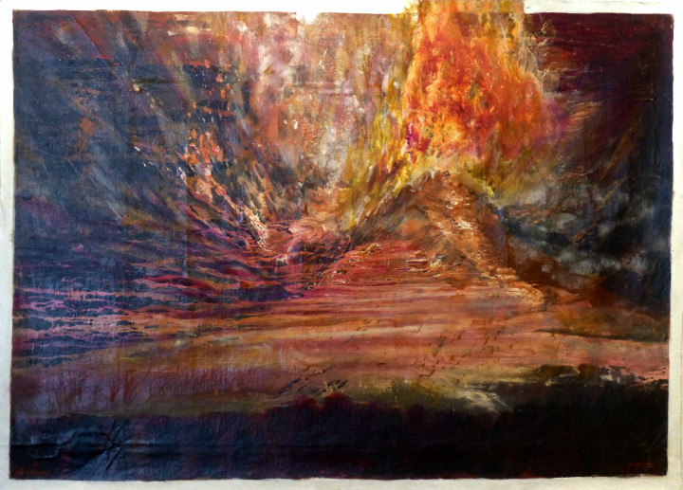

Slide 4
Revelation Recap

Slide 6
Part 2: BABYLON destroyed
(Revelation 18-19:5)

Slide 7
18:1 After these things I saw another angel, who possessed great authority, coming down out of heaven,

Slide 8
and the earth was lit up by his radiance. 2 He shouted with a powerful voice:

Slide 9
“Fallen, fallen, is Babylon the great!
She has become a lair for demons,

Slide 10
a haunt for every unclean spirit,
a haunt for every unclean bird,
a haunt for every unclean and detested beast.

Slide 11
3 For all the nations have fallen from the wine of her immoral passion,

Slide 12
and the kings of the earth have committed sexual immorality with her,

Slide 13
and the merchants of the earth have gotten rich from the power of her sensual behavior.”

Slide 15
4 Then I heard another voice from heaven saying,

Slide 16
“Come out of her, my people, so you will not take part in her sins,

Slide 17
and so you will not receive her plagues,

Slide 18
5 because her sins have piled up all the way to heaven and God has remembered her crimes.

Slide 19
6 Repay her the same way she repaid others; pay her back double corresponding to her deeds.

Slide 20
In the cup she mixed, mix double the amount for her.

Slide 21
7 As much as she exalted herself and lived in sensual luxury, to this extent give her torment and grief

Slide 22
because she said to herself:
‘I rule as queen and am no widow; I will never experience grief!’

Slide 23
8 For this reason, she will experience her plagues in a single day:

Slide 24
disease, mourning, and famine,

Slide 25
and she will be burned down with fire,

Slide 26
because the Lord God who judges her is powerful!”

Slide 28
9 Then the kings of the earth who committed immoral acts with her and lived in sensual luxury with her

Slide 29
will weep and wail for her when they see the smoke from the fire that burns her up.

Slide 30
10 They will stand a long way off because they are afraid of her torment, and will say,

Slide 32
“Woe, woe, O great city,
Babylon the powerful city!

Slide 33
For in a single hour your doom has come!”

Slide 35
11 Then the merchants of the earth will weep and mourn for her because no one buys their cargo any longer—

Slide 36
12 cargo such as gold, silver, precious stones, pearls, fine linen, purple cloth, silk, scarlet cloth,

Slide 37
all sorts of things made of citron wood, all sorts of objects made of ivory, all sorts of things made of expensive wood, bronze, iron and marble,

Slide 38
13 cinnamon, spice, incense, perfumed ointment, frankincense, wine, olive oil and costly flour, wheat,

Slide 39
cattle and sheep, horses and four-wheeled carriages,

Slide 40
slaves and human lives.

Slide 42
14 (The ripe fruit
you greatly desired
has gone from you,

Slide 43
and all your luxury
and splendor
have gone from you—
they will never ever
be found again!)

Slide 45
15 The merchants who sold these things, who got rich from her, will stand a long way off because they are afraid of her torment.

Slide 46
They will weep and mourn, 16 saying,

Slide 48
“Woe, woe, O great city—
dressed in fine linen,
purple and scarlet clothing,
and adorned with gold, precious stones, and pearls—

Slide 49
17 because in a single hour such great wealth
has been destroyed!”

Slide 51
And every ship’s captain, and all who sail along the coast—seamen, and all who make their living from the sea, stood a long way off

Slide 52
18 and they began to shout when they saw the smoke from the fire that burned her up,

Slide 53
“Who is like the great city?”

Slide 54
19 And they threw dust on their heads and were shouting with weeping and mourning,

Slide 56
“Woe, Woe, O great city—
in which all those
who had ships on the sea
got rich from her wealth—

Slide 57
because in a single hour
she has been destroyed!”

Slide 59
20 (Rejoice over her,
O heaven,
and you saints
and apostles and prophets,

Slide 60
for God has pronounced judgment against her on your behalf!)

Slide 62
21 Then one powerful angel picked up a stone like a huge millstone, threw it into the sea, and said,

Slide 64
“With this kind of sudden violent force Babylon the great city will be thrown down, and it will never be found again!

Slide 65
22 And the sound of the harpists, musicians,
flute players, and trumpeters
will never be heard in you again.

Slide 66
No craftsman who practices any trade will ever be found in you again; the noise of a mill will never be heard in you again.

Slide 67
23 Even the light from a lamp
will never shine in you again!

Slide 68
The voices of the bridegroom and his bride will never be heard in you again.

Slide 69
For your merchants were the tycoons of the world,

Slide 70
because all the nations were deceived by your magic spells!

Slide 71
24 The blood of the saints and prophets was found in her,
along with the blood of all those who had been killed on the earth.”

Slide 73
19:1 After these things I heard what sounded like the loud voice of a vast throng in heaven, saying,

Slide 75
“Hallelujah! Salvation and glory and power belong to our God, 2 because his judgments are true and just.

Slide 76
For he has judged the great prostitute who corrupted the earth with her sexual immorality,

Slide 77
and has avenged the blood of his servants poured out by her own hands!”

Slide 79
3 Then a second time the crowd shouted,

Slide 80
“Hallelujah! The smoke rises from her forever and ever.”

Slide 81
4 The twenty-four elders and the four living creatures threw themselves to the ground

Slide 82
and worshiped God, who was seated on the throne, saying:

Slide 83
“Amen! Hallelujah!”

Slide 85
5 Then a voice came from the throne, saying:

Slide 87
“Praise our God all you
his servants,
and all you who fear him,
both small and great!”

Slide 89
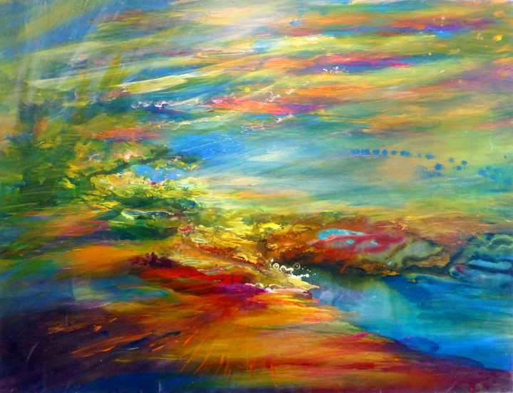

Slide 90
Have you ever wondered
why the world rebels against God?

