Slide 2
The Fall of Babylon
(Revelation 17-19a)

Slide 3
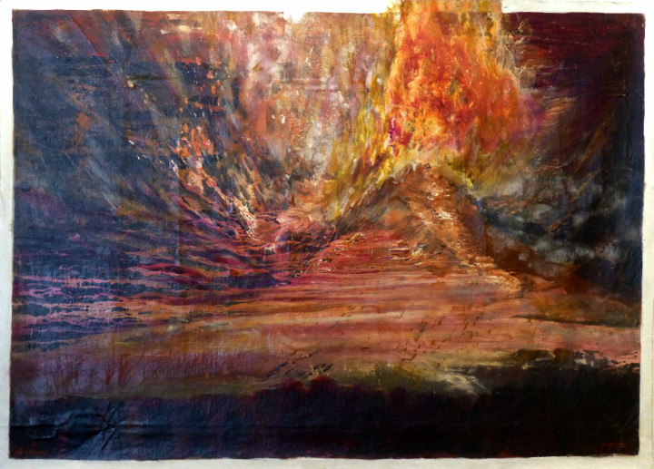

Slide 4
Revelation Recap

Slide 5
What is revelation all about?

Slide 7
Babylon The Great Prostitute
(Revelation 17:1-18)

Slide 8
1 Then one of the seven angels who had the seven bowls came and spoke to me.

Slide 9
“Come,” he said, “I will show you the condemnation and punishment of the great prostitute who sits on many waters,

Slide 10
2 with whom the kings of the earth committed sexual immorality and the earth’s inhabitants got drunk with the wine of her immorality.”

Slide 11
3 So he carried me away in the Spirit to a wilderness, and there I saw a woman sitting on a scarlet beast that was full of blasphemous names and had seven heads and ten horns.

Slide 12
4 Now the woman was dressed in purple and scarlet clothing, and adorned with gold, precious stones, and pearls.

Slide 13
She held in her hand a golden cup filled with detestable things and unclean things from her sexual immorality.

Slide 14
5 On her forehead was written a name, a mystery: “Babylon the Great, the Mother of prostitutes and of the detestable things of the earth.”

Slide 15
6 I saw that the woman was drunk with the blood of the saints and the blood of those who testified to Jesus. I was greatly astounded when I saw her.

Slide 17
7 But the angel said to me, “Why are you astounded? I will interpret for you the mystery of the woman and of the beast with the seven heads and ten horns that carries her.

Slide 18
8 The beast you saw was, and is not, but is about to come up from the abyss and then go to destruction.

Slide 19
The inhabitants of the earth—all those whose names have not been written in the book of life since the foundation of the world—

Slide 20
will be astounded when they see that the beast was, and is not, but is to come.

Slide 21
9 (This requires a mind that has wisdom.) The seven heads are seven mountains the woman sits on. They are also seven kings:

Slide 22
10 five have fallen; one is, and the other has not yet come, but whenever he does come, he must remain for only a brief time.

Slide 23
11 The beast that was, and is not, is himself an eighth king and yet is one of the seven, and is going to destruction.

Slide 24
12 The ten horns that you saw are ten kings who have not yet received a kingdom, but will receive ruling authority as kings with the beast for one hour.

Slide 25
13 These kings have a single intent, and they will give their power and authority to the beast.

Slide 27
14 They will make war with the Lamb, but the Lamb will conquer them, because he is Lord of lords and King of kings,

Slide 28
and those accompanying the Lamb are the called, chosen, and faithful.”

Slide 29
15 Then the angel said to me, “The waters you saw (where the prostitute is seated) are peoples, multitudes, nations, and languages.

Slide 30
16 The ten horns that you saw, and the beast—these will hate the prostitute and make her desolate and naked. They will consume her flesh and burn her up with fire.

Slide 31
17 For God has put into their minds to carry out his purpose by making a decision to give their royal power to the beast until the words of God are fulfilled.

Slide 32
18 As for the woman you saw, she is the great city that has sovereignty over the kings of the earth.”

Slide 34
Babylon the Mother of Prostitutes
(Revelation 17:1-6)

Slide 35
1 Then one of the seven angels who had the seven bowls came and spoke to me.

Slide 36
“Come,” he said, “I will show you the condemnation and punishment of the great prostitute who sits on many waters,

Slide 37
2 with whom the kings of the earth committed sexual immorality and the earth’s inhabitants got drunk with the wine of her immorality.”

Slide 38
3 So he carried me away in the Spirit to a wilderness, and there I saw a woman sitting on a scarlet beast that was full of blasphemous names and had seven heads and ten horns.

Slide 39
4 Now the woman was dressed in purple and scarlet clothing, and adorned with gold, precious stones, and pearls.

Slide 40
She held in her hand a golden cup filled with detestable things and unclean things from her sexual immorality.

Slide 41
5 On her forehead was written a name, a mystery: “Babylon the Great, the Mother of prostitutes and of the detestable things of the earth.”

Slide 42
6 I saw that the woman was drunk with the blood of the saints and the blood of those who testified to Jesus. I was greatly astounded when I saw her.

Slide 44
Is your life patterned
after Babylon or heaven?

Slide 45
The Angel’s Interpretation
(Revelation 17:7-13)

Slide 46
7 But the angel said to me, “Why are you astounded? I will interpret for you the mystery of the woman and of the beast with the seven heads and ten horns that carries her.

Slide 47
8 The beast you saw was, and is not, but is about to come up from the abyss and then go to destruction.

Slide 48
The inhabitants of the earth—all those whose names have not been written in the book of life since the foundation of the world—

Slide 49
will be astounded when they see that the beast was, and is not, but is to come.

Slide 50
9 (This requires a mind that has wisdom.) The seven heads are seven mountains the woman sits on. They are also seven kings:

Slide 51
10 five have fallen; one is, and the other has not yet come, but whenever he does come, he must remain for only a brief time.

Slide 52
11 The beast that was, and is not, is himself an eighth king and yet is one of the seven, and is going to destruction.

Slide 53
12 The ten horns that you saw are ten kings who have not yet received a kingdom, but will receive ruling authority as kings with the beast for one hour.

Slide 54
13 These kings have a single intent, and they will give their power and authority to the beast.

Slide 56
What is the common thread
behind all sin?

Slide 57
The Lamb’s Victory
(Revelation 17:14-18)

Slide 58
14 They will make war with the Lamb, but the Lamb will conquer them, because he is Lord of lords and King of kings,

Slide 59
and those accompanying the Lamb are the called, chosen, and faithful.”

Slide 60
15 Then the angel said to me, “The waters you saw (where the prostitute is seated) are peoples, multitudes, nations, and languages.

Slide 61
16 The ten horns that you saw, and the beast—these will hate the prostitute and make her desolate and naked. They will consume her flesh and burn her up with fire.

Slide 62
17 For God has put into their minds to carry out his purpose by making a decision to give their royal power to the beast until the words of God are fulfilled.

Slide 63
18 As for the woman you saw, she is the great city that has sovereignty over the kings of the earth.”

Slide 65
What does it mean
to be called, chosen, and faithful?

Slide 66
