Slide 2
The War in HEaven
(Revelation 12)

Slide 3
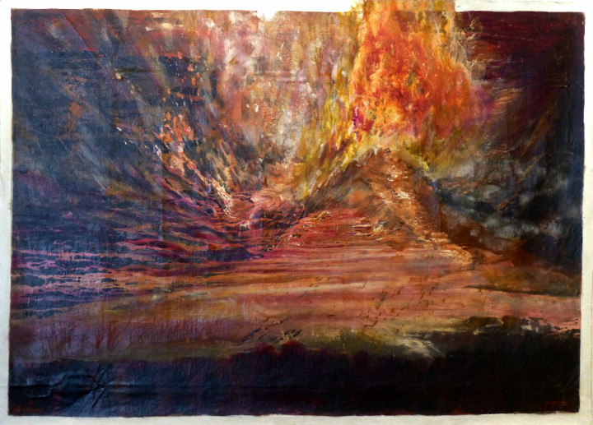

Slide 4
Revelation Recap

Slide 5
• Written by John, to encourage the persecuted Church and future generations of Christians

Slide 6
• Written to remind and reveal God’s character, purposes, and plans for redemption, restoration, and justice.

Slide 7
• Dense with prophetic language (symbols and images, similes, hyperbole, wordplay, creative math, layered meanings, and mixed metaphors)

Slide 8
• Filled with references from all across the Bible, and the ancient world (think ‘easter eggs’ from scripture and past culture)

Slide 10
The Truth about Spiritual Warfare
(Revelation 12)

Slide 11
1 Then a great sign appeared in heaven: a woman clothed with the sun, and with the moon under her feet, and on her head was a crown of twelve stars.

Slide 12
2 She was pregnant and was screaming in labor pains, struggling to give birth.

Slide 13
3 Then another sign appeared in heaven: a huge red dragon that had seven heads and ten horns, and on its heads were seven diadem crowns.

Slide 14
4 Now the dragon’s tail swept away a third of the stars in heaven and hurled them to the earth.

Slide 15
Then the dragon stood before the woman who was about to give birth, so that he might devour her child as soon as it was born.

Slide 16
5 So the woman gave birth to a son, a male child, who is going to rule over all the nations with an iron rod. Her child was suddenly caught up to God and to his throne,

Slide 17
6 and she fled into the wilderness where a place had been prepared for her by God, so she could be taken care of for 1,260 days.

Slide 18
7 Then war broke out in heaven: Michael and his angels fought against the dragon, and the dragon and his angels fought back.

Slide 19
8 But the dragon was not strong enough to prevail, so there was no longer any place left in heaven for him and his angels.

Slide 20
9 So that huge dragon—the ancient serpent, the one called the devil and Satan, who deceives the whole world—was thrown down to the earth, and his angels along with him.

Slide 21
10 Then I heard a loud voice in heaven saying,

Slide 22
“The salvation and the power
and the kingdom of our God,
and the ruling authority of his Christ, have now come,

Slide 23
because the accuser of our brothers and sisters,
the one who accuses them day and night before our God,
has been thrown down.

Slide 24
11 But they overcame him
by the blood of the Lamb
and by the word of their testimony,
and they did not love their lives so much that they were afraid to die.

Slide 25
12 Therefore you heavens rejoice, and all who reside in them!
But woe to the earth and the sea
because the devil has come down to you!

Slide 26
He is filled with terrible anger,
for he knows that he only has a little time!”

Slide 27
13 Now when the dragon realized that he had been thrown down to the earth, he pursued the woman who had given birth to the male child.

Slide 28
14 But the woman was given the two wings of a giant eagle so that she could fly out into the wilderness,

Slide 29
to the place God prepared for her, where she is taken care of—away from the presence of the serpent—for a time, times, and half a time.

Slide 30
15 Then the serpent spouted water like a river out of his mouth after the woman in an attempt to sweep her away by a flood,

Slide 31
16 but the earth came to her rescue; the ground opened up and swallowed the river that the dragon had spewed from his mouth.

Slide 32
17 So the dragon became enraged at the woman and went away to make war on the rest of her children,

Slide 33
those who keep God’s commandments and hold to the testimony about Jesus.

Slide 34
(12:18) And the dragon stood on the sand of the seashore.

Slide 36
The Woman and the Dragon
(Revelation 12:1-6)

Slide 37
1 Then a great sign appeared in heaven: a woman clothed with the sun, and with the moon under her feet, and on her head was a crown of twelve stars.

Slide 38
2 She was pregnant and was screaming in labor pains, struggling to give birth.

Slide 39
3 Then another sign appeared in heaven: a huge red dragon that had seven heads and ten horns, and on its heads were seven diadem crowns.

Slide 40
4 Now the dragon’s tail swept away a third of the stars in heaven and hurled them to the earth.

Slide 41
Then the dragon stood before the woman who was about to give birth, so that he might devour her child as soon as it was born.

Slide 42
5 So the woman gave birth to a son, a male child, who is going to rule over all the nations with an iron rod. Her child was suddenly caught up to God and to his throne,

Slide 43
6 and she fled into the wilderness where a place had been prepared for her by God, so she could be taken care of for 1,260 days.

Slide 45
Why does God allow
Satan to rebel?

Slide 46
Recounting the Dragon’s Fall
(Revelation 12:7-12)

Slide 47
7 Then war broke out in heaven: Michael and his angels fought against the dragon, and the dragon and his angels fought back.

Slide 48
8 But the dragon was not strong enough to prevail, so there was no longer any place left in heaven for him and his angels.

Slide 49
9 So that huge dragon—the ancient serpent, the one called the devil and Satan, who deceives the whole world—was thrown down to the earth, and his angels along with him.

Slide 50
10 Then I heard a loud voice in heaven saying,

Slide 51
“The salvation and the power
and the kingdom of our God,
and the ruling authority of his Christ, have now come,

Slide 52
because the accuser of our brothers and sisters,
the one who accuses them day and night before our God,
has been thrown down.

Slide 53
11 But they overcame him
by the blood of the Lamb
and by the word of their testimony,
and they did not love their lives so much that they were afraid to die.

Slide 54
12 Therefore you heavens rejoice, and all who reside in them!
But woe to the earth and the sea
because the devil has come down to you!

Slide 55
He is filled with terrible anger,
for he knows that he only has a little time!”

Slide 57
How do you view conflict, spiritual warfare
and opposition in your life?

Slide 58
The Persecution of the Woman
(Revelation 12:13-17)

Slide 59
13 Now when the dragon realized that he had been thrown down to the earth, he pursued the woman who had given birth to the male child.

Slide 60
14 But the woman was given the two wings of a giant eagle so that she could fly out into the wilderness,

Slide 61
to the place God prepared for her, where she is taken care of—away from the presence of the serpent—for a time, times, and half a time.

Slide 62
15 Then the serpent spouted water like a river out of his mouth after the woman in an attempt to sweep her away by a flood,

Slide 63
16 but the earth came to her rescue; the ground opened up and swallowed the river that the dragon had spewed from his mouth.

Slide 64
17 So the dragon became enraged at the woman and went away to make war on the rest of her children,

Slide 65
those who keep God’s commandments and hold to the testimony about Jesus.

Slide 66
(12:18) And the dragon stood on the sand of the seashore.

Slide 68
What has Jesus done
through your life?

