Slide 2
The Mark of the beast
(Revelation 13)

Slide 3
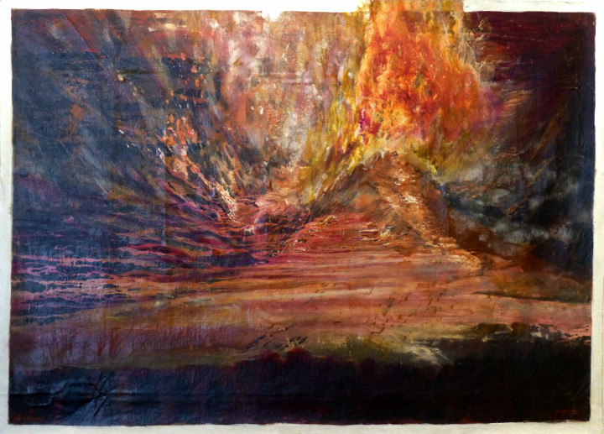

Slide 4
Revelation Recap

Slide 5
• Written by John, to encourage the persecuted Church and future generations of Christians

Slide 6
• Written to remind and reveal God’s character, purposes, and plans for redemption, restoration, and justice.

Slide 7
• Dense with prophetic language (symbols and images, similes, hyperbole, wordplay, creative math, layered meanings, and mixed metaphors)

Slide 8
• Filled with references from all across the Bible, and the ancient world (think ‘easter eggs’ from scripture and past culture)

Slide 10
The False Trinity and their ‘mark’
(Revelation 13)

Slide 11
1 Then I saw a beast coming up out of the sea. It had ten horns and seven heads, and on its horns were ten diadem crowns, and on its heads a blasphemous name.

Slide 12
2 Now the beast that I saw was like a leopard, but its feet were like a bear’s, and its mouth was like a lion’s mouth.

Slide 13
The dragon gave the beast his power, his throne, and great authority to rule.

Slide 14
3 One of the beast’s heads appeared to have been killed, but the lethal wound had been healed. And the whole world followed the beast in amazement;

Slide 15
4 they worshiped the dragon because he had given ruling authority to the beast, and they worshiped the beast too, saying:

Slide 16
“Who is like the beast?” and “Who is able to make war against him?”

Slide 17
5 The beast was given a mouth speaking proud words and blasphemies, and he was permitted to exercise ruling authority for forty-two months.

Slide 18
6 So the beast opened his mouth to blaspheme against God—to blaspheme both his name and his dwelling place, that is, those who dwell in heaven.

Slide 19
7 The beast was permitted to go to war against the saints and conquer them.

Slide 20
He was given ruling authority over every tribe, people, language, and nation, 8 and all those who live on the earth will worship the beast,

Slide 21
everyone whose name has not been written since the foundation of the world in the book of life belonging to the Lamb who was killed.

Slide 22
9 If anyone has an ear, he had better listen!

Slide 23
10 If anyone is meant for captivity,
into captivity he will go.

Slide 24
If anyone is to be killed by the sword,
then by the sword he must be killed.

Slide 25
This requires steadfast endurance and faith from the saints.

Slide 26
11 Then I saw another beast coming up from the earth. He had two horns like a lamb, but was speaking like a dragon.

Slide 27
12 He exercised all the ruling authority of the first beast on his behalf,

Slide 28
and made the earth and those who inhabit it worship the first beast, the one whose lethal wound had been healed.

Slide 29
13 He performed momentous signs, even making fire come down from heaven to earth in front of people

Slide 30
14 and, by the signs he was permitted to perform on behalf of the beast, he deceived those who live on the earth.

Slide 31
He told those who live on the earth to make an image to the beast who had been wounded by the sword, but still lived.

Slide 32
15 The second beast was empowered to give life to the image of the first beast so that it could speak,

Slide 33
and could cause all those who did not worship the image of the beast to be killed.

Slide 34
16 He also caused everyone (small and great, rich and poor, free and slave) to obtain a mark on their right hand or on their forehead.

Slide 35
17 Thus no one was allowed to buy or sell things unless he bore the mark of the beast—that is, his name or his number.

Slide 36
18 This calls for wisdom: Let the one who has insight calculate the beast’s number, for it is man’s number, and his number is 666.

Slide 38
The Beast from the Sea
(Revelation 13:1-10)

Slide 39
1 Then I saw a beast coming up out of the sea. It had ten horns and seven heads, and on its horns were ten diadem crowns, and on its heads a blasphemous name.

Slide 40
2 Now the beast that I saw was like a leopard, but its feet were like a bear’s, and its mouth was like a lion’s mouth.

Slide 41
The dragon gave the beast his power, his throne, and great authority to rule.

Slide 42
3 One of the beast’s heads appeared to have been killed, but the lethal wound had been healed. And the whole world followed the beast in amazement;

Slide 43
4 they worshiped the dragon because he had given ruling authority to the beast, and they worshiped the beast too, saying:

Slide 44
“Who is like the beast?” and “Who is able to make war against him?”

Slide 45
5 The beast was given a mouth speaking proud words and blasphemies, and he was permitted to exercise ruling authority for forty-two months.

Slide 46
6 So the beast opened his mouth to blaspheme against God—to blaspheme both his name and his dwelling place, that is, those who dwell in heaven.

Slide 47
7 The beast was permitted to go to war against the saints and conquer them.

Slide 48
He was given ruling authority over every tribe, people, language, and nation, 8 and all those who live on the earth will worship the beast,

Slide 49
everyone whose name has not been written since the foundation of the world in the book of life belonging to the Lamb who was killed.

Slide 50
9 If anyone has an ear, he had better listen!

Slide 51
10 If anyone is meant for captivity,
into captivity he will go.

Slide 52
If anyone is to be killed by the sword,
then by the sword he must be killed.

Slide 53
This requires steadfast endurance and faith from the saints.

Slide 55
Has the LORD called you
to suffer alongside Him?

Slide 56
The Beast of the Earth
(Revelation 13:11-18)

Slide 57
11 Then I saw another beast coming up from the earth. He had two horns like a lamb, but was speaking like a dragon.

Slide 58
12 He exercised all the ruling authority of the first beast on his behalf,

Slide 59
and made the earth and those who inhabit it worship the first beast, the one whose lethal wound had been healed.

Slide 60
13 He performed momentous signs, even making fire come down from heaven to earth in front of people

Slide 61
14 and, by the signs he was permitted to perform on behalf of the beast, he deceived those who live on the earth.

Slide 62
He told those who live on the earth to make an image to the beast who had been wounded by the sword, but still lived.

Slide 63
15 The second beast was empowered to give life to the image of the first beast so that it could speak,

Slide 64
and could cause all those who did not worship the image of the beast to be killed.

Slide 65
16 He also caused everyone (small and great, rich and poor, free and slave) to obtain a mark on their right hand or on their forehead.

Slide 66
17 Thus no one was allowed to buy or sell things unless he bore the mark of the beast—that is, his name or his number.

Slide 67
18 This calls for wisdom: Let the one who has insight calculate the beast’s number, for it is man’s number, and his number is 666.

Slide 69
Which “kind of mark”
has worship imprinted on your life?

Slide 71
