Slide 2
The Seven Trumpets of judgement
(Revelation ch 8-11)

Slide 3
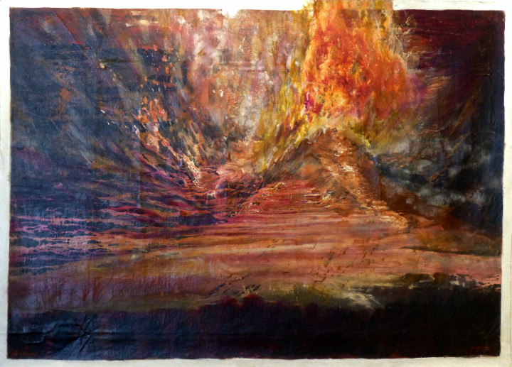

Slide 4
Revelation Recap

Slide 5
• Written by John, to encourage the persecuted Church and future generations of Christians

Slide 6
• Written to remind and reveal God’s character, purposes, and plans for redemption, restoration, and justice.

Slide 7
• Dense with prophetic language (symbols and images, similes, hyperbole, wordplay, creative math, layered meanings, and mixed metaphors)

Slide 8
• Filled with references from all across the Bible, and the ancient world (think ‘easter eggs’ from scripture and past culture)

Slide 10
The Seven Trumpets of judgement
(Revelation ch 8-11)

Slide 11
Part 3
(Revelation 10:1-11)

Slide 12
1 Then I saw another powerful angel descending from heaven, wrapped in a cloud, with a rainbow above his head; his face was like the sun, and his legs were like pillars of fire.

Slide 13
2 He held in his hand a little scroll that was open, and he put his right foot on the sea and his left on the land.

Slide 14
3 Then he shouted in a loud voice like a lion roaring, and when he shouted, the seven thunders sounded their voices.

Slide 15
4 When the seven thunders spoke, I was preparing to write, but just then I heard a voice from heaven say,

Slide 16
“Seal up what the seven thunders spoke and do not write it down.”

Slide 17
5 Then the angel I saw standing on the sea and on the land raised his right hand to heaven 6 and swore by the one who lives forever and ever,

Slide 18
“There will be no more delay! 7 But in the days when the seventh angel is about to blow his trumpet,

Slide 19
the mystery of God is completed, just as he has proclaimed to his servants the prophets.”

Slide 20
8 Then the voice I had heard from heaven began to speak to me again,

Slide 21
“Go and take the open scroll in the hand of the angel who is standing on the sea and on the land.”

Slide 22
9 So I went to the angel and asked him to give me the little scroll. He said to me,

Slide 23
“Take the scroll and eat it. It will make your stomach bitter, but it will be as sweet as honey in your mouth.”

Slide 24
10 So I took the little scroll from the angel’s hand and ate it, and it did taste as sweet as honey in my mouth, but when I had eaten it, my stomach became bitter.

Slide 25
11 Then they told me:
“You must prophesy again about many peoples, nations, languages, and kings.”

Slide 27
The Angel with the Little Scroll
(Revelation 10:1-7)

Slide 28
1 Then I saw another powerful angel descending from heaven, wrapped in a cloud, with a rainbow above his head; his face was like the sun, and his legs were like pillars of fire.

Slide 29
2 He held in his hand a little scroll that was open, and he put his right foot on the sea and his left on the land.

Slide 30
3 Then he shouted in a loud voice like a lion roaring, and when he shouted, the seven thunders sounded their voices.

Slide 31
4 When the seven thunders spoke, I was preparing to write, but just then I heard a voice from heaven say,

Slide 32
“Seal up what the seven thunders spoke and do not write it down.”

Slide 33
5 Then the angel I saw standing on the sea and on the land raised his right hand to heaven 6 and swore by the one who lives forever and ever,

Slide 34
“There will be no more delay! 7 But in the days when the seventh angel is about to blow his trumpet,

Slide 35
the mystery of God is completed, just as he has proclaimed to his servants the prophets.”

Slide 37
Are you ready for
God to reveal Himself?

Slide 38
The Bittersweet Message
(Revelation 10:8-11)

Slide 39
8 Then the voice I had heard from heaven began to speak to me again,

Slide 40
“Go and take the open scroll in the hand of the angel who is standing on the sea and on the land.”

Slide 41
9 So I went to the angel and asked him to give me the little scroll. He said to me,

Slide 42
“Take the scroll and eat it. It will make your stomach bitter, but it will be as sweet as honey in your mouth.”

Slide 43
10 So I took the little scroll from the angel’s hand and ate it, and it did taste as sweet as honey in my mouth, but when I had eaten it, my stomach became bitter.

Slide 44
11 Then they told me:
“You must prophesy again about many peoples, nations, languages, and kings.”

Slide 46
What does it mean
to submit to God?

Slide 47
