Slide 2
The Seven Trumpets of judgement
(Revelation ch 8-11)

Slide 3
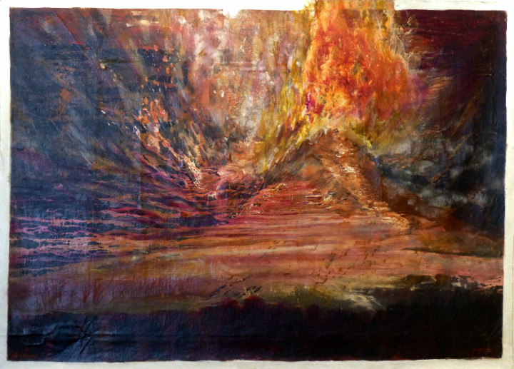

Slide 4
Revelation Recap

Slide 5
• Written by John, to encourage the persecuted Church and future generations of Christians

Slide 6
• Written to remind and reveal God’s character, purposes, and plans for redemption, restoration, and justice.

Slide 7
• Dense with prophetic language (symbols and images, similes, hyperbole, wordplay, creative math, layered meanings, and mixed metaphors)

Slide 8
• Filled with references from all across the Bible, and the ancient world (think ‘easter eggs’ from scripture and past culture)

Slide 10
The Seven Trumpets of judgement
(Revelation ch 8-11)

Slide 11
Part 2
(Revelation 9:1-21)

Slide 12
1 Then the fifth angel blew his trumpet, and I saw a star that had fallen from the sky to the earth, and he was given the key to the shaft of the abyss.

Slide 13
2 He opened the shaft of the abyss and smoke rose out of it like smoke from a giant furnace. The sun and the air were darkened with smoke from the shaft.

Slide 14
3 Then out of the smoke came locusts onto the earth, and they were given power like that of the scorpions of the earth.

Slide 15
4 They were told not to damage the grass of the earth, or any green plant or tree, but only those people who did not have the seal of God on their forehead.

Slide 16
5 The locusts were not given permission to kill them, but only to torture them for five months, and their torture was like that of a scorpion when it stings a person.

Slide 17
6 In those days people will seek death, but will not be able to find it; they will long to die, but death will flee from them.

Slide 18
7 Now the locusts looked like horses equipped for battle. On their heads were something like crowns similar to gold, and their faces looked like men’s faces.

Slide 19
8 They had hair like women’s hair, and their teeth were like lions’ teeth. 9 They had breastplates like iron breastplates, and the sound of their wings

Slide 20
was like the noise of many horse-drawn chariots charging into battle. 10 They have tails and stingers like scorpions, and their ability to injure people for five months is in their tails.

Slide 21
11 They have as king over them the angel of the abyss, whose name in Hebrew is Abaddon, and in Greek, Apollyon.

Slide 22
12 The first woe has passed, but two woes are still coming after these things!

Slide 23
13 Then the sixth angel blew his trumpet, and I heard a single voice coming from the horns on the golden altar that is before God,

Slide 24
14 saying to the sixth angel, the one holding the trumpet, “Set free the four angels who are bound at the great river Euphrates!”

Slide 25
15 Then the four angels who had been prepared for this hour, day, month, and year were set free to kill a third of humanity.

Slide 26
16 The number of soldiers on horseback was 200,000,000; I heard their number.

Slide 27
17 Now this is what the horses and their riders looked like in my vision: The riders had breastplates that were fiery red, dark blue, and sulfurous yellow in color.

Slide 28
18 A third of humanity was killed by these three plagues, that is, by the fire, the smoke, and the sulfur that came out of their mouths.

Slide 29
19 For the power of the horses resides in their mouths and in their tails because their tails are like snakes, having heads that inflict injuries.

Slide 30
20 The rest of humanity, who had not been killed by these plagues, did not repent of the works of their hands so that they did not stop worshiping demons

Slide 31
and idols made of gold, silver, bronze, stone, and wood—idols that cannot see or hear or walk about.

Slide 32
21 Furthermore, they did not repent of their murders, of their magic spells, of their sexual immorality, or of their stealing.

Slide 34
The Fifth Trumpet:
Hell on Earth
(Revelation 9:1-12)

Slide 35
1 Then the fifth angel blew his trumpet, and I saw a star that had fallen from the sky to the earth, and he was given the key to the shaft of the abyss.

Slide 36
2 He opened the shaft of the abyss and smoke rose out of it like smoke from a giant furnace. The sun and the air were darkened with smoke from the shaft.

Slide 37
3 Then out of the smoke came locusts onto the earth, and they were given power like that of the scorpions of the earth.

Slide 38
4 They were told not to damage the grass of the earth, or any green plant or tree, but only those people who did not have the seal of God on their forehead.

Slide 39
5 The locusts were not given permission to kill them, but only to torture them for five months, and their torture was like that of a scorpion when it stings a person.

Slide 40
6 In those days people will seek death, but will not be able to find it; they will long to die, but death will flee from them.

Slide 41
7 Now the locusts looked like horses equipped for battle. On their heads were something like crowns similar to gold, and their faces looked like men’s faces.

Slide 42
8 They had hair like women’s hair, and their teeth were like lions’ teeth. 9 They had breastplates like iron breastplates, and the sound of their wings

Slide 43
was like the noise of many horse-drawn chariots charging into battle. 10 They have tails and stingers like scorpions, and their ability to injure people for five months is in their tails.

Slide 44
11 They have as king over them the angel of the abyss, whose name in Hebrew is Abaddon, and in Greek, Apollyon.

Slide 45
12 The first woe has passed, but two woes are still coming after these things!

Slide 47
What is your attitude
towards sin?

Slide 48
The Sixth Trumpet:
Demonic Culture Judged
(Revelation 9:13-21)

Slide 49
13 Then the sixth angel blew his trumpet, and I heard a single voice coming from the horns on the golden altar that is before God,

Slide 50
14 saying to the sixth angel, the one holding the trumpet, “Set free the four angels who are bound at the great river Euphrates!”

Slide 51
15 Then the four angels who had been prepared for this hour, day, month, and year were set free to kill a third of humanity.

Slide 52
16 The number of soldiers on horseback was 200,000,000; I heard their number.

Slide 53
17 Now this is what the horses and their riders looked like in my vision: The riders had breastplates that were fiery red, dark blue, and sulfurous yellow in color.

Slide 54
18 A third of humanity was killed by these three plagues, that is, by the fire, the smoke, and the sulfur that came out of their mouths.

Slide 55
19 For the power of the horses resides in their mouths and in their tails because their tails are like snakes, having heads that inflict injuries.

Slide 56
20 The rest of humanity, who had not been killed by these plagues, did not repent of the works of their hands so that they did not stop worshiping demons

Slide 57
and idols made of gold, silver, bronze, stone, and wood—idols that cannot see or hear or walk about.

Slide 58
21 Furthermore, they did not repent of their murders, of their magic spells, of their sexual immorality, or of their stealing.

Slide 60
What is your
‘repentance sensativity’ level?

Slide 61
