Slide 2
The Seven Trumpets of judgement
(Revelation ch 8-11)

Slide 3
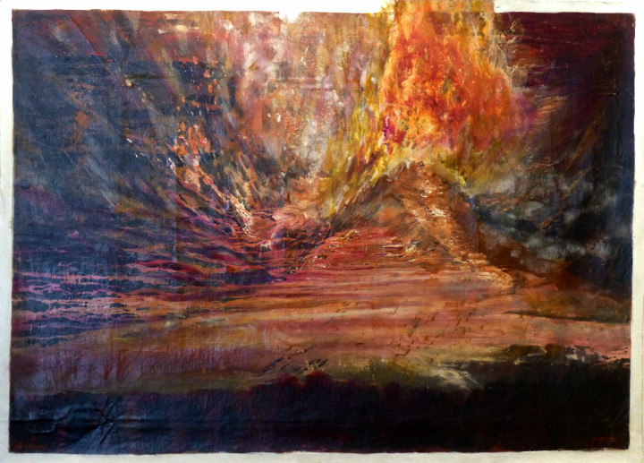

Slide 4
Revelation Recap

Slide 5
• Written by John, to encourage the persecuted Church and future generations of Christians

Slide 6
• Written to remind and reveal God’s character, purposes, and plans for redemption, restoration, and justice.

Slide 7
• Dense with prophetic language (symbols and images, similes, hyperbole, wordplay, creative math, layered meanings, and mixed metaphors)

Slide 8
• Filled with references from all across the Bible, and the ancient world (think ‘easter eggs’ from scripture and past culture)

Slide 10
The Seven Trumpets of judgement
(Revelation ch 8-11)

Slide 11
Part 1
(Revelation 8:1-13)

Slide 12
8:1 Now when the Lamb opened the seventh seal there was silence in heaven for about half an hour.

Slide 13
2 Then I saw the seven angels who stand before God, and seven trumpets were given to them. 3 Another angel holding a golden censer came and was stationed at the altar.

Slide 14
A large amount of incense was given to him to offer up, with the prayers of all the saints, on the golden altar that is before the throne.

Slide 15
4 The smoke coming from the incense, along with the prayers of the saints, ascended before God from the angel’s hand.

Slide 16
5 Then the angel took the censer, filled it with fire from the altar, and threw it on the earth, and there were crashes of thunder, roaring, flashes of lightning, and an earthquake.

Slide 17
6 Now the seven angels holding the seven trumpets prepared to blow them. 7 The first angel blew his trumpet, and there was hail and fire mixed with blood,

Slide 18
and it was thrown at the earth so that a third of the earth was burned up, a third of the trees were burned up, and all the green grass was burned up.

Slide 19
8 Then the second angel blew his trumpet, and something like a great mountain of burning fire was thrown into the sea. A third of the sea became blood, destroyed.

Slide 20
9 and a third of the creatures living in the sea died, and a third of the ships were completely destroyed.

Slide 21
10 Then the third angel blew his trumpet, and a huge star burning like a torch fell from the sky; it landed on a third of the rivers and on the springs of water.

Slide 22
11 (Now the name of the star is Wormwood.) So a third of the waters became wormwood, and many people died from these waters because they were poisoned.

Slide 23
12 Then the fourth angel blew his trumpet, and a third of the sun was struck, and a third of the moon, and a third of the stars, so that a third of them were darkened.

Slide 24
And there was no light for a third of the day and for a third of the night likewise.

Slide 25
13 Then I looked, and I heard an eagle flying directly overhead, proclaiming with a loud voice, “Woe! Woe! Woe to those who live on the earth

Slide 26
because of the remaining sounds of the trumpets of the three angels who are about to blow them!”

Slide 28
The Opening of the Seventh Seal
(Revelation 8:1-5)

Slide 29
8:1 Now when the Lamb opened the seventh seal there was silence in heaven for about half an hour.

Slide 30
2 Then I saw the seven angels who stand before God, and seven trumpets were given to them. 3 Another angel holding a golden censer came and was stationed at the altar.

Slide 31
A large amount of incense was given to him to offer up, with the prayers of all the saints, on the golden altar that is before the throne.

Slide 32
4 The smoke coming from the incense, along with the prayers of the saints, ascended before God from the angel’s hand.

Slide 33
5 Then the angel took the censer, filled it with fire from the altar, and threw it on the earth, and there were crashes of thunder, roaring, flashes of lightning, and an earthquake.

Slide 35
Do you view prayer as a gift from God,
or as a gift to God?

Slide 36
The First Four Trumpets
(Revelation 8:6-12)

Slide 37
6 Now the seven angels holding the seven trumpets prepared to blow them. 7 The first angel blew his trumpet, and there was hail and fire mixed with blood,

Slide 38
and it was thrown at the earth so that a third of the earth was burned up, a third of the trees were burned up, and all the green grass was burned up.

Slide 39
8 Then the second angel blew his trumpet, and something like a great mountain of burning fire was thrown into the sea. A third of the sea became blood, destroyed.

Slide 40
9 and a third of the creatures living in the sea died, and a third of the ships were completely destroyed.

Slide 41
10 Then the third angel blew his trumpet, and a huge star burning like a torch fell from the sky; it landed on a third of the rivers and on the springs of water.

Slide 42
11 (Now the name of the star is Wormwood.) So a third of the waters became wormwood, and many people died from these waters because they were poisoned.

Slide 43
12 Then the fourth angel blew his trumpet, and a third of the sun was struck, and a third of the moon, and a third of the stars, so that a third of them were darkened.

Slide 44
And there was no light for a third of the day and for a third of the night likewise.

Slide 46
What things do you wish
God would rectify or remove?

Slide 47
The Woe to Come
(Revelation 8:13)

Slide 48
13 Then I looked, and I heard an eagle flying directly overhead, proclaiming with a loud voice,

Slide 49
“Woe! Woe! Woe to those who live on the earth

Slide 50
because of the remaining sounds of the trumpets of the three angels who are about to blow them!”

Slide 52
What would more of God
in your life look like?

Slide 53
