Slide 1
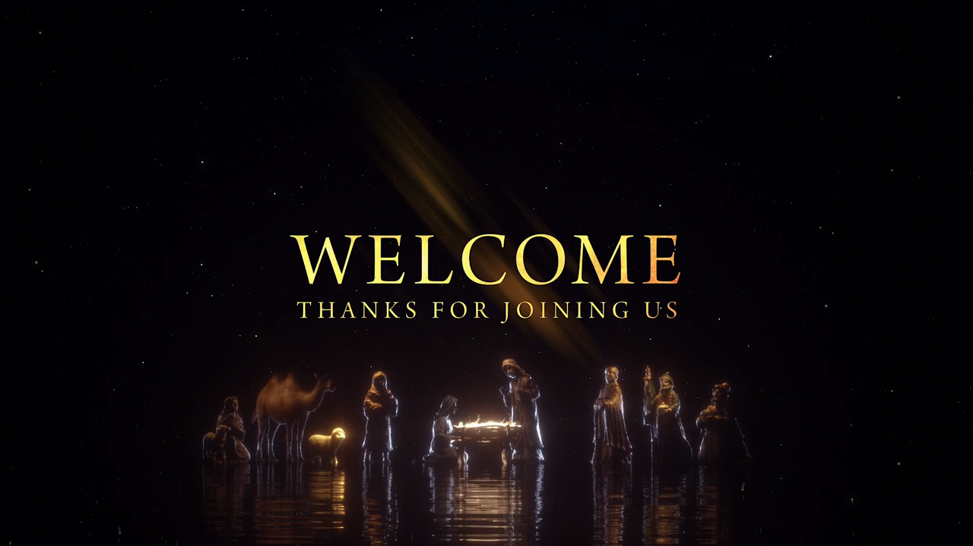

Slide 2

Good Good Father

Slide 3
I've heard a thousand stories
Of what they think Your like

Slide 4
But I've heard the tender whisper Of love in the dead of night

Slide 5
You tell me that Your pleased and That I'm never alone

Slide 6
You're a good, good father
It's who You are
It's who You are
It's who You are

Slide 7
And I'm loved by you
It's who I am
It's who I am
It's who I am

Slide 8
I've seen many searching for Answers far and wide

Slide 9
But I know we're all searching for Answers only you provide

Slide 10
Because You know just what we Need before we say a word

Slide 11
You're a good, good father
It's who You are
It's who You are
It's who You are

Slide 12
And I'm loved by you
It's who I am
It's who I am
It's who I am

Slide 13
You are perfect in all
of your ways
You are perfect in all
of your ways
You are perfect in all
Of your ways to us

Slide 14
You're a good, good father
It's who You are
It's who You are
It's who You are

Slide 15
And I'm loved by you
It's who I am
It's who I am
It's who I am

Slide 16
Love so undeniable
I can hardly speak
Peace so unexplainable
I can hardly think

Slide 17
As You call me deeper still
As You call me deeper still
As You call me deeper still
Into love love love

Slide 18
You're a good, good father
It's who You are
It's who You are
It's who You are

Slide 19
And I'm loved by you
It's who I am
It's who I am
It's who I am

Slide 21
Great is Thy Faithfulness

Slide 22
Great is Thy faithfulness
O God my Father
There is no shadow of
Turning with Thee

Slide 23
Thou changest not Thy compassions
They fail not
As Thou hast been
Thou forever wilt be

Slide 24
Great is Thy faithfulness!
Great is Thy faithfulness!
Morning by morning
New mercies I see

Slide 25
All I have needed
Thy hand hath provided
Great is Thy faithfulness
Lord unto me

Slide 26
Summer and winter
And springtime and harvest
Sun, moon and stars
In their courses above

Slide 27
Join with all nature
In manifold witness
To Thy great faithfulness
Mercy and love

Slide 28
Great is Thy faithfulness!
Great is Thy faithfulness!
Morning by morning
New mercies I see

Slide 29
All I have needed
Thy hand hath provided
Great is Thy faithfulness
Lord unto me

Slide 30
Pardon for sin
And a peace that endureth
Thy own dear presence
To cheer and to guide

Slide 31
Strength for today
And bright hope for tomorrow
Blessings all mine
With ten thousand beside

Slide 32
Great is Thy faithfulness!
Great is Thy faithfulness!
Morning by morning
New mercies I see

Slide 33
All I have needed
Thy hand hath provided
Great is Thy faithfulness
Lord unto me

Slide 35
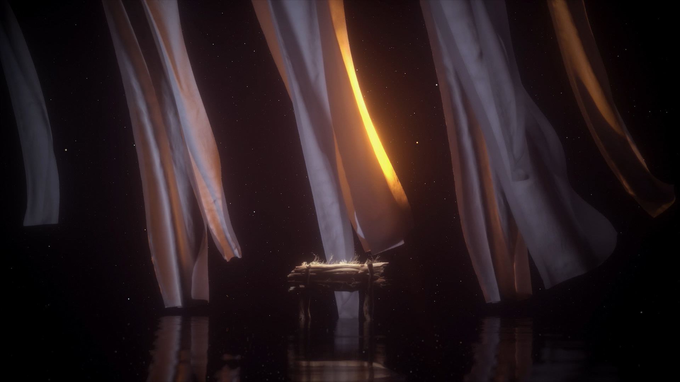
Greetings and family matters

Slide 36
Tithes and offerings

Slide 37
God of Wonders

Slide 38
Lord of all creation
Of water earth and sky
The heavens are Your Tabernacle
Glory to the Lord on high

Slide 39
God of wonders
beyond our galaxy
You are Holy, Holy
The universe declares
Your Majesty
And You are Holy, Holy

Slide 40
Lord of Heaven and Earth
Lord of Heaven and Earth

Slide 41
Early in the morning
I will celebrate the light
When I stumble in the darkness
I will call Your name by night

Slide 42
God of wonders
beyond our galaxy
You are Holy, Holy
The universe declares
Your Majesty
And You are Holy, Holy

Slide 43
Lord of Heaven and Earth
Lord of Heaven and Earth

Slide 44
Hallelujah
To the Lord of Heaven and Earth

Slide 45
Hallelujah
To the Lord of Heaven and Earth

Slide 46
Hallelujah
To the Lord of Heaven and Earth

Slide 47
God of wonders
beyond our galaxy
You are Holy, Holy

Slide 48
Precious Lord
Reveal Your heart to me
Father holy, Father holy

Slide 49
The universe declares
Your majesty
You are Holy, Holy
You are Holy, Holy

Slide 51
The Heart of Worship

Slide 52
When the music fades
All is stripped away
And I simply come

Slide 53
Longing just to bring
Something that's of worth
That will bless your heart

Slide 54
I'll bring you more than a song
For a song in itself
Is not what you have required

Slide 55
You search much deeper within
Through the way things appear
You're looking into my heart

Slide 56
I'm coming back to
The heart of worship
And it's all about you,
It's all about you, Jesus

Slide 57
I'm sorry, Lord
For the thing I've made it
When it's all about you
It's all about you, Jesus

Slide 58
King of endless worth
No one could express
How much you deserve

Slide 59
Though I'm weak and poor
All I have is yours
Every single breath

Slide 60
I'll bring you more than a song
For a song in itself
Is not what you have required

Slide 61
You search much deeper within
Through the way things appear
You're looking into my heart

Slide 62
I'm coming back to
The heart of worship
And it's all about you,
It's all about you, Jesus

Slide 63
I'm sorry, Lord
For the thing I've made it
When it's all about you
It's all about you, Jesus

Slide 64
I'm coming back to
The heart of worship
And it's all about you,
It's all about you, Jesus

Slide 65
I'm sorry, Lord
For the thing I've made it
When it's all about you
It's all about you, Jesus

Slide 67
Reading of the spalm

Slide 68
  Christian—
  A Different Life!

Slide 69
  Would you want people to follow your example in life?

Slide 70
  You, however, have followed my teaching,…
  2 Tim. 3:10 ESV

Slide 71
  The Bible-where you get truth!

Slide 72
  Everyone did what was right in his own eyes!
  Judges 21:25b ESV

Slide 73
  …my conduct,… 2 Tim. 3:10 ESV

Slide 74
  Conduct—living out what we believe as true!

Slide 75
  …my aim in life,… 2 Tim. 3:10 ESV

Slide 76
  …do you not know that your body is a temple of the Holy Spirit within you, whom you have from God? 1 Cor. 6:19 ESV

Slide 77
  You are not your own, for you were bought with a price. So glorify God in your body. 1 Cor. 6:20 ESV

Slide 78
  …my faith,… 2 Tim. 3:10 ESV

Slide 79
  …faith comes from hearing, and hearing through the Word of Christ. Rom. 10:17 ESV

Slide 80
  …my patience, my love, my steadfastness, 2 Tim. 3:10 ESV

Slide 81
  my persecutions and sufferings that happened to me at Antioch, at Iconium, and at Lystra—which persecutions I endured; yet from them all the Lord rescued me. 2 Tim. 3:11 ESV

Slide 82
  Indeed, all who desire to live a godly life in Christ Jesus will be persecuted, 2 Tim. 3:12 ESV

Slide 83
  If you were of the world, the world would love you as its own; but because you are not of the world, but I chose you out of the world, therefore the world hates you.
  John 15:19 ESV

Slide 84
  while evil people and imposters will go on from bad to worse, deceiving and being deceived.
  2 Tim. 3:12 ESV

Slide 85
  But as for you, continue in what you have learned and have firmly believed, knowing from whom you have learned it.
  2 Tim. 3:14 ESV

Slide 86
  and how from childhood you have been acquainted with the sacred writings, which are able to make you wise for salvation through faith in Christ Jesus.
  2 Tim. 3:15 ESV

Slide 87
  All Scripture is breathed out by God …
  2 Tim. 3:16 ESV

Slide 88
  Hebrews 4:12

Slide 89
  All Scripture is breathed out by God and profitable for teaching, for reproof, for correction, and for training in righteousness,
  2 Tim. 3:16 ESV

Slide 90
  that the man of God may be complete, equipped for every good work.
  2 Tim. 3:17 ESV

Slide 91
  As Christians, we have been called to live in stark contrast to the world!

Slide 92
  May we glorify the Lord
  As we walk in this life!

Slide 94
This is Amazing Grace

Slide 95
Who breaks the power
Of sin and darkness
Whose love is mighty
And so much stronger

Slide 96
The King of Glory
The King above all kings

Slide 97
Who shakes the whole earth
With holy thunder
And leaves us breathless
In awe and wonder

Slide 98
The King of Glory
The King above all kings

Slide 99
This is amazing grace
This is unfailing love
That You would take my place
That You would bear my cross

Slide 100
You lay down Your life
That I would be set free
Oh, Jesus, I sing for
All that You've done for me

Slide 101
Who brings our chaos
Back into order
Who makes the orphan
A son and daughter

Slide 102
The King of Glory
The King of Glory

Slide 103
Who rules the nations
With truth and justice
Shines like the sun
In all of its brilliance

Slide 104
The King of Glory
The King above all kings

Slide 105
This is amazing grace
This is unfailing love
That You would take my place
That You would bear my cross

Slide 106
You lay down Your life
That I would be set free
Oh, Jesus, I sing for
All that You've done for me

Slide 107
Worthy is the Lamb
Who was slain
Worthy is the King
Who conquered the grave

Slide 108
Worthy is the Lamb
Who was slain
Worthy is the King
Who conquered the grave

Slide 109
Worthy is the Lamb
Who was slain
Worthy is the King
Who conquered the grave

Slide 110
Worthy is the Lamb
Who was slain
Worthy, worthy, worthy

Slide 111
This is amazing grace
This is unfailing love
That You would take my place
That You would bear my cross

Slide 112
You lay down Your life
That I would be set free
Oh, Jesus, I sing for
All that You've done for me

Slide 114
