Slide 1
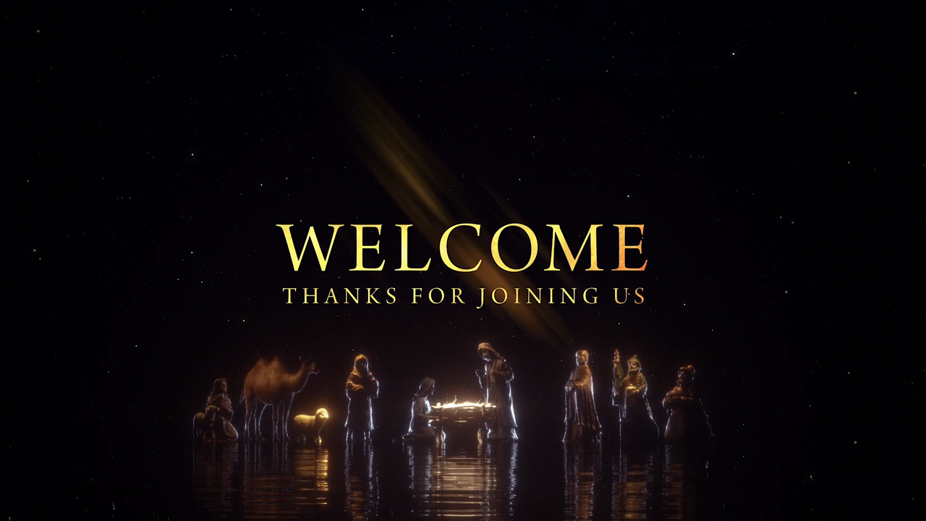

Slide 2
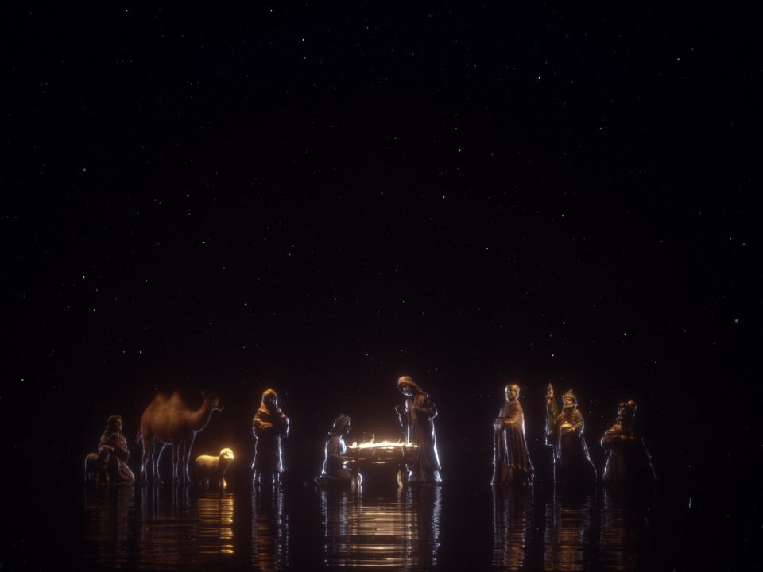
O Come O Come Emmanuel

Slide 3
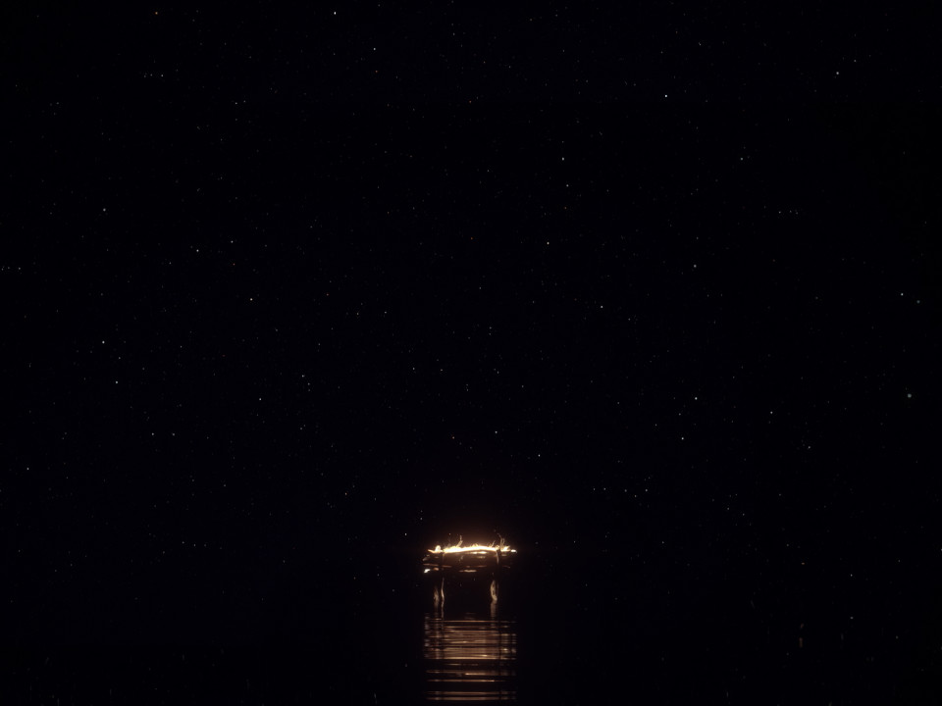
O Come, O Come, Emmanuel
And ransom captive Israel
That mourns in lonely exile here
Until de Son of God appear

Slide 4
Rejoice! Rejoice! Emmanuel
Shall come to thee, O Israel

Slide 5
O Come Thou Key of David, come
And open wide our heavenly home
Make safe the way
that leads on high
And close the path to misery

Slide 6
Rejoice! Rejoice! Emmanuel
Shall come to thee, O Israel

Slide 7
O Come, O come
Thou Lord of might
Who to Thy tribes, on Sinai’s height
In ancient times didst give the law
In cloud, and majesty and awe

Slide 8
Rejoice! Rejoice! Emmanuel
Shall come to thee, O Israel

Slide 9
O Come, O Come, Emmanuel
And ransom captive Israel
That mourns in lonely exile here
Until de Son of God appear

Slide 10
Rejoice! Rejoice! Emmanuel
Shall come to thee, O Israel

Slide 11
Rejoice! Rejoice! Emmanuel
Shall come to thee, O Israel

Slide 13
You Hold Me Now

Slide 14
On that day when I see all that You have for me When I see You face to face there surrounded by Your grace

Slide 15
All my fears swept away in the light of Your embrace
Where Your love is all I need and forever I am free

Slide 16
Where the streets are made of gold In Your presence healed and whole Let the songs of heaven rise to You alone

Slide 17
No weeping no hurt or pain
No suffering, You hold me now,
You hold me now

Slide 18
No darkness no sick or lame
No hiding, You hold me now,
You hold me now

Slide 19
In this life I will stand
Through my joy and my pain Knowing there's a greater day There's a hope that never fails

Slide 20
Where Your Name is lifted high
And forever praises rise
For the glory of Your Name
I'm believing for the day

Slide 21
Where the wars and violence cease All creation lives in peace
Let the songs of heaven rise to You alone

Slide 22
No weeping no hurt or pain
No suffering, You hold me now,
You hold me now

Slide 23
No darkness no sick or lame
No hiding, You hold me now,
You hold me now

Slide 24
For eternity
All my heart will give
All the glory to Your Name

Slide 25
No weeping no hurt or pain
No suffering, You hold me now,
You hold me now

Slide 26
No darkness no sick or lame
No hiding, You hold me now,
You hold me now

Slide 28
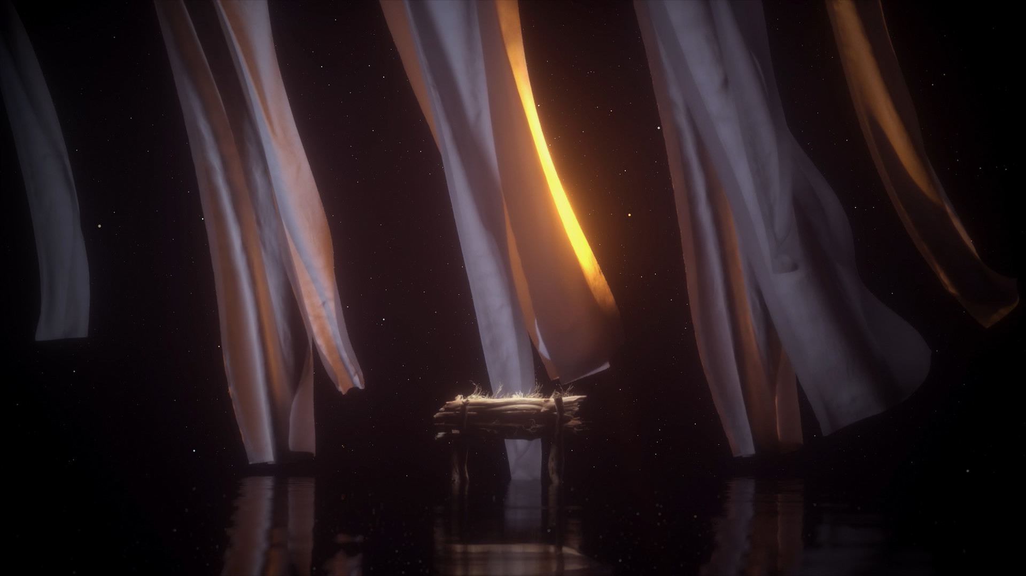
Greetings and family matters

Slide 29
Tithes and offerings

Slide 30
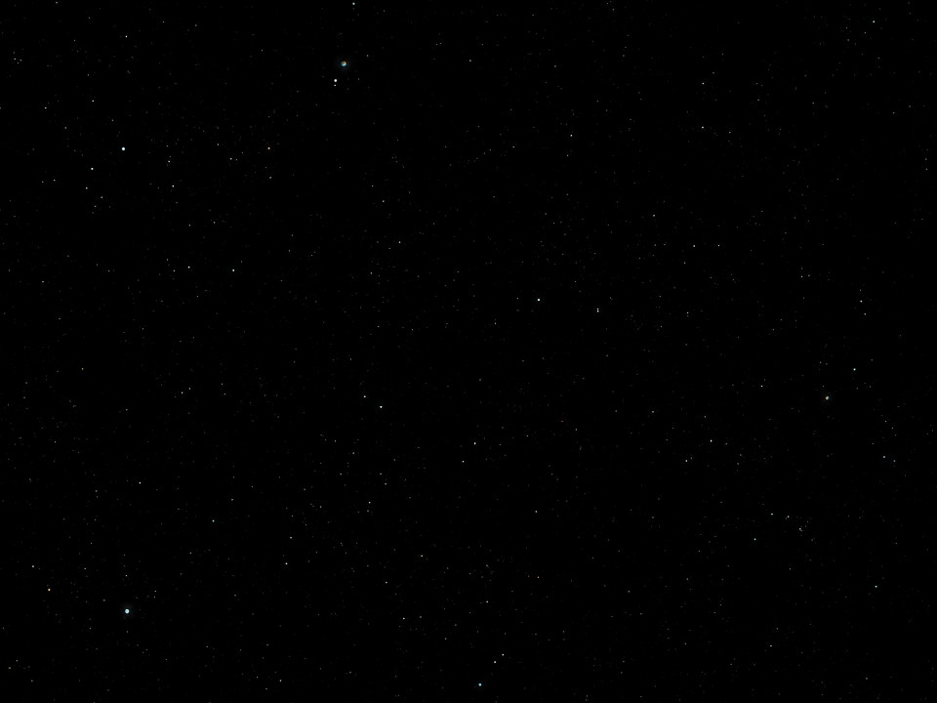
For To Us A Child Is Born

Slide 31
For to us a child is born
A Son is given
A Son is given

Slide 32
For to us a child is born
A Son is given
A Son is given
The messiah
Oh to see him…

Slide 33
…To see him high and lifted up
Shinning in
The light of your glory

Slide 34
Pour out your power and love
As we sing holy, holy, holy

Slide 35
For to us a child is born
A Son is given
A Son is given

Slide 36
For to us a child is born
A Son is given
A Son is given
The messiah
Oh to see him…

Slide 37
…To see him high and lifted up
Shinning in
The light of your glory

Slide 38
Pour out your power and love
As we sing holy, holy, holy

Slide 39
Holy, Holy, Holy

Slide 40
Holy, Holy, Holy

Slide 41
Holy, Holy, Holy

Slide 42
Holy, Holy, Holy

Slide 43
For to us a child is born
Holy, holy, holy
For to us a child is born
Holy, holy, holy

Slide 45
Goodness of God

Slide 46
I love You, Lord
For Your mercy never fails me
All my days, I've been held
In Your hands

Slide 47
From the moment that I wake up
Until I lay my head
Oh, I will sing
of the goodness of God

Slide 48
And all my life
You have been faithful
And all my life
You have been so, so good

Slide 49
With every breath that I am able
Oh, I will sing
of the goodness of God

Slide 50
I love Your voice
You have led me through the fire
In the darkest night
You are close like no other

Slide 51
I've known You as a Father
I've known You as a Friend
And I have lived
In the goodness of God

Slide 52
And all my life
You have been faithful
And all my life
You have been so, so good

Slide 53
With every breath that I am able
Oh, I will sing
of the goodness of God

Slide 54
'Cause Your goodness
Is running after
It's running after me
Your goodness is running after
It's running after me

Slide 55
With my life laid down
I'm surrendered now
I give You everything

Slide 56
'Cause Your goodness
Is running after
It's running after me

Slide 57
'Cause Your goodness
Is running after
It's running after me
Your goodness is running after
It's running after me

Slide 58
With my life laid down
I'm surrendered now
I give You everything

Slide 59
'Cause Your goodness
Is running after
It's running after me

Slide 60
And all my life
You have been faithful
And all my life
You have been so, so good

Slide 61
With every breath that I am able
Oh, I will sing
of the goodness of God

Slide 62
'Cause all my life
You have been faithful
And all my life
You have been so, so good

Slide 63
With every breath that I am able
Oh, I will sing
of the goodness of God
Oh, I will sing
of the goodness of God

Slide 65
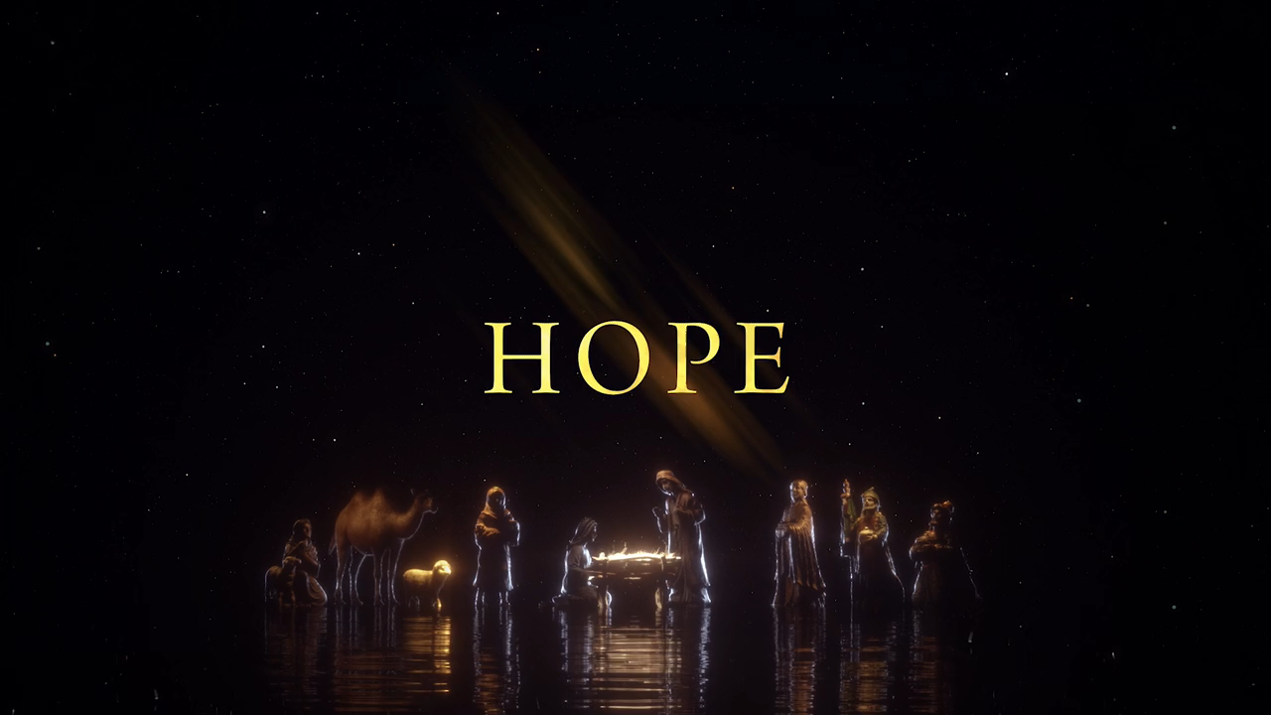

Slide 66
Our World in the Last Days!

Slide 67
  Are we in the last days?

Slide 68
  But understand this, that in the last days there will come times of difficulty. 2 Tim. 3:1 ESV

Slide 69
  …the Spirit expressly says that in later times some will depart from the faith... 1 Tim. 4:1 ESV

Slide 70
  For people will be lovers of self, 2 Tim. 3:2 ESV

Slide 71
  Self-love and Self-awareness!

Slide 72
  And they heard the sound of the Lord God walking in the garden in the cool of the day, and the man and his wife hid themselves from the presence of the Lord God among the trees of the garden. Gen. 3:8 ESV

Slide 73
  But the Lord God called to the man and said to him, “Where are you?”
  Gen. 3:9 ESV

Slide 74
  And he said, “I heard the sound of You in the garden, and I was afraid, because I was naked, and I hid myself.” Gen. 3:10 ESV

Slide 75
  He said, “Who told you that you were naked?” Gen. 3:11 ESV

Slide 76
  Adam was now self-aware, but prior, he was God-aware!

Slide 77
  Do nothing from selfish ambition or conceit, but in humility count others more significant than yourselves. Let each of you look not only to his own interests, but also the interests of others. Phil. 2:3 ESV

Slide 78
  We want to define our own lives, not God!

Slide 79
  …lovers of money, proud, arrogant, abusive, disobedient to their parents, ungrateful, unholy, heartless, unappeasable, slanderous, without self-control, brutal, not loving good,
  2 Tim. 3:2-3 ESV

Slide 80
  treacherous, reckless, swollen with conceit, lovers of pleasure rather than lovers of God,
  2 Tim. 3:4 ESV

Slide 81
  having the appearance of godliness, but denying its power. Avoid such people. 2 Tim. 3:5 ESV

Slide 82
  For among them are those who creep into households and capture weak women, burdened with sins and led astray by various passions, 2 Tim. 3:6 ESV

Slide 83
  always learning and never able to arrive at a knowledge of truth.
  2 Tim. 3:7 ESV

Slide 84
  Just as Jannes and Jambres opposed Moses, so these men also oppose the truth, men corrupted in mind and disqualified regarding the faith. 2 Tim. 3:8 ESV

Slide 85
  But they will not get very far, for their folly will be plain to all, as was that of those two men.
  2 Tim. 3:9 ESV

Slide 86
  Psalm 2

Slide 87
  Revelation 19:15-16

Slide 88
  Arise, shine, for Your light has come, and the glory of the Lord has risen upon you. Isaiah 60:1 ESV

Slide 89
  For behold, darkness shall cover the earth, and thick darkness the peoples, but the Lord will rise upon you, and His glory will be seen upon you . Isaiah 60:2 ESV

Slide 90
  In the thick darkness, the Lord shines on His people!

Slide 92
Is he worthy?

Slide 93
Do you feel the world is broken?
(We do)
Do you feel the shadows deepen?
(We do)

Slide 94
But do you know that
all the dark won't
Stop the light
from getting through?
(We do)

Slide 95
Do you wish that
you could see it all made new?
(We do)

Slide 96
is all creation groaning?
(It is)
Is a new creation coming?
(It is)

Slide 97
Is the glory of the Lord to be
the light within our midst?
(It is)
Is it good that we remind ourselves of this?
(It is)

Slide 98
Is anyone worthy?
Is anyone whole?
Is anyone able to break
the seal and open the scroll?

Slide 99
The Lion of Judah who conquered the grave
He was David's root and the Lamb who died to ransom the slave

Slide 100
Is He worthy? Is He worthy?
Of all blessing and honor and glory
Is He worthy of this?
He is

Slide 102
Does the Father truly love us?
(He does)
Does the Spirit move among us?
(He does)

Slide 103
And does Jesus, our Messiah hold forever those He loves?
(He does)
Does our God intend to dwell again with us?
(He does)

Slide 105
Is anyone worthy?
Is anyone whole?
Is anyone able to break
the seal and open the scroll?

Slide 106
The Lion of Judah who conquered the grave
He was David's root and the Lamb who died to ransom the slave

Slide 107
From every people and tribe
Every nation and tongue
He has made us a kingdom and priests to God
To reign with the Son

Slide 108
Is He worthy? Is He worthy?
Of all blessing and honor and glory
Is He worthy of this?
He is

Slide 110
