Slide 2
Our Great God

Slide 3
Eternal God, unchanging Mysterious and unknown Your boundless love unfailing In grace and mercy shown

Slide 4
Bright seraphim in endless flight Around your glorious throne They raised their voices day and night In praise to You alone

Slide 5
Hallelujah Glory be to our great God Hallelujah Glory be to our great God

Slide 6
Lord, we are weak and frail Helpless in the storm Surround us with your angels Fold us in your arms

Slide 7
Our cold and ruthless enemy His pleasure is our harm Rise up, oh Lord, and he will flee Before our Sovereign God

Slide 8
Hallelujah Glory be to our great God Hallelujah Glory be to our great God

Slide 9
Let every creature in the sea And every flying bird Let every mountain, every field And valley of the earth

Slide 10
Let all the moons and all the stars In all the universe Sing praises to the living God Who rules them by His word

Slide 11
Hallelujah Glory be to our great God Hallelujah Glory be to our great God

Slide 12
Hallelujah Glory be to our great God Hallelujah Glory be to our great God

Slide 14
How Great is Our God

Slide 15
The splendor of a King,
clothed in majesty
Let all the earth rejoice All the earth rejoice

Slide 16
He wraps himself in Light,
and darkness tries to hide
And trembles at His voice Trembles at His voice

Slide 17
How great is our God
Sing with me
How great is our God

Slide 18
And all will see how great
How great is our God

Slide 19
Age to age He stands
And time is in His hands
Beginning and the end
Beginning and the end

Slide 20
The Godhead Three in One Father, Spirit, Son
The Lion and the Lamb
The Lion and the Lamb

Slide 21
How great is our God
Sing with me
How great is our God

Slide 22
And all will see how great
How great is our God

Slide 23
Name above all names
Worthy of our praise
My heart will sing
How great is our God

Slide 24
How great is our God
Sing with me
How great is our God

Slide 25
And all will see how great
How great is our God

Slide 26
How great is our God
Sing with me
How great is our God

Slide 27
And all will see how great
How great is our God

Slide 31
Our God Saves

Slide 32
In the Name of the Father
In the Name of the Son
In the Name of the Spirit
Lord we come.

Slide 33
We’re gathered together
To lift up Your Name
To call on our Savior
To fall on Your Grace

Slide 34
In the Name of the Father
In the Name of the Son
In the Name of the Spirit
Lord we come.

Slide 35
We’re gathered together
To lift up Your Name
To call on our Savior
To fall on Your Grace

Slide 36
Hear the joyful sound
of our offering
As Your saints bow down
As your people sing

Slide 37
We will rise with you
Lifted on Your wings
And the world will see that

Slide 38
Our God Saves
Our God Saves
There is Hope
In Your Name

Slide 39
In the Name of the Father
In the Name of the Son
In the Name of the Spirit
Lord we come

Slide 40
We’re gathered together
To lift up Your Name
To call on our Savior
To fall on Your Grace

Slide 41
Hear the joyful sound
of our offering
As Your saints bow down
As your people sing

Slide 42
We will rise with you
Lifted on Your wings
And the world will see that

Slide 43
Our God Saves
Our God Saves
There is Hope
In Your Name

Slide 44
Mourning turns
To songs of praise
Our God Saves
Our God Saves

Slide 45
Hear the joyful sound
of our offering
As Your saints bow down
As your people sing

Slide 46
We will rise with you
Lifted on Your wings
And the world will see that

Slide 47
Our God Saves
Our God Saves
There is Hope
In Your Name

Slide 48
Mourning turns
To songs of praise
Our God Saves
Our God Saves

Slide 50
This I Believe

Slide 51
Our Father everlasting The all creating One God Almighty

Slide 52
Through Your Holy Spirit Conceiving Christ the Son
Jesus our Saviour

Slide 53
I believe in God our Father I believe in Christ the Son I believe in the Holy Spirit

Slide 54
Our God is three in one I believe in the resurrection That we will rise again
For I believe in the Name of Jesus

Slide 55
Our Judge and our Defender Suffered and crucified Forgiveness is in You

Slide 56
Descended into darkness You rose in glorious life Forever seated high

Slide 57
I believe in God our Father I believe in Christ the Son I believe in the Holy Spirit

Slide 58
Our God is three in one I believe in the resurrection That we will rise again
For I believe in the Name of Jesus

Slide 59
believe in You I believe You rose again I believe that Jesus Christ is Lord

Slide 60
believe in You I believe You rose again I believe that Jesus Christ is Lord

Slide 61
I believe in God our Father I believe in Christ the Son I believe in the Holy Spirit

Slide 62
Our God is three in one I believe in the resurrection That we will rise again
For I believe in the Name of Jesus

Slide 63
For I believe in the Name of Jesus
For I believe in the Name of Jesus
For I believe in the Name of Jesus

Slide 64
I believe in life eternal I believe in the virgin birth I believe in the saints' communion

Slide 65
And in Your holy Church I believe in the resurrection When Jesus comes again For I believe in the Name of Jesus

Slide 66
I believe in God our Father I believe in Christ the Son I believe in the Holy Spirit

Slide 67
Our God is three in one I believe in the resurrection That we will rise again
For I believe in the Name of Jesus

Slide 69
Psalm 46

Slide 70
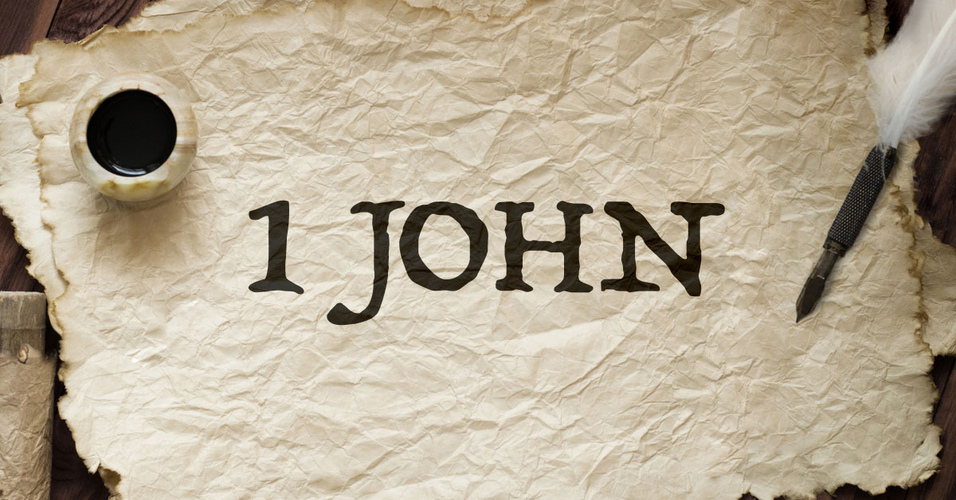

Slide 71
The Age of the Anti-Christs
(1 John 2:18-27)

Slide 72
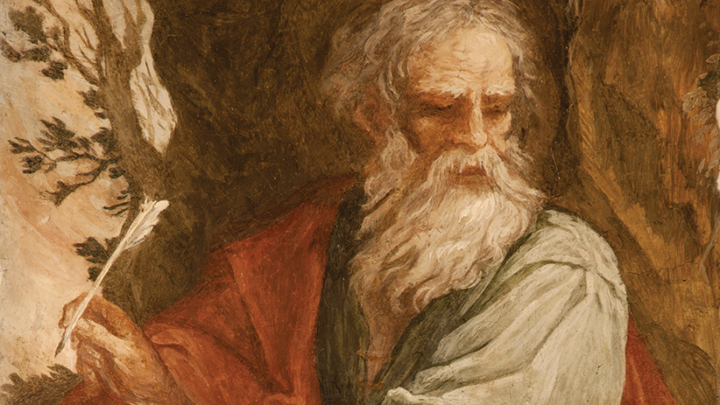

Slide 73
The letters of John the Apostle

Slide 74
Who:
written by John the Apostle in his old age, to Christians & Churches across the ancient world

Slide 75
What:
written to encourage and remind Christians about their identity and role as believers

Slide 76
How:
Written in layered prose, with language dense in ideas, and allusions to John’s original Gospel

Slide 78
The Coming of the Antichrist
(1 John 2:18-19)

Slide 79
18 Children, it is the last hour, and just as you heard

Slide 80
that the antichrist is coming, so now many antichrists have appeared.

Slide 81
We know from this that it is the last hour.

Slide 82
19 They went out from us, but they did not really belong to us

Slide 83
because if they had belonged to us, they would have remained with us.

Slide 84
But they went out from us to demonstrate that all of them do not belong to us.

Slide 86
Where are we looking
for salvation?

Slide 87
The Lies of the Antichrist
(1 John 2:20-23)

Slide 88
20 Nevertheless you have an anointing from the Holy One, and you all know.

Slide 89
21 I have not written to you that you do not know the truth,

Slide 90
but that you do know it, and that no lie is of the truth.

Slide 91
22 Who is the liar but the person who denies that Jesus is the Christ?

Slide 92
This one is the antichrist: the person who denies the Father and the Son.

Slide 93
23 Everyone who denies the Son does not have the Father either.

Slide 94
The person who confesses the Son has the Father also.

Slide 96
Are we mixing the truth of
the Gospel with other ideas?

Slide 97
The Power to Remain
(1 John 2:24-27)

Slide 98
24 As for you, what you have heard from the beginning must remain in you.

Slide 99
If what you heard from the beginning remains in you, you also will remain in the Son and in the Father.

Slide 100
25 Now this is the promise that he himself made to us: eternal life.

Slide 101
26 These things I have written to you about those who are trying to deceive you.

Slide 102
27 Now as for you, the anointing that you received from him resides in you,

Slide 103
and you have no need for anyone to teach you.

Slide 104
But as his anointing teaches you about all things, it is true and is not a lie.

Slide 105
Just as it has taught you, you reside in him.

Slide 107
Are we actively
abiding in God?

Slide 110
Build My Life

Slide 111
Worthy of every song
We could ever sing Worthy of all the praise
We could ever bring

Slide 112
Worthy of every breath
We could ever breathe We live for You

Slide 113
Jesus, the name above
Every other name Jesus, the only one
Who could ever save

Slide 114
Worthy of every breath
We could ever breathe We live for You

Slide 115
Holy, there is no one like You There is none beside You Open up my eyes in wonder

Slide 116
Show me who You are And fill me with Your heart And lead me in
Your love to those around me

Slide 117
Worthy of every song
We could ever sing Worthy of all the praise
We could ever bring

Slide 118
Worthy of every breath
We could ever breathe We live for You

Slide 119
Jesus, the name above
Every other name Jesus, the only one
Who could ever save

Slide 120
Worthy of every breath
We could ever breathe We live for You

Slide 121
Holy, there is no one like You There is none beside You Open up my eyes in wonder

Slide 122
Show me who You are And fill me with Your heart And lead me in
Your love to those around me

Slide 123
Holy, there is no one like You There is none beside You Open up my eyes in wonder

Slide 124
Show me who You are And fill me with Your heart And lead me in
Your love to those around me

Slide 125
I will build my life upon Your love It is a firm foundation I will put my trust in You alone And I will not be shaken

Slide 126
I will build my life upon Your love It is a firm foundation I will put my trust in You alone And I will not be shaken

Slide 127
Holy, there is no one like You There is none beside You Open up my eyes in wonder

Slide 128
Show me who You are And fill me with Your heart And lead me in
Your love to those around me

Slide 129
I will build my life upon Your love It is a firm foundation I will put my trust in You alone And I will not be shaken

