Slide 2
God of Wonders

Slide 3
Lord of all creation Of water earth and sky
The heavens are Your Tabernacle Glory to the Lord on high

Slide 4
God of wonders beyond our galaxy
You are Holy, Holy The universe declares Your Majesty
And You are Holy, Holy

Slide 5
Lord of Heaven and Earth
Lord of Heaven and Earth

Slide 6
Early in the morning
I will celebrate the light
When I stumble in the darkness
I will call Your name by night

Slide 7
God of wonders beyond our galaxy
You are Holy, Holy The universe declares Your Majesty
And You are Holy, Holy

Slide 8
Lord of Heaven and Earth
Lord of Heaven and Earth

Slide 9
Hallelujah
To the Lord of Heaven and Earth

Slide 10
Hallelujah
To the Lord of Heaven and Earth

Slide 11
Hallelujah
To the Lord of Heaven and Earth

Slide 12
God of wonders beyond our galaxy
You are Holy, Holy

Slide 13
Precious Lord
Reveal Your heart to me
Father holy, Father holy

Slide 14
The universe declares Your majesty
You are Holy, Holy
You are Holy, Holy

Slide 18
No Longer Slaves

Slide 19
You unravel me
With a melody You surround me with a song

Slide 20
Of deliverance
From my enemies Till all my fears have gone

Slide 21
I'm no longer a slave to fear I am a child of God

Slide 22
I'm no longer a slave to fear I am a child of God

Slide 23
From my mothers womb You have chosen me Love has called my name

Slide 24
I've been born again
Into a family Your blood flows through my veins

Slide 25
I'm no longer a slave to fear I am a child of God

Slide 26
I'm no longer a slave to fear I am a child of God

Slide 27
I'm no longer a slave to fear I am a child of God

Slide 28
I am surrounded By the arms of the father I am surrounded By songs of deliverance

Slide 29
We've been liberated From our bondage We're the sons and the daughters Let us sing our freedom

Slide 30
You split the sea So I could walk right through it My fears were drowned
In perfect love

Slide 31
You rescued me and I Stand and sing I am child of God

Slide 32
You split the sea So I could walk right through it You drowned my fears
In perfect love

Slide 33
You rescued me and I will Stand and sing I am child of God

Slide 34
I'm no longer a slave to fear I am a child of God

Slide 36
No Longer Slaves

Slide 37
I won't forget
The wonder of how You brought Deliverance, the exodus of my heart

Slide 38
'Cause You found me, You freed me Held back the waters for my release O Yahweh

Slide 39
You're the God who fights for me Lord of every victory Hallelujah Hallelujah

Slide 40
You have torn apart the sea You have led me through the deep Hallelujah Hallelujah

Slide 41
The cloud by day
Is a sign that You are with me The fire by night
Is the guiding light to my feet

Slide 42
'Cause You found me, You freed me Held back the waters for my release O Yahweh

Slide 43
You're the God who fights for me Lord of every victory Hallelujah Hallelujah

Slide 44
You have torn apart the sea You have led me through the deep Hallelujah Hallelujah

Slide 45
You stepped into my Egypt And You took me by the hand And You marched me out in freedom Into the promised land

Slide 46
And now I will not forget You, no I'll sing of all You've done Death is swallowed up forever By the fury of Your love

Slide 47
You stepped into my Egypt And You took me by the hand And You marched me out in freedom Into the promised land

Slide 48
And now I will not forget You, no I'll sing of all You've done Death is swallowed up forever By the fury of Your love

Slide 49
You're the God who fights for me Lord of every victory Hallelujah Hallelujah

Slide 50
You have torn apart the sea You have led me through the deep Hallelujah Hallelujah

Slide 52
119:129-136

Slide 54
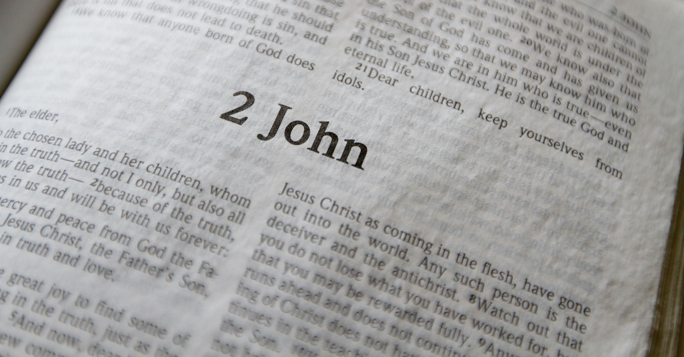

Slide 55
Walking in Truth & Love
(2 John 1:1-13)

Slide 56
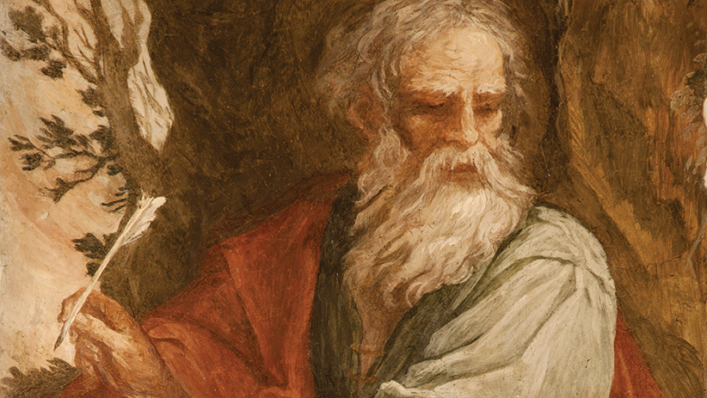

Slide 57
The letters of John the Apostle

Slide 58
Who:
written by John the Apostle in his old age, to Christians & Churches across the ancient world

Slide 59
What:
written to encourage and remind Christians about their identity and walks as believers

Slide 60
How:
Written in layered prose, with language dense in ideas, and allusions to John’s original Gospel

Slide 62
A Thankful Greeting
(2 John 1:1-3)

Slide 63
1 From the elder, to an elect lady and her children, whom I love in truth (and not I alone, but also all those who know the truth),

Slide 64
2 because of the truth that resides in us and will be with us forever.

Slide 65
3 Grace, mercy, and peace will be with us from God the Father and from Jesus Christ the Son of the Father, in truth and love.

Slide 67
Is your life filled with God’s
grace, mercy, and peace?

Slide 68
Truth and Love
(2 John 1:4-7)

Slide 69
4 I rejoiced greatly because I have found some of your children living according to the truth, just as the Father commanded us.

Slide 70
5 But now I ask you, lady (not as if I were writing a new commandment to you, but the one we have had from the beginning),

Slide 71
that we love one another.

Slide 72
6 (Now this is love: that we walk according to his commandments.)

Slide 73
This is the commandment, just as you have heard from the beginning; thus you should walk in it.

Slide 74
7 For many deceivers have gone out into the world, people who do not confess Jesus as Christ coming in the flesh. This person is the deceiver and the antichrist!

Slide 76
Are we walking in the
truth and love
of Christ?

Slide 77
A Warning About Deception
(1 John 1:8-11)

Slide 78
8 Watch out, so that you do not lose the things we have worked for, but receive a full reward.

Slide 79
9 Everyone who goes on ahead and does not remain in the teaching of Christ does not have God.

Slide 80
The one who remains in this teaching has both the Father and the Son.

Slide 81
10 If anyone comes to you and does not bring this teaching, do not receive him into your house and do not give him any greeting

Slide 82
11 because the person who gives him a greeting shares in his evil deeds.

Slide 84
Have we gone ahead of God
in our thinking or beliefs?

Slide 85
Final Greetings
(1 John 1:12-13)

Slide 86
12 Though I have many other things to write to you, I do not want to do so with paper and ink,

Slide 87
but I hope to come visit you and speak face to face so that our joy may be complete.

Slide 88
13 The children of your elect sister greet you.

Slide 90
What impact are our lives having
in the Kingdom?

Slide 93
Build My Life

Slide 94
Worthy of every song
We could ever sing Worthy of all the praise
We could ever bring

Slide 95
Worthy of every breath
We could ever breathe We live for You

Slide 96
Jesus, the name above
Every other name Jesus, the only one
Who could ever save

Slide 97
Worthy of every breath
We could ever breathe We live for You

Slide 98
Holy, there is no one like You There is none beside You Open up my eyes in wonder

Slide 99
Show me who You are And fill me with Your heart And lead me in
Your love to those around me

Slide 100
Worthy of every song
We could ever sing Worthy of all the praise
We could ever bring

Slide 101
Worthy of every breath
We could ever breathe We live for You

Slide 102
Jesus, the name above
Every other name Jesus, the only one
Who could ever save

Slide 103
Worthy of every breath
We could ever breathe We live for You

Slide 104
Holy, there is no one like You There is none beside You Open up my eyes in wonder

Slide 105
Show me who You are And fill me with Your heart And lead me in
Your love to those around me

Slide 106
Holy, there is no one like You There is none beside You Open up my eyes in wonder

Slide 107
Show me who You are And fill me with Your heart And lead me in
Your love to those around me

Slide 108
I will build my life upon Your love It is a firm foundation I will put my trust in You alone And I will not be shaken

Slide 109
I will build my life upon Your love It is a firm foundation I will put my trust in You alone And I will not be shaken

Slide 110
Holy, there is no one like You There is none beside You Open up my eyes in wonder

Slide 111
Show me who You are And fill me with Your heart And lead me in
Your love to those around me

Slide 112
I will build my life upon Your love It is a firm foundation I will put my trust in You alone And I will not be shaken

