Slide 1
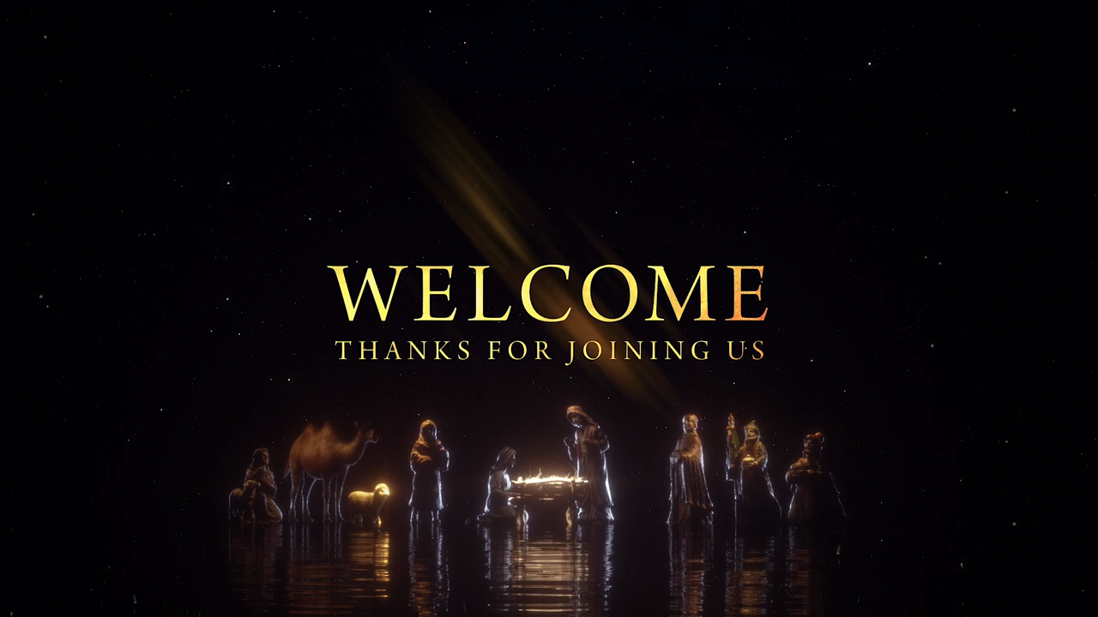

Slide 2

Hark The Herald Angels Sing
(Hymn 277)

Slide 3
Hark the herald angels sing
Glory to the newborn King
Peace on earth and mercy mild
God and sinners reconciled

Slide 4
Joyful, all ye nations rise
Join the triumph of the skies
With angelic host proclaim
Christ is born in Bethlehem

Slide 5
Hark the herald angels sing
Glory to the newborn King

Slide 6
Christ by highest heav'n adored
Christ the everlasting Lord
Late in time behold Him come
Offspring of a virgin's womb

Slide 7
Veiled in flesh, the Godhead see; hail the incarnate diety
Pleased as man with men to dwell, Jesus our Immanuel

Slide 8
Hark the herald angels sing
Glory to the newborn King

Slide 9
Hail the heav'n born
Prince of Peace
Hail the Son of Righteousness
Light and life to all He brings
Risen with healing in His wings

Slide 10
Mild He lays His glory by
Born that man no more may die
Born to raise the sons of earth
Born to give them second birth

Slide 11
Hark the herald angels sing
Glory to the newborn King

Slide 13
King of Heaven

Slide 14
Jesus, let Your kingdom come here
Let Your will be done here in us

Slide 15
Jesus, there is no one greater
You alone are Savior
Show the world Your love

Slide 16
King of heaven, come down
King of heaven, come now

Slide 17
Let Your glory reign
Shining like the day
King of heaven, come

Slide 18
King of heaven rise up
Who can stand against us

Slide 19
You are strong to save
In Your Mighty Name
King of Heaven, come

Slide 20
We are children of Your mercy
Rescued for Your glory

Slide 21
We cry Jesus
Set our hearts towards You
That every eye would see You
Lifted high

Slide 22
King of heaven, come down
King of heaven, come now

Slide 23
Let Your glory reign
Shining like the day
King of heaven, come

Slide 24
King of heaven rise up
Who can stand against us

Slide 25
You are strong to save
In Your Mighty Name
King of Heaven, come

Slide 26
King of heaven, come

Slide 27
King of heaven, come

Slide 28
King of heaven, come

Slide 29
King of heaven, come

Slide 30
King of heaven, come down
King of heaven, come now

Slide 31
Let Your glory reign
Shining like the day
King of heaven, come

Slide 32
King of heaven rise up
Who can stand against us

Slide 33
You are strong to save
In Your Mighty Name
King of Heaven, come

Slide 35
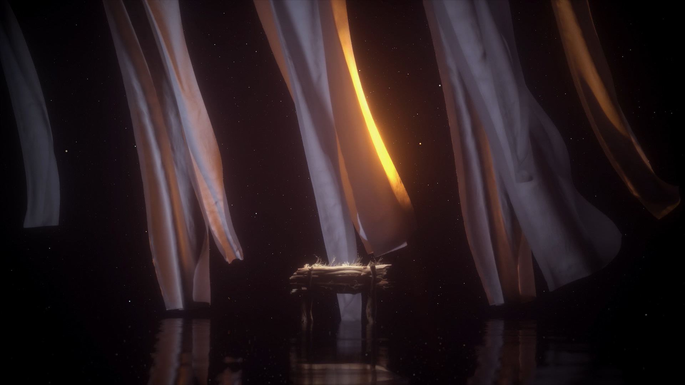
Greetings and family matters

Slide 36
Tithes and offerings

Slide 37
O Come All Ye Faithful
(Hymn 249)

Slide 38
O come all ye faithful
Joyful and triumphant
O come ye, O come ye to Bethlehem

Slide 39
Come and behold Him
Born the King of angels

Slide 40
O come let us adore Him
O come let us adore him
O come let us adore Him
Christ the Lord

Slide 41
Sing choirs of angels
Sing in exultation
Sing all ye bright hosts
Of heaven above

Slide 42
Glory to God
All glory in the highest

Slide 43
O come let us adore Him
O come let us adore him
O come let us adore Him
Christ the Lord

Slide 44
O come let us adore Him
O come let us adore him
O come let us adore Him
Christ the Lord

Slide 46
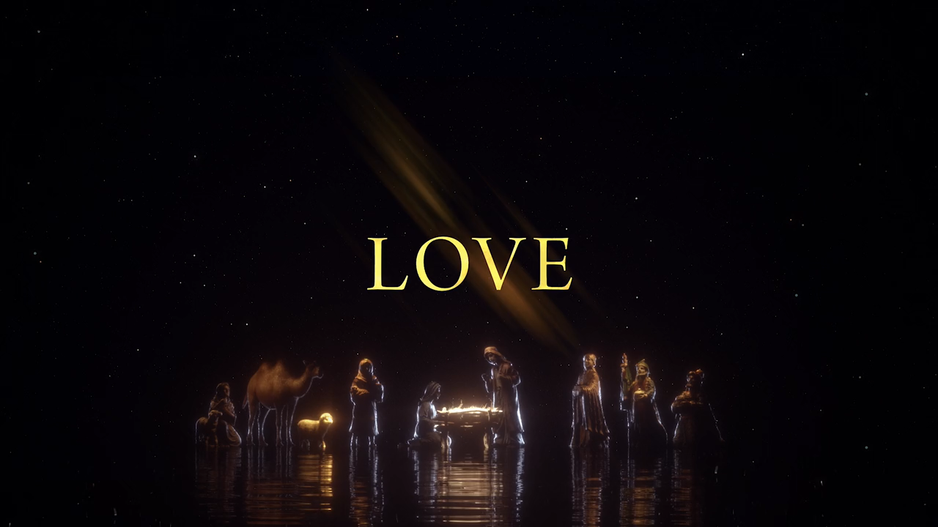

Slide 47

Holding Fast!

Slide 48
  Do you depend upon God in your life?

Slide 49
  Follow the pattern of the sound words that you have heard from me, in the faith and love that are in Christ Jesus. 2 Tim. 1:13 ESV

Slide 50
  For the time is coming when people will not endure sound teaching but have itching ears they will accumulate for themselves teachers to suit their own passions, 2 Tim. 4:3 ESV

Slide 51
  and will turn away from listening to the truth. 2 Tim. 4:4 ESV

Slide 52
  By the Holy Spirit who dwells within us, guard the good deposit entrusted to you. 2 Tim. 1:14 ESV

Slide 53
  You are aware that all who are in Asia turned away from me, among whom are Phygelus and Hermogenes. 2 Tim. 1:15 ESV

Slide 54
  May the Lord grant mercy to the household of Onesiphorus, for he refreshed me and was not ashamed of my chains, 2 Tim. 1:16 ESV

Slide 55
  …he who refreshes others will himself be refreshed. Prov. 11:25 ESV

Slide 56
  But when he arrived in Rome he searched for me earnestly and found me— 2 Tim. 1:17 ESV

Slide 57
  may the Lord grant him to find mercy from the Lord on that day! –and you well know all the service he rendered in Ephesus. 2 Tim. 1:18 ESV

Slide 58
  You then, my child, be strengthened by the grace that is in Christ Jesus, and what you have heard from me in the presence of many witnesses entrust to faithful men, who will be able to teach others also. 2 Tim. 2:1-2 ESV

Slide 59
  Share in suffering as a good soldier of Christ Jesus. No soldier gets entangled in civilian pursuits, since his aim is to please the one who enlisted him. 2 Tim. 2:3-4 ESV

Slide 60
  An athlete is not crowned unless he competes according to the rules.
  2 Tim. 2:5 ESV

Slide 61
  It is the hard-working farmer who ought to have the first share of the crops.
  2 Tim. 2:6 ESV

Slide 62
  Think over what I say, for the Lord will give you understanding in everything.
  2 Tim. 2:7 ESV

Slide 63
  Remember Jesus Christ, risen from the dead, the offspring of David, as preached in my gospel, for which I am suffering, bound with chains as a criminal. But the Word of God is not bound! 2 Tim. 2:8-9 ESV

Slide 64
  Therefore I endure everything for the sake of the elect, that they also may obtain salvation that is in Christ Jesus with eternal glory. 2 Tim. 2:10 ESV

Slide 65
  The saying is trustworthy, for: if we have died with Him, we will also live with Him; 2 Tim. 2:11 ESV

Slide 66
  if we endure, we will also reign with Him;
  if we deny Him, He also will deny us; 2 Tim. 2:12 ESV

Slide 67
  if we are faithless, He remains faithful—for He cannot deny Himself. 2 Tim. 2:13 ESV

Slide 68
  He gives power to the faint, and to him who has no might He increases strength… Isaiah 40:29 ESV

Slide 69
  but they who wait for the Lord shall renew their strength; Isaiah 40:29 ESV

Slide 71
Came To My Rescue

Slide 72
Falling on my knees in worship
Giving all I am to seek your face
Lord all I am is yours

Slide 73
My whole life
I place in your hands
God of Mercy
Humbled I bow down
In your presence at your throne

Slide 74
I called you answered
And you came to my rescue and I
I wanna be where you are

Slide 75
My whole life
I place in your hands
God of Mercy
Humbled I bow down
In your presence at your throne

Slide 76
I called you answered
And you came to my rescue and I
I wanna be where you are

Slide 77
I called you answered
And you came to my rescue and I
I wanna be where you are

Slide 78
In my life be lifted high
In our world be lifted high
In our love be lifted high

Slide 79
In my life be lifted high
In our world be lifted high
In our love be lifted high

Slide 80
I called you answered
And you came to my rescue and I
I wanna be where you are

Slide 82


