Slide 2
GOD SO LOVED

Slide 3
Come all you weary Come all you thirsty Come to the well That never runs dry

Slide 4
Drink of the water Come and thirst no more

Slide 5
Well, come all you sinners Come find His mercy Come to the table He will satisfy

Slide 6
Taste of His goodness Find what you're looking for

Slide 7
For God so loved The world that He gave us His one and only Son to save us

Slide 8
Whoever believes in Him Will live forever

Slide 10
Bring all your failures Bring your addictions Come lay them down At the foot of the cross

Slide 11
Jesus is waiting there With open arms See His open arms

Slide 12
For God so loved The world that He gave us His one and only Son to save us

Slide 13
Whoever believes in Him Will live forever

Slide 14
The power of hell Forever defeated Now it is well I'm walking in freedom

Slide 15
For God so loved God so loved the world

Slide 17
Praise God Praise God From whom all blessings flow

Slide 18
Praise Him Praise Him For the wonders of His love

Slide 19
Praise God Praise God From whom all blessings flow

Slide 20
Praise Him Praise Him For the wonders of His love

Slide 21
For God so loved The world that He gave us His one and only Son to save us

Slide 22
Whoever believes in Him Will live forever

Slide 23
The power of hell Forever defeated Now it is well I'm walking in freedom

Slide 24
For God so loved God so loved the world

Slide 25
The power of hell Forever defeated Now it is well I'm walking in freedom

Slide 26
For God so loved God so loved the world

Slide 28
Bring all your failures Bring your addictions Come lay them down At the foot of the cross

Slide 29
Jesus is waiting God so loved the world

Slide 34
Great is Thy Faithfulness

Slide 35
Great is Thy faithfulness
O God my Father
There is no shadow of
Turning with Thee

Slide 36
Thou changest not Thy compassions
They fail not
As Thou hast been
Thou forever wilt be

Slide 37
Great is Thy faithfulness!
Great is Thy faithfulness!
Morning by morning
New mercies I see

Slide 38
All I have needed
Thy hand hath provided
Great is Thy faithfulness
Lord unto me

Slide 39
Summer and winter
And springtime and harvest
Sun, moon and stars
In their courses above

Slide 40
Join with all nature
In manifold witness To Thy great faithfulness
Mercy and love

Slide 41
Great is Thy faithfulness!
Great is Thy faithfulness!
Morning by morning
New mercies I see

Slide 42
All I have needed
Thy hand hath provided Great is Thy faithfulness
Lord unto me

Slide 43
Pardon for sin
And a peace that endureth
Thy own dear presence
To cheer and to guide

Slide 44
Strength for today
And bright hope for tomorrow
Blessings all mine
With ten thousand beside

Slide 45
Great is Thy faithfulness!
Great is Thy faithfulness!
Morning by morning
New mercies I see

Slide 46
All I have needed
Thy hand hath provided
Great is Thy faithfulness
Lord unto me

Slide 48
Psalm 100

Slide 49
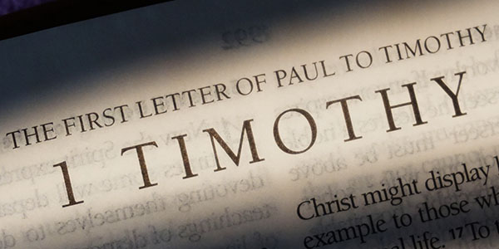

Slide 50
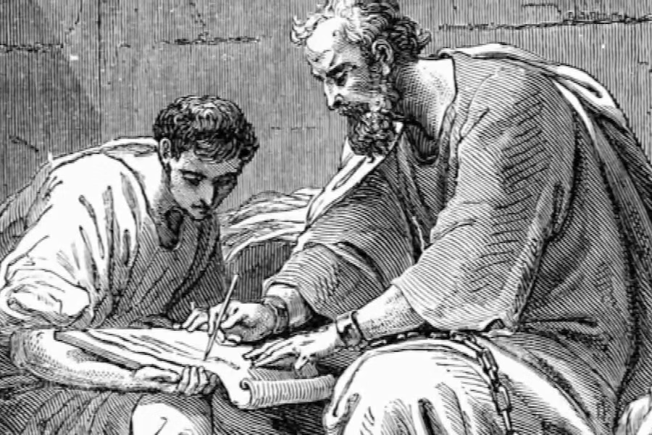

Slide 51
The letters to Timothy

Slide 52
Who:
written by Paul the Apostle after release from prison, to Timothy and the Church

Slide 53
What:
written to encourage and guide their churches to remain faithful to the truth

Slide 54
How:
Written in a very direct personal tone, with many popular quotations

Slide 56
Life in the Church
(1 Timothy 5:1-25)

Slide 58
Having Purposeful Relationships
(1 Timothy 5:1-8)

Slide 59
1 Do not address an older man harshly but appeal to him as a father. Speak to younger men as brothers,

Slide 60
2 older women as mothers, and younger women as sisters—with complete purity.

Slide 61
3 Honor widows who are truly in need. 4 But if a widow has children or grandchildren,

Slide 62
they should first learn to fulfill their duty toward their own household and so repay their parents what is owed them. For this is what pleases God.

Slide 63
5 But the widow who is truly in need, and completely on her own, has set her hope on God and continues in her pleas and prayers night and day.

Slide 64
6 But the one who lives for pleasure is dead even while she lives. 7 Reinforce these commands, so that they will be beyond reproach.

Slide 65
8 But if someone does not provide for his own, especially his own family, he has denied the faith and is worse than an unbeliever.

Slide 67
Are your relationships
righteous?

Slide 68
The Christian Ideal of Charity
(1 Timothy 5:9-16)

Slide 69
9 No widow should be put on the list unless she is at least sixty years old, was the wife of one husband, 10 and has a reputation for good works:

Slide 70
as one who has raised children, practiced hospitality, washed the feet of the saints, helped those in distress—

Slide 71
as one who has exhibited all kinds of good works.

Slide 72
11 But do not accept younger widows on the list, because their passions may lead them away from Christ and they will desire to marry,

Slide 73
12 and so incur judgment for breaking their former pledge. 13 And besides that, going around from house to house they learn to be lazy,

Slide 74
and they are not only lazy, but also gossips and busybodies, talking about things they should not.

Slide 75
14 So I want younger women to marry, raise children, and manage a household, in order to give the adversary no opportunity to vilify us.

Slide 76
15 For some have already wandered away to follow Satan. 16 If a believing woman has widows in her family, let her help them.

Slide 77
The church should not be burdened so that it may help the widows who are truly in need.

Slide 79
How useful are you
for God?

Slide 80
Caring for Leaders
(1 Timothy 5:17-25)

Slide 81
17 Elders who provide effective leadership must be counted worthy of double honor, especially those who work hard in speaking and teaching.

Slide 82
18 For the scripture says, “Do not muzzle an ox while it is treading out the grain,” and, “The worker deserves his pay.”

Slide 83
19 Do not accept an accusation against an elder unless it can be confirmed by two or three witnesses. 20 Those guilty of sin must be rebuked before all, as a warning to the rest.

Slide 84
21 Before God and Christ Jesus and the elect angels, I solemnly charge you to carry out these commands without prejudice or favoritism of any kind.

Slide 85
22 Do not lay hands on anyone hastily and so identify with the sins of others. Keep yourself pure.

Slide 86
23 (Stop drinking just water, but use a little wine for your digestion and your frequent illnesses.)

Slide 87
24 The sins of some people are obvious, going before them into judgment, but for others, they show up later.

Slide 88
25 Similarly good works are also obvious, and the ones that are not cannot remain hidden.

Slide 90
What things in your life
are evident to others?

Slide 93
You Hold Me Now

Slide 94
On that day when I see all that You have for me When I see You face to face there surrounded by Your grace

Slide 95
All my fears swept away in the light of Your embrace Where Your love is all I need and forever I am free

Slide 96
Where the streets are made of gold In Your presence healed and whole Let the songs of heaven rise to You alone

Slide 97
No weeping no hurt or pain No suffering, You hold me now, You hold me now

Slide 98
No darkness no sick or lame No hiding, You hold me now, You hold me now

Slide 99
In this life I will stand Through my joy and my pain Knowing there's a greater day There's a hope that never fails

Slide 100
Where Your Name is lifted high And forever praises rise For the glory of Your Name I'm believing for the day

Slide 101
Where the wars and violence cease All creation lives in peace Let the songs of heaven rise to You alone

Slide 102
No weeping no hurt or pain No suffering, You hold me now, You hold me now

Slide 103
No darkness no sick or lame No hiding, You hold me now, You hold me now

Slide 104
For eternity All my heart will give All the glory to Your Name

Slide 105
No weeping no hurt or pain No suffering, You hold me now, You hold me now

Slide 106
No darkness no sick or lame No hiding, You hold me now, You hold me now

