Slide 2
My Lighthouse

Slide 3
In my wrestling and in my doubts
In my failures You won't walk out

Slide 4
Your great love will lead me through
You are the peace in my troubled sea
You are the peace in my troubled sea

Slide 5
In the silence, You won't let go
In my questions, Your truth will hold

Slide 6
Your great love will lead me through
You are the peace in my troubled sea
You are the peace in my troubled sea

Slide 7
My Lighthouse
My lighthouse
Shining in the darkness
I will follow You

Slide 8
My Lighthouse
My Lighthouse
I will trust the promise
You will carry me safe to shore

Slide 9
I won't fear what tomorrow brings
With each morning I'll rise and sing

Slide 10
My God’s love will lead me through
You are the peace in my troubled sea
You are the peace in my troubled sea

Slide 11
My Lighthouse
My lighthouse
Shining in the darkness
I will follow You

Slide 12
My Lighthouse
My Lighthouse
I will trust the promise
You will carry me safe to shore

Slide 13
Fire before us
You're the brightest
You will lead us through the storms

Slide 14
Fire before us
You're the brightest
You will lead us through the storms

Slide 15
Fire before us
You're the brightest
You will lead us through the storms

Slide 16
Fire before us
You're the brightest
You will lead us through the storms

Slide 17
My Lighthouse
My lighthouse
Shining in the darkness
I will follow You

Slide 18
My Lighthouse
My Lighthouse
I will trust the promise
You will carry me safe to shore

Slide 20
You never let go

Slide 21
Even though I walk
Through the valley
Of the shadow of death Your perfect love is casting out fear

Slide 22
And even when I'm caught in the middle of the storms of this life I won't turn back I know you are near

Slide 23
And I will fear no evil For my God is with me And if my God is with me Whom then shall I fear? Whom then shall I fear?

Slide 24
Oh no, You never let go Through the calm
And through the storm

Slide 25
Oh no, You never let go In every high and every low Oh no, You never let go Lord, You never let go of me

Slide 26
And I can see a light that is coming For the heart that holds on A glorious light beyond all compare

Slide 27
And there will be an end
To these troubles But until that day comes We'll live to know You here on the earth

Slide 28
And I will fear no evil For my God is with me And if my God is with me Whom then shall I fear? Whom then shall I fear?

Slide 29
Oh no, You never let go Through the calm
And through the storm

Slide 30
Oh no, You never let go In every high and every low Oh no, You never let go Lord, You never let go of me

Slide 31
Yes, I can see a light that is coming for the heart that holds on

Slide 32
And there will be an end to these troubles But until that day comes Still I will praise You
Still I will praise You

Slide 33
Oh no, You never let go Through the calm
And through the storm

Slide 34
Oh no, You never let go In every high and every low Oh no, You never let go Lord, You never let go of me

Slide 38
Forever Reign

Slide 39
You are good, You are good When there's nothing good in me You are love, You are love On display for all to see

Slide 40
You are light, You are light When the darkness closes in You are hope, You are hope You have covered all my sin

Slide 41
You are peace, You are peace When my fear is crippling You are true, You are true Even in my wandering

Slide 42
You are joy, You are joy You're the reason that I sing You are life, You are life In You death has lost it's sting

Slide 43
Oh, I’m running to Your arms I’m running to Your arms The riches of Your love Will always be enough

Slide 44
Nothing compares to Your embrace Light of the world, forever reign

Slide 45
You are more, You are more Than my words will ever say You are Lord, You are Lord All creation will proclaim

Slide 46
You are here, You are here In your presence I'm made whole You are God, You are God Of all else I'm letting go

Slide 47
Oh, I’m running to Your arms I’m running to Your arms The riches of Your love Will always be enough

Slide 48
Nothing compares to Your embrace Light of the world, forever reign

Slide 49
My heart will sing No other name Jesus, Jesus

Slide 50
My heart will sing No other name Jesus, Jesus

Slide 51
Oh, I’m running to Your arms I’m running to Your arms SThe riches of Your love Will always be enough

Slide 52
Nothing compares to Your embrace Light of the world, forever reign

Slide 54
I Believe

Slide 55
I believe there is one salvation One doorway that leads to life One redemption, one confession I believe in the name of Jesus Christ

Slide 56
I believe in the crucifixion By His blood, I have been set free I believe in the resurrection Hallelujah, His life is death's defeat

Slide 57
All praise to God the Father All praise to Christ the Son All praise to the Holy Spirit

Slide 58
Our God has overcome The King who was and is And evermore will be In Jesus mighty name I believe

Slide 59
I believe, I believe

Slide 60
I believe in the hope of heaven He's preparing a place for me Far beyond what hearts imagine Ears have heard or eyes have seen

Slide 61
I believe that a day is coming He's returning to claim His bride Light the altar, keep it burning See the Lamb who rose A roaring Lion

Slide 62
All praise to God the Father All praise to Christ the Son All praise to the Holy Spirit

Slide 63
Our God has overcome The King who was and is And evermore will be In Jesus mighty name I believe

Slide 64
Oh I believe in you

Slide 65
No, I'll never be ashamed Of the gospel of Jesus Christ How could I ever walk away From the One who saved my life?

Slide 66
No, I'll never be ashamed Of the gospel of Jesus Christ How could I ever walk away From the One who saved my life?

Slide 67
No, I'll never be ashamed Of the gospel of Jesus Christ How could I ever walk away From the One who saved my life?

Slide 68
All praise to God the Father All praise to Christ the Son All praise to the Holy Spirit

Slide 69
Our God has overcome The King who was and is And evermore will be In Jesus mighty name I believe

Slide 70
All praise to God the Father All praise to Christ the Son All praise to the Holy Spirit

Slide 71
Our God has overcome The King who was and is And evermore will be In Jesus mighty name I believe

Slide 72
I believe, I believe

Slide 74
Psalm 119:25-32

Slide 75
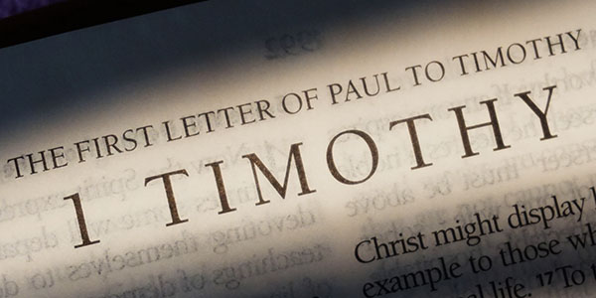

Slide 76
Bearing The burden of Truth
(1 Timothy 4:1-16)

Slide 77
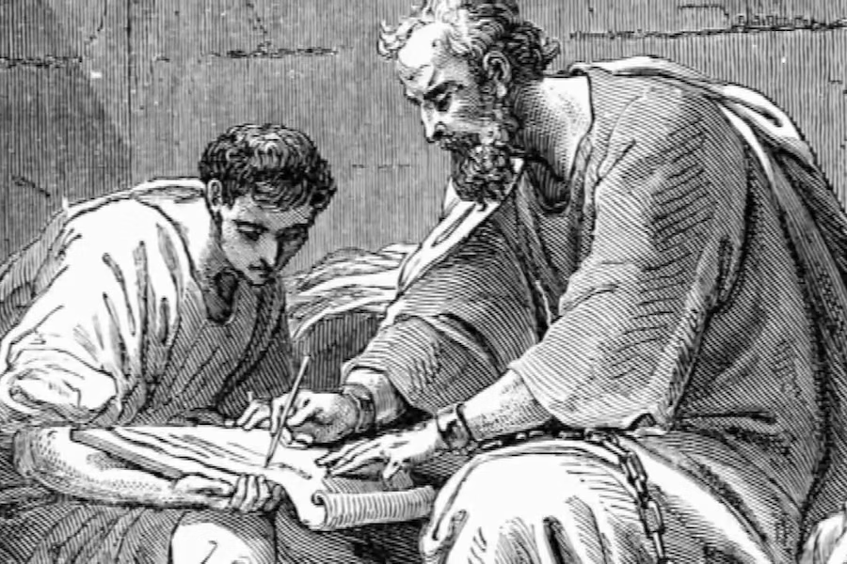

Slide 78
The letters to Timothy

Slide 79
Who:
written by Paul the Apostle after release from prison, to Timothy and the church

Slide 80
What:
written to encourage and guide their churches to remain faithful to the truth

Slide 81
How:
Written in a very direct personal tone, with many popular quotations

Slide 83
The Dangers of Bad Ideas
(1 Timothy 4:1-5)

Slide 84
1 Now the Spirit explicitly says that in the later times some will desert the faith and occupy themselves with deceiving spirits and demonic teachings,

Slide 85
2 influenced by the hypocrisy of liars whose consciences are seared. 3 They will prohibit marriage and require abstinence from foods

Slide 86
that God created to be received with thanksgiving by those who believe and know the truth.

Slide 87
4 For every creation of God is good, and no food is to be rejected if it is received with thanksgiving.

Slide 88
5 For it is sanctified by God’s word and by prayer.

Slide 90
Whose ideas
are we listening to?

Slide 91
Training for Godliness
(1 Timothy 4:6-10)

Slide 92
6 By pointing out such things to the brothers and sisters, you will be a good servant of Christ Jesus,

Slide 93
having nourished yourself on the words of the faith and of the good teaching that you have followed.

Slide 94
7 But reject those myths fit only for the godless and gullible, and train yourself for godliness.

Slide 95
8 For “physical exercise has some value, but godliness is valuable in every way. It holds promise for the present life and for the life to come.”

Slide 96
9 This saying is trustworthy and deserves full acceptance.

Slide 97
10 In fact this is why we work hard and struggle, because we have set our hope on the living God,

Slide 98
who is the Savior of all people, especially of believers.

Slide 100
What areas of your life
are you trying to improve?

Slide 101
Perseverance in the Faith
(1 Timothy 4:11-16)

Slide 102
11 Command and teach these things.

Slide 103
12 Let no one look down on you because you are young, but set an example for the believers in your speech, conduct, love, faithfulness, and purity.

Slide 104
13 Until I come, give attention to the public reading of scripture, to exhortation, to teaching.

Slide 105
14 Do not neglect the spiritual gift you have, given to you and confirmed by prophetic words when the elders laid hands on you.

Slide 106
15 Take pains with these things; be absorbed in them, so that everyone will see your progress.

Slide 107
16 Be conscientious about how you live and what you teach. Persevere in this, because by doing so you will save both yourself and those who listen to you.

Slide 109
Who has been impacted
by your salvation?

Slide 112
How Great is Our God

Slide 113
The splendor of a King,
clothed in majesty
Let all the earth rejoice All the earth rejoice

Slide 114
He wraps himself in Light,
and darkness tries to hide
And trembles at His voice Trembles at His voice

Slide 115
How great is our God
Sing with me
How great is our God

Slide 116
And all will see how great
How great is our God

Slide 117
Age to age He stands
And time is in His hands
Beginning and the end
Beginning and the end

Slide 118
The Godhead Three in One Father, Spirit, Son
The Lion and the Lamb
The Lion and the Lamb

Slide 119
How great is our God
Sing with me
How great is our God

Slide 120
And all will see how great
How great is our God

Slide 121
Name above all names
Worthy of our praise
My heart will sing
How great is our God

Slide 122
How great is our God
Sing with me
How great is our God

Slide 123
And all will see how great
How great is our God

Slide 124
How great is our God
Sing with me
How great is our God

Slide 125
And all will see how great
How great is our God

