Slide 2
Here for You

Slide 3
Let our praise be Your welcome Let our songs be a sign We are here for You We are here for You

Slide 4
Let Your breath come from heaven Fill our hearts with Your life We are here for You We are here for You

Slide 5
To You our hearts are open Nothing here is hidden You are our one desire

Slide 6
You alone are holy Only You are worthy God, let Your fire fall down

Slide 7
Let our shout be Your anthem Your renown fill the skies We are here for You We are here for You

Slide 8
Let Your Word move in power Let what's dead come to life We are here for You We are here for You

Slide 9
To You our hearts are open Nothing here is hidden You are our one desire

Slide 10
You alone are holy Only You are worthy God, let Your fire fall down

Slide 11
To You our hearts are open Nothing here is hidden You are our one desire

Slide 12
You alone are holy Only You are worthy God, let Your fire fall down

Slide 13
We welcome You with praise We welcome You with praise Almighty God of love Be welcomed in this place

Slide 14
We welcome You with praise We welcome You with praise Almighty God of love Be welcomed in this place

Slide 15
Let every heart adore Let every soul awake Almighty God of love Be welcomed in this place

Slide 16
We welcome You with praise We welcome You with praise Almighty God of love Be welcomed in this place

Slide 17
To You our hearts are open Nothing here is hidden You are our one desire

Slide 18
You alone are holy Only You are worthy God, let Your fire fall down

Slide 19
We welcome You with praise We welcome You with praise Almighty God of love Be welcomed in this place

Slide 20
We welcome You with praise We welcome You with praise Almighty God of love Be welcomed in this place

Slide 21
Let every heart adore Let every soul awake Almighty God of love Be welcomed in this place

Slide 22
We welcome You with praise We welcome You with praise Almighty God of love Be welcomed in this place

Slide 26
It is Well

Slide 27
When peace, like a river attendeth my way When sorrows like sea billows roll

Slide 28
Whatever my lot Thou has taught me to say It is well, it is well, with my soul

Slide 29
It is well, It is well Through the storm I am held It is well, it is well with my soul

Slide 30
My sin, Oh the bliss of this glorious thought My sin, not in part but the whole

Slide 31
Is nailed to the cross and I bear it no more Praise the Lord Praise the Lord, O my soul

Slide 32
It is well, It is well Through the storm I am held It is well, it is well with my soul

Slide 33
It is well, It is well God has won, Christ prevailed It is well, it is well with my soul

Slide 34
And Lord, haste the day when my faith shall be sight The clouds be rolled back as a scroll

Slide 35
The trump shall resound and the Lord shall descend Even so, it is well with my soul

Slide 36
It is well, It is well Through the storm I am held It is well, it is well with my soul

Slide 37
It is well, It is well God has won, Christ prevailed It is well, it is well with my soul

Slide 38
It is well with my soul It is well, it is well with my soul

Slide 41
Psalm 2

Slide 42
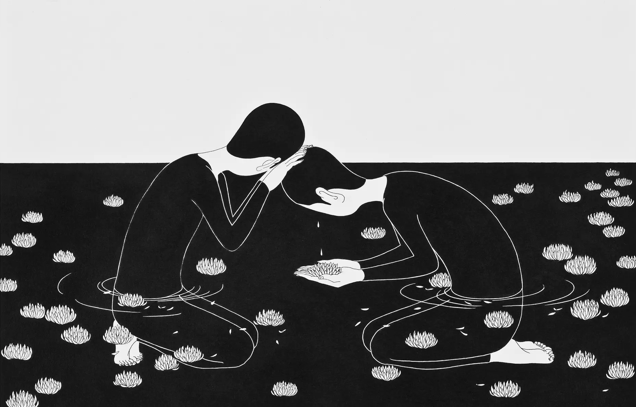

Slide 43
The Problem of Evil (pt 2)
(Genesis ch1-6)

Slide 44
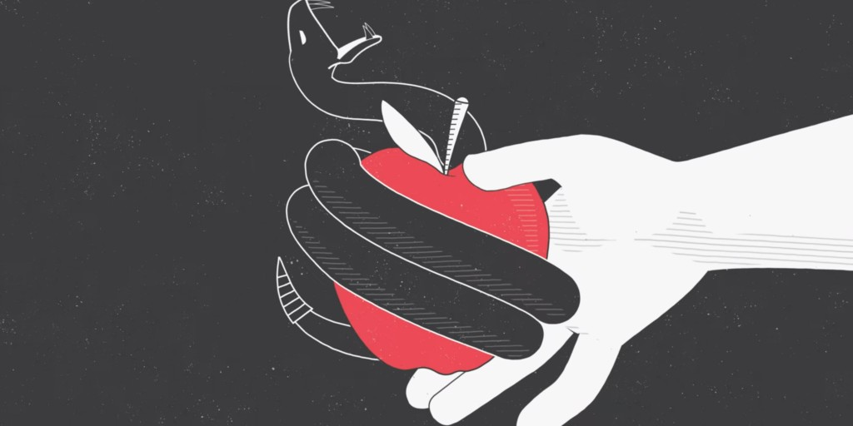

Slide 46
The way that God created the universe helps us understand the world we are in today:

Slide 47
1. God created a good universe, where communion with Him was a choice. Evil did not exist in God’s original creation.

Slide 48
2. Mankind was made to be His image-bearers; we’re responsible to rule the earth for Him, and free to make our own choices.

Slide 49
3. Evil came into the world through our disobedience, and separated us from God. This is called sin and it corrupts humanity.

Slide 50
The way we govern the world is a reflection of our broken relationship with God and with each other; violence, war, and tragedy is the result.

Slide 52
How do you typically
deal with suffering?

Slide 53
Where is God in our suffering?
(Genesis chapter 4:1-16)

Slide 54
1 Now the man was intimate with his wife Eve, and she became pregnant and gave birth to Cain.

Slide 55
Then she said, “I have created a man just as the LORD did!”

Slide 56
2 Then she gave birth to his brother Abel. Abel took care of the flocks, while Cain cultivated the ground.

Slide 57
3 At the designated time Cain brought some of the fruit of the ground for an offering to the LORD.

Slide 58
4 But Abel brought some of the firstborn of his flock—even the fattest of them. And the LORD was pleased with Abel and his offering,

Slide 59
5 but with Cain and his offering he was not pleased. So Cain became very angry, and his expression was downcast.

Slide 60
6 Then the LORD said to Cain, “Why are you angry, and why is your expression downcast? 7 Is it not true that if you do what is right, you will be fine?

Slide 61
But if you do not do what is right, sin is crouching at the door. It desires to dominate you, but you must subdue it.”

Slide 62
8 Cain said to his brother Abel, “Let’s go out to the field.” While they were in the field, Cain attacked his brother Abel and killed him.

Slide 63
9 Then the LORD said to Cain, “Where is your brother Abel?” And he replied, “I don’t know! Am I my brother’s guardian?”

Slide 64
10 But the Lord said, “What have you done? The voice of your brother’s blood is crying out to me from the ground!

Slide 65
11 So now you are banished from the ground, which has opened its mouth to receive your brother’s blood from your hand.

Slide 66
12 When you try to cultivate the ground it will no longer yield its best for you. You will be a homeless wanderer on the earth.”

Slide 67
13 Then Cain said to the LORD, “My punishment is too great to endure! 14 Look, you are driving me off the land today,

Slide 68
and I must hide from your presence. I will be a homeless wanderer on the earth; whoever finds me will kill me!”

Slide 69
15 But the LORD said to him, “All right then, if anyone kills Cain, Cain will be avenged seven times as much.”

Slide 70
Then the LORD put a special mark on Cain so that no one who found him would strike him down.

Slide 71
God is not unresponsive to evil—He continually exhorts and admonishes mankind to do what is right!

Slide 72
2. God is not unmoved by our pain and suffering—He is deeply concerned with justice and restoration!

Slide 73
3. God is not unloving even to those who destroy the lives of others—He offers everyone forgiveness and new life!

Slide 75
Do we trust God to handle
even the worst things in our lives?

Slide 76
What is God’s Solution for Evil?
(Genesis 6:5-8)

Slide 77
Genesis 6:5-8
“But the LORD saw that the wickedness of humankind had become great on the earth.

Slide 78
Every inclination of the thoughts of their minds was only evil all the time.

Slide 79
6 The LORD regretted that he had made humankind on the earth, and he was highly offended.

Slide 80
7 So the LORD said, “I will wipe humankind, whom I have created, from the face of the earth—

Slide 81
everything from humankind to animals, including creatures that move on the ground and birds of the air, for I regret that I have made them.”

Slide 82
8 But Noah found favor in the sight of the LORD.”

Slide 83
God is broken-hearted over our sin and rebellion—He will not let it destroy His creation!

Slide 84
2. God will pour out His wrath and cleanse all traces of evil—but the righteous will be rescued and redeemed!

Slide 85
3. God will pull a ‘New Heaven and Earth’ out from the ashes—where suffering is gone, Christ rules, and life is eternal!

Slide 87
Is our hope in this world
or the next?

Slide 89
Has suffering lead us to despair of our lives
or to trust in God?

Slide 92
Never Once

Slide 93
Standing on this mountaintop Looking just how far we’ve come Knowing that for every step You were with us

Slide 94
Kneeling on this battle ground Seeing just how much You’ve done Knowing every victory Is Your power in us

Slide 95
Scars and struggles on the way But with joy our hearts can say Yes, our hearts can say

Slide 96
Never once did we ever walk alone Never once did You leave us on our own You are faithful, God, You are faithful

Slide 97
Kneeling on this battle ground Seeing just how much You’ve done Knowing every victory Is Your power in us

Slide 98
Scars and struggles on the way But with joy our hearts can say Yes, our hearts can say

Slide 99
Never once did we ever walk alone Never once did You leave us on our own You are faithful, God, You are faithful You are faithful, God, You are faithful

Slide 100
Scars and struggles on the way But with joy our hearts can say Never once did we ever walk alone

Slide 101
Carried by Your constant grace Held within Your perfect peace Never once, no, we never walk alone

Slide 102
Never once did we ever walk alone Never once did You leave us on our own You are faithful, God, You are faithful

Slide 103
Every step we are breathing in Your grace Evermore we’ll be breathing out Your praise

Slide 104
You are faithful, God, You are faithful You are faithful, God, You are faithful You are faithful, God, You are faithful

