Slide 2
Above All

Slide 3
Above all powers Above all kings Above all nature
And all created things

Slide 4
Above all wisdom
And all the ways of man You were here
Before the world began

Slide 5
Above all kingdoms Above all thrones Above all wonders
The world has ever known

Slide 6
Above all wealth
And treasures of the earth There's no way to measure
What You're worth

Slide 7
Crucified Laid behind the stone You lived to die Rejected and alone

Slide 8
Like a rose
Trampled on the ground You took the fall And thought of me Above all

Slide 9
Above all powers Above all kings Above all nature
And all created things

Slide 10
Above all wisdom
And all the ways of man You were here
Before the world began

Slide 11
Above all kingdoms Above all thrones Above all wonders
The world has ever known

Slide 12
Above all wealth
And treasures of the earth There's no way to measure
What You're worth

Slide 13
Crucified Laid behind the stone You lived to die Rejected and alone

Slide 14
Like a rose
Trampled on the ground You took the fall And thought of me Above all

Slide 15
Crucified Laid behind the stone You lived to die Rejected and alone

Slide 16
Like a rose
Trampled on the ground You took the fall And thought of me Above all

Slide 17
Like a rose
Trampled on the ground You took the fall And thought of me Above all

Slide 19
Come as You Are

Slide 20
Come out of sadness From wherever you've been
Come broken hearted Let rescue begin

Slide 21
Come find your mercy Oh sinner come kneel
Earth has no sorrow That heaven can't heal

Slide 22
Earth has no sorrow That heaven can't heal

Slide 23
So lay down your burdens Lay down your shame All who are broken Lift up your face

Slide 24
Oh wanderer come home You're not too far So lay down your hurt Lay down your heart Come as you are

Slide 25
There's hope for the hopeless And all those who've strayed Come sit at the table Come taste the grace

Slide 26
There's rest for the weary Rest that endures Earth has no sorrow That heaven can't cure

Slide 27
So lay down your burdens Lay down your shame All who are broken Lift up your face

Slide 28
Oh wanderer come home You're not too far So lay down your hurt Lay down your heart Come as you are

Slide 29
Come as you are Fall in his arms Come as you are There's joy for the morning

Slide 30
Oh sinner be still Earth has no sorrow That heaven can't heal Earth has no sorrow That heaven can't heal

Slide 31
So lay down your burdens Lay down your shame All who are broken Lift up your face

Slide 32
Oh wanderer come home You're not too far So lay down your hurt Lay down your heart Come as you are

Slide 33
Come as you are
Come as you are
Come as you are

Slide 37
Goodness of God

Slide 38
I love You, Lord For Your mercy never fails me All my days, I've been held
In Your hands

Slide 39
From the moment that I wake up Until I lay my head Oh, I will sing of the goodness of God

Slide 40
And all my life
You have been faithful And all my life
You have been so, so good

Slide 41
With every breath that I am able Oh, I will sing of the goodness of God

Slide 42
I love Your voice You have led me through the fire In the darkest night You are close like no other

Slide 43
I've known You as a Father I've known You as a Friend And I have lived
In the goodness of God

Slide 44
And all my life
You have been faithful And all my life
You have been so, so good

Slide 45
With every breath that I am able Oh, I will sing of the goodness of God

Slide 46
'Cause Your goodness
Is running after It's running after me Your goodness is running after It's running after me

Slide 47
With my life laid down I'm surrendered now I give You everything

Slide 48
'Cause Your goodness
Is running after It's running after me

Slide 49
'Cause Your goodness
Is running after It's running after me Your goodness is running after It's running after me

Slide 50
With my life laid down I'm surrendered now I give You everything

Slide 51
'Cause Your goodness
Is running after It's running after me

Slide 52
And all my life
You have been faithful And all my life
You have been so, so good

Slide 53
With every breath that I am able Oh, I will sing of the goodness of God

Slide 54
'Cause all my life
You have been faithful And all my life
You have been so, so good

Slide 55
With every breath that I am able Oh, I will sing of the goodness of God
Oh, I will sing of the goodness of God

Slide 57
Lead Me to the Cross

Slide 58
Savior, I come Quiet my soul Remember

Slide 59
Redemptions hill Where Your blood was spilled For my ransom

Slide 60
Everything I once held dear I count it all as loss

Slide 61
Lead me to the cross where your love poured out Bring me to my knees Lord, I lay me down

Slide 62
Rid me of myself I belong to You Lead me Lead me to the cross

Slide 63
You were as I Tempted and tried Human

Slide 64
The Word became flesh Bore my sin and death Now You’re risen

Slide 65
Everything I once held dear I count it all as loss

Slide 66
Lead me to the cross Where your love poured out Bring me to my knees Lord, I lay me down

Slide 67
Rid me of myself I belong to You Lead me Lead me to the cross

Slide 68
To Your heart To Your heart

Slide 69
Lead me to Your heart Lead me to Your heart

Slide 70
Lead me to the cross Where your love poured out Bring me to my knees Lord, I lay me down

Slide 71
Rid me of myself I belong to You Lead me Lead me to the cross

Slide 73
Psalm 14

Slide 76
Sacrifice and sacrilege (pt 1)
(Matthew 26:1-16)

Slide 77
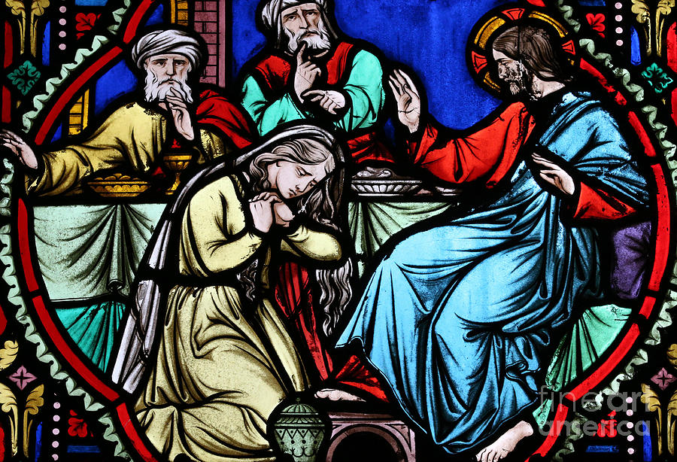

Slide 78
The Book of Matthew up through chapter 26

Slide 79
Jesus’ identity is progressively unveiled as King, Savior, and God

Slide 80
Jesus’ teaching is profound and unlike any other religious leader ever

Slide 81
Many broken people are transformed by simply meeting Jesus, while others are repulsed, and choose to hate Him

Slide 83
The Growing Conspiracy
(Matthew 26:1-5)

Slide 84
26:1 When Jesus had finished saying all these things, he told his disciples,

Slide 85
2 “You know that after two days the Passover is coming, and the Son of Man will be handed over to be crucified.”

Slide 86
3 Then the chief priests and the elders of the people met together in the palace of the high priest, who was named Caiaphas.

Slide 87
4 They planned to arrest Jesus by stealth and kill him.

Slide 88
5 But they said, “Not during the feast, so that there won’t be a riot among the people.”

Slide 90
Are we submitting to
or subverting God’s work?

Slide 91
A Beautiful Sacrifice
(Matthew 26:6-13)

Slide 92
6 Now while Jesus was in Bethany at the house of Simon the leper,

Slide 93
7 a woman came to him with an alabaster jar of expensive perfumed oil,

Slide 94
and she poured it on his head as he was at the table.

Slide 95
8 When the disciples saw this, they became indignant and said,
“Why this waste?

Slide 96
9 It could have been sold at a high price and the money given to the poor!”

Slide 97
10 When Jesus learned of this, he said to them, “Why are you bothering this woman? She has done a good service for me.

Slide 98
11 For you will always have the poor with you, but you will not always have me!

Slide 99
12 When she poured this oil on my body, she did it to prepare me for burial.

Slide 100
13 I tell you the truth, wherever this gospel is proclaimed in the whole world,

Slide 101
what she has done will also be told in memory of her.”

Slide 103
What sacrifices are we
making for Christ?

Slide 104
The Betrayal of a Disciple
(Matthew 26:14-16)

Slide 105
14 Then one of the 12, the one named Judas Iscariot, went to the chief priests

Slide 106
15 and said, “What will you give me to betray him into your hands?” So they set out 30 silver coins for him.

Slide 107
16 From that time on, Judas began looking for an opportunity to betray him.

Slide 109
Have you given your
weakness to Christ?

Slide 112
I Surrender

Slide 113
Here I am
Down on my knees again
Surrendering all
Surrendering all

Slide 114
Find me here
Lord as You draw me near
Desperate for You
Desperate for You

Slide 115
I surrender

Slide 116
Drench my soul
As mercy and grace unfold
I hunger and thirst
I hunger and thirst

Slide 117
With arms stretched wide
I know You hear my cry
Speak to me now
Speak to me now

Slide 118
I surrender
I surrender
I wanna know You more
I wanna know You more

Slide 119
Like a rushing wind
Jesus breathe within
Lord have Your way
Lord have Your way in me

Slide 120
Like a mighty storm
Stir within my soul
Lord have Your way
Lord have Your way in me

Slide 121
I surrender
I surrender
I wanna know You more
I wanna know You more

