Slide 2
Our God

Slide 3
Water You turned into wine,
Opened the eyes of the blind
There´s no one like You
None like You

Slide 4
Into the darkness You shine,
Out of the ashes we rise
There´s no one like you,
None like You

Slide 5
Our God is greater,
Our God is stronger
God You are higher than any other

Slide 6
Our God is healer,
Awesome in power
Our God,
Our God

Slide 7
Into the darkness You shine,
Out of the ashes we rise
There´s no one like you,
None like You

Slide 8
Our God is greater,
Our God is stronger
God You are higher than any other

Slide 9
Our God is healer,
Awesome in power
Our God,
Our God

Slide 10
Our God is greater,
Our God is stronger
God You are higher than any other

Slide 11
Our God is healer,
Awesome in power
Our God,
Our God

Slide 12
And if Our God is for us,
Then who could ever stop us

Slide 13
And if our God is with us,
Then what can stand against?

Slide 14
Our God is greater,
Our God is stronger
God You are higher than any other

Slide 15
Our God is healer,
Awesome in power
Our God,
Our God

Slide 16
And if Our God is for us,
Then who could ever stop us

Slide 17
And if our God is with us,
Then what can stand against?

Slide 18
Our God is greater,
Our God is stronger
God You are higher than any other

Slide 19
Our God is healer,
Awesome in power
Our God,
Our God

Slide 21
Your Love, Oh Lord

Slide 22
Your love O Lord Reaches to the heavens Your faithfulness stretches to the sky

Slide 23
Your righteous-ness is like the mighty mountains Your justice flows like the ocean´s tide

Slide 24
I will lift my voice To worship You my king I will find my strength In the shadow of Your wings

Slide 25
Your love O Lord reaches to the heavens Your faithfulness stretches to the sky

Slide 26
Your righteous-ness is like the mighty mountains Your justice flows like the ocean´s tide

Slide 27
I will lift my voice To worship You my king I will find my strength In the shadow of Your wings

Slide 28
I will lift my voice To worship You my king I will find my strength In the shadow of Your wings

Slide 29
Your love O Lord reaches to the heavens Your faithfulness stretches to the sky

Slide 33
God is Able

Slide 34
God is able
He will never fail
He is almighty God

Slide 35
Greater than all seek
Greater than all we ask
He has done great things

Slide 36
Lifted up
He defeated the grave
Raised to life
Our God is able

Slide 37
In His name
We overcome
For the Lord, Our God is able

Slide 38
God is with us
God is on our side
He will make a way

Slide 39
For above all we know
For above all we hope
He has done great things

Slide 40
God is with us
He will go before
He will never leave us
He will never leave us

Slide 41
God is for us
He has open arms
He will never fail us
He will never fail us

Slide 42
Lifted up
He defeated the grave
Raised to life
Our God is able

Slide 43
In His name
We overcome
For the Lord, Our God is able

Slide 44
God is with us
He will go before
He will never leave us
He will never leave us

Slide 45
God is for us
He has open arms
He will never fail us
He will never fail us

Slide 46
Lifted up
He defeated the grave
Raised to life
Our God is able

Slide 47
In His name
We overcome
For the Lord, Our God is able

Slide 49
Build my life

Slide 50
Worthy of every song
We could ever sing
Worthy of all the praise
we could ever bring

Slide 51
Worthy of every breath
we could ever breathe
We live for You

Slide 52
Jesus the name above
every other name
Jesus the only one
who could ever save

Slide 53
Worthy of every breath
we could ever breathe
We live for You
We live for You

Slide 54
Holy there is no one like You
There is none beside You
Open up my eyes in wonder

Slide 55
And show me
Who You are and fill me
With Your heart and lead me
In Your love to those around me

Slide 56
Worthy of every song
We could ever sing
Worthy of all the praise
we could ever bring

Slide 57
Worthy of every breath
we could ever breathe
We live for You

Slide 58
Worthy of every song
We could ever sing
Worthy of all the praise
we could ever bring

Slide 59
Worthy of every breath
we could ever breathe
We live for You

Slide 60
Holy there is no one like You
There is none beside You
Open up my eyes in wonder

Slide 61
And show me
Who You are and fill me
With Your heart and lead me
In Your love to those around me

Slide 62
Holy there is no one like You
There is none beside You
Open up my eyes in wonder

Slide 63
And show me
Who You are and fill me
With Your heart and lead me
In Your love to those around me

Slide 64
I will build my life upon Your love
It is a firm foundation

Slide 65
I will put my trust in You a lone
And I will not be shaken

Slide 66
I will build my life upon Your love
It is a firm foundation

Slide 67
I will put my trust in You a lone
And I will not be shaken

Slide 68
Holy there is no one like You
There is none beside You
Open up my eyes in wonder

Slide 69
And show me
Who You are and fill me
With Your heart and lead me
In Your love to those around me

Slide 70
Holy there is no one like You
There is none beside You
Open up my eyes in wonder

Slide 71
And show me
Who You are and fill me
With Your heart and lead me
In Your love to those around me

Slide 72
I will build my life upon Your love
It is a firm foundation

Slide 73
I will put my trust in You a lone
And I will not be shaken

Slide 74
I will build my life upon Your love
It is a firm foundation

Slide 75
I will put my trust in You a lone
And I will not be shaken

Slide 76
I will build my life upon Your love
It is a firm foundation

Slide 77
I will put my trust in You a lone
And I will not be shaken

Slide 79
Psalm 23

Slide 82
Jesus and The Wedding Miracle
(John 2:1-11)

Slide 83
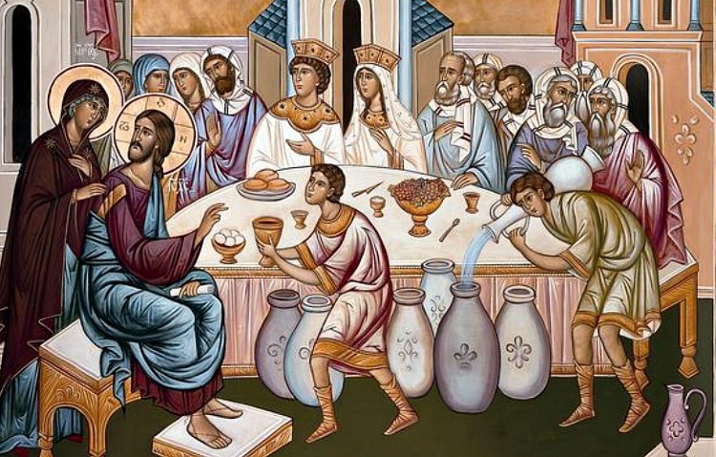

Slide 84
Jesus attends a Wedding reception
(John 2:1-2)

Slide 85
2:1 Now on the third day there was a wedding at Cana in Galilee.

Slide 86
Jesus’ mother was there, 2 and Jesus and his disciples were also invited to the wedding.

Slide 88
Have you invited Jesus
into your everyday life?

Slide 89
An Unforeseen Problem
(John 2:3-8)

Slide 90
3 When the wine ran out, Jesus’ mother said to him, “They have no wine left.”

Slide 91
4 Jesus replied, “Woman, why are you saying this to me? My time has not yet come.”

Slide 92
5 His mother told the servants, “Whatever he tells you, do it.”

Slide 93
6 Now there were six stone water jars there for Jewish ceremonial washing, each holding 20 or 30 gallons.

Slide 94
7 Jesus told the servants, “Fill the water jars with water.” So they filled them up to the very top.

Slide 95
8 Then he told them, “Now draw some out and take it to the head steward,” and they did.

Slide 97
Whom do we take
our problems to?

Slide 98
The Miraculous Results
(John 2:9-11)

Slide 99
9 When the head steward tasted the water that had been turned to wine, not knowing where it came from

Slide 100
(though the servants who had drawn the water knew), he called the bridegroom

Slide 101
10 and said to him, “Everyone serves the good wine first, and then the cheaper wine when the guests are drunk.

Slide 102
You have kept the good wine until now!”

Slide 103
11 Jesus did this as the first of his miraculous signs, in Cana of Galilee.

Slide 104
In this way he revealed his glory, and his disciples believed in him.

Slide 106
Are we participating
in the work of Jesus?

Slide 109
What a Beautiful Name

Slide 110
You were the Word at the beginning One with God the Lord most high

Slide 111
Your hidden glory in creation Now revealed in You our Christ

Slide 112
What a beautiful Name It is What a beautiful name It is The Name of Jesus Christ my king

Slide 113
What a beautiful Name it is nothing compares to this

Slide 114
What a beautiful Name it is The Name of Jesus

Slide 115
You didn´t want heaven without us So Jesus You brought heaven down

Slide 116
My sin was great Your love was greater What could separate us now?

Slide 117
What a wonderful Name It is What a wonderful Name it is The name of Jesus Christ my King

Slide 118
What a wonderful Name it is, nothing compares to this What a wonderful Name it is The Name of Jesus

Slide 119
What a wonderful Name it is The Name of Jesus

Slide 120
Death could not hold You The veil tore before You You silence the boast of sin and grave

Slide 121
The heavens are roaring The praise of Your glory For You are raised to life again

Slide 122
You have no rival, You have no equal Now and forever God You reign

Slide 123
Yours is the kingdom, Yours is the glory Yours is the Name above all Name

Slide 124
What a powerful Name it is, What a powerful Name it is The Name of Jesus Christ my King

Slide 125
What a powerful Name it is Nothing can stand against What a powerful Name it is The Name of Jesus

Slide 126
What a powerful Name it is The Name of Jesus

Slide 127
What a powerful Name it is The Name of Jesus

